Slide 1
Introductions

Slide 2
Who we are
David Rubin, MD
Executive Director
MGH Psychiatry Academy
I have no disclosures
Rob Althoff, MD, PhD
Chair, Department of Psychiatry
University of Vermont
Received funds from NIH, Klingenstein Third Generation Foundation, JAACAP. Ownership interest in WISER Systems, LLC
Mona Potter, MD
Associate Director,
Division of Professional and Public Education, MGH
Chief Medical Officer
InStride Health

Slide 3
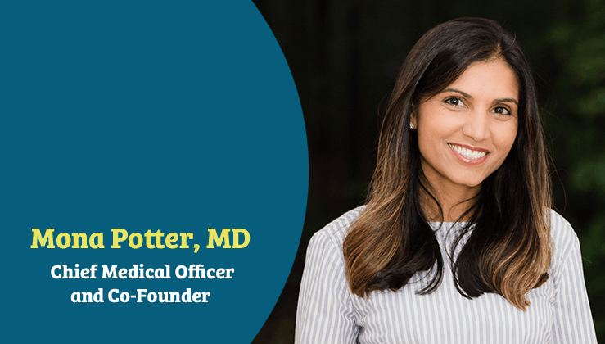
Who we are

Slide 4

Who we are

Slide 5


Slide 6
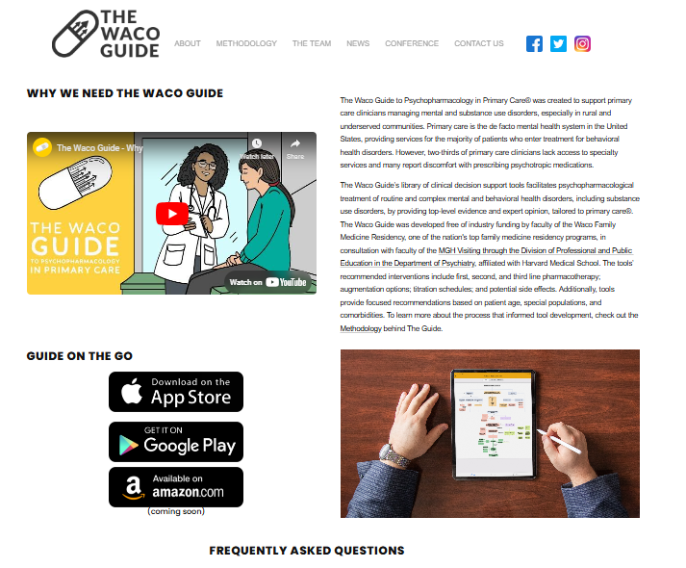
Tools for This Training
https://wacoguide.org/

Slide 7

Go to
pigeonhole.at
Enter passcode
TENASKA

Slide 8
