Slide 1
Clinical Pearls of Depression

Slide 2

Reality testing intact or improved

Slide 3
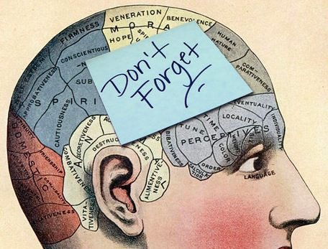
Depressive episodes are remembered

Slide 4

Not necessarily a life long illness with one episode

Slide 5
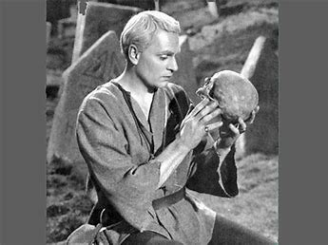
Melancholic – decreased sleep, decreased appetite, diurnal variation

Slide 6
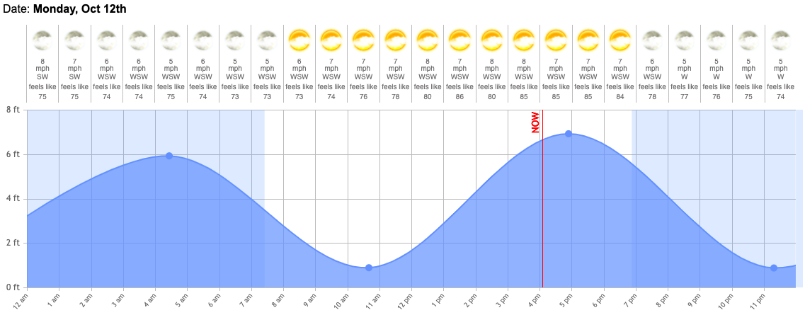
Diurnal Variation

Slide 7
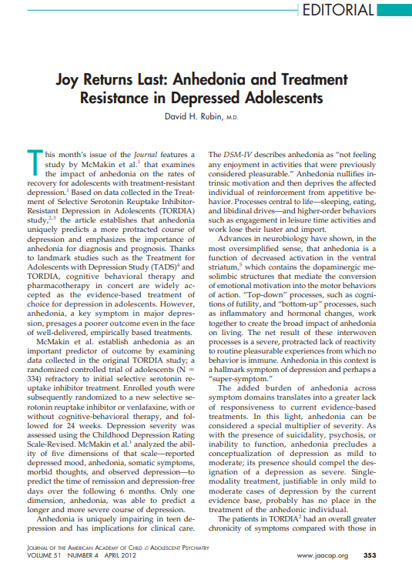
Joy Returns Last

Slide 8
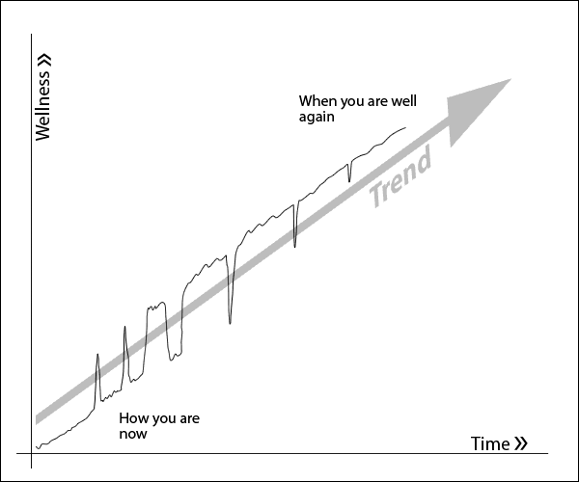
Two steps forward, one step back

Slide 9


Rethink start low, go slow

Slide 10
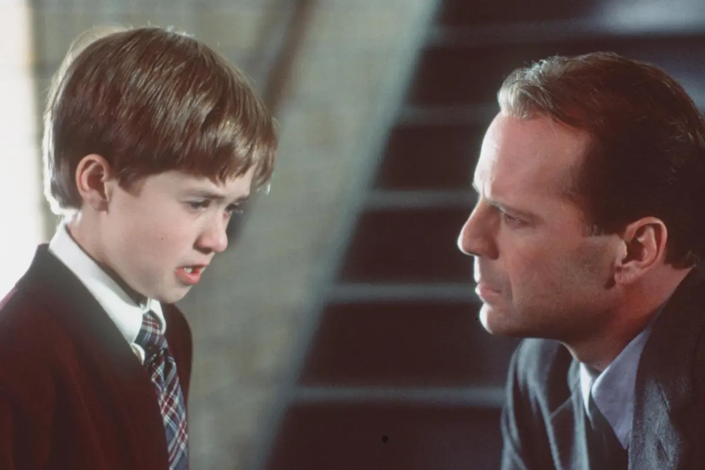
Patient last to know depressed, last to know recovery

