Slide 1
Case Presentations

Slide 2


Slide 3
Case 1
Steven is a 28 year old who was born in Brooklyn, New York. His father, a member of the 107th Infantry Regiment, was killed in action. He was raised by his mother, a nurse, who died of tuberculosis, leaving Steve alone at the age of eighteen. At just 5-foot-4-inch tall and weighing only 90 pounds (41 kg), Steven was also afflicted with a number of medical issues including asthma, scoliosis, and a heart arrhythmia. Wanting to follow in his father’s footsteps, 2 months ago he attempted to enlist in the Army but was turned away due to his illnesses. Over the ensuing 2 months he has become more despondent with worsening mood, decreasing ability to initiate sleep, and loss of appetite leading to decreased weight, which he can ill afford. He has had low energy and has lost interest in the things that he finds enjoyable, including hanging out with friends.

Slide 4
Question 1
What is the next step in the assessment of Steven?
Assess for recent losses
Assess for substance use
Assess for suicidal ideation
Any of the above is an appropriate next step

Slide 5
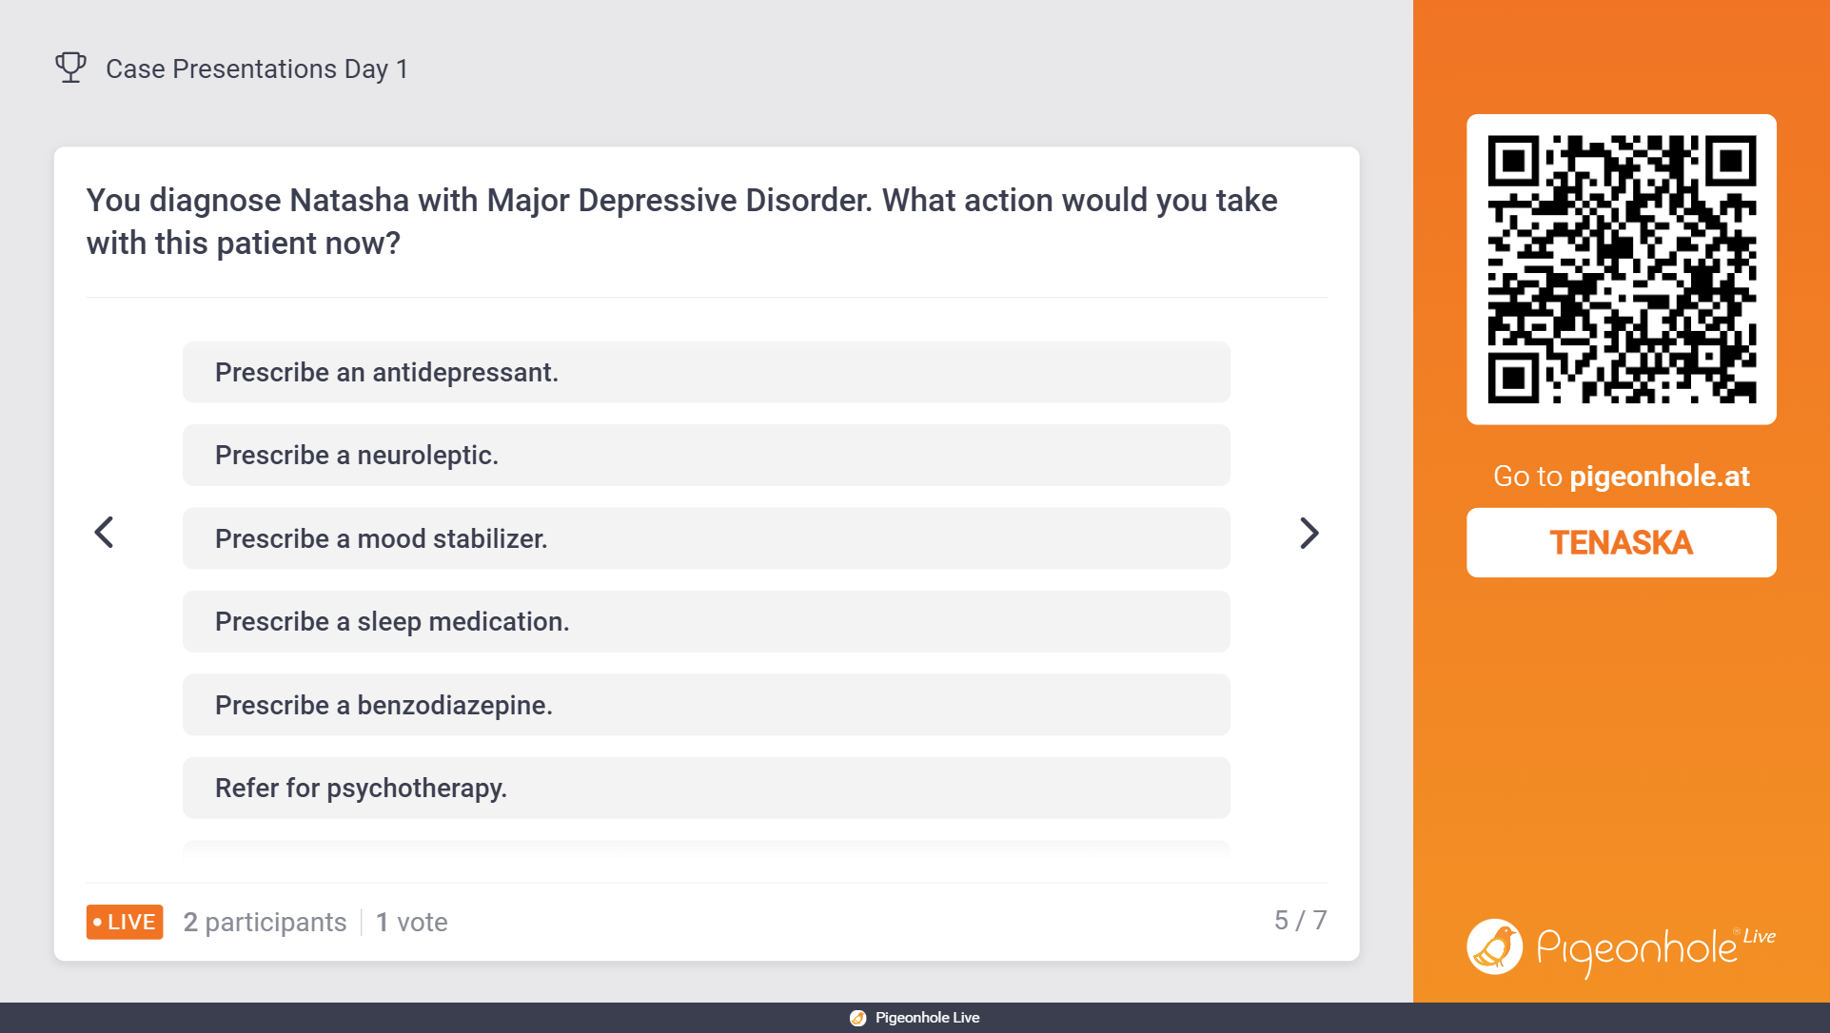

Slide 6
Case 2
Natasha is a 21-year-old college female who lives off-campus with two friends. She is slim, athletic, fanatical about running and health. She does not like to take any OTC or prescribed medications; only natural foods and herbs. She had a fall 10 weeks ago while running, can't remember how it happened. Was referred by her primary for an evaluation as she has been feeling "off" for past two months. She appears fidgety during appointment. She complains of strong feelings of anxiety with palpitations and hyperventilation at least once a week. Less of an appetite than before. Feeling tired, even though she is sleeping and napping more than usual. Much less interest in sex. Worries about minor things that didn't bother her before. Feeling less interested in her classes and hobbies. Not feeling as good about her self as is usual for her. Often feeling sad or blue. Feeling like she has let people down. Sometimes feeling that life is not worth living. Symptoms have been occurring for the past month.

Slide 7
Case 2: Other information
No history of psychiatric hospitalizations or treatment.
Reports no difficulty with her school work or history of academic/developmental issues.
Reports occasional social consumption of alcohol but denies any problems with substance abuse.
Allergic to penicillin.

Slide 8
Question 2: What broad psychiatric diagnostic category would you consider as the main concern?
Anxiety Disorder
Adjustment Disorder
Substance Use Disorder
Mental Disorder Due to General Medical Condition
Mood Disorder
Personality Disorder

Slide 10
Question 3: Which mood disorder seems the most likely?
Major Depressive Disorder
Bipolar II Disorder
Dysthymic Disorder

Slide 11


Slide 12
Case 3
You are called to the home of Clint, a 35‑year‑old male who is found unresponsive on a bathroom floor by a roommate. On arrival, there are no signs of trauma and there is drug paraphernalia present. The patient is minimally responsive to painful stimuli, has snoring respirations, and exhibits shallow breathing at 6 breaths/min with an oxygen saturation of 86% on room air. Vital signs show bradycardia (52 bpm) and hypotension (94/58 mmHg). The pupils are pinpoint and minimally reactive bilaterally, lung sounds are clear with poor air movement, and capillary blood glucose is normal at 102 mg/dL.

Slide 13
Question 4: Which finding most strongly indicates life‑threatening opioid toxicity that requires immediate intervention?
A. Hypotension of 94/58 mmHg
B. Pinpoint pupils
C. Respiratory rate of 6 breaths per minute
D. Presence of drug paraphernalia

Slide 14


Slide 15
Case 4
Bruce is a 25‑year‑old with no documented medical history who was found sitting on a couch by friends who called EMS because the patient appeared “out of it” after ingesting a large amount of a powdered substance that he had mixed into a drink several hours earlier. On EMS arrival, the patient is awake but lethargic, slow to respond, and intermittently nauseated. Vital signs show a heart rate of 104 bpm, blood pressure 128/76 mmHg, respiratory rate 14 breaths/min, and oxygen saturation 98% on room air. Pupils are mildly constricted but reactive, skin is warm and sweaty, and the patient reports dizziness, abdominal discomfort, and generalized body aches. Friends deny use of alcohol or other drugs. There is no evidence of trauma, and finger‑stick glucose is normal.

Slide 16
Question 5: Which feature of this case helps differentiate kratom intoxication from a classic opioid overdose?
A. Pinpoint pupils and severe respiratory depression
B. Mild sedation with preserved respiratory rate and oxygenation
C. Bradycardia and hypotension
D. Cyanosis and shallow breathing

Slide 17
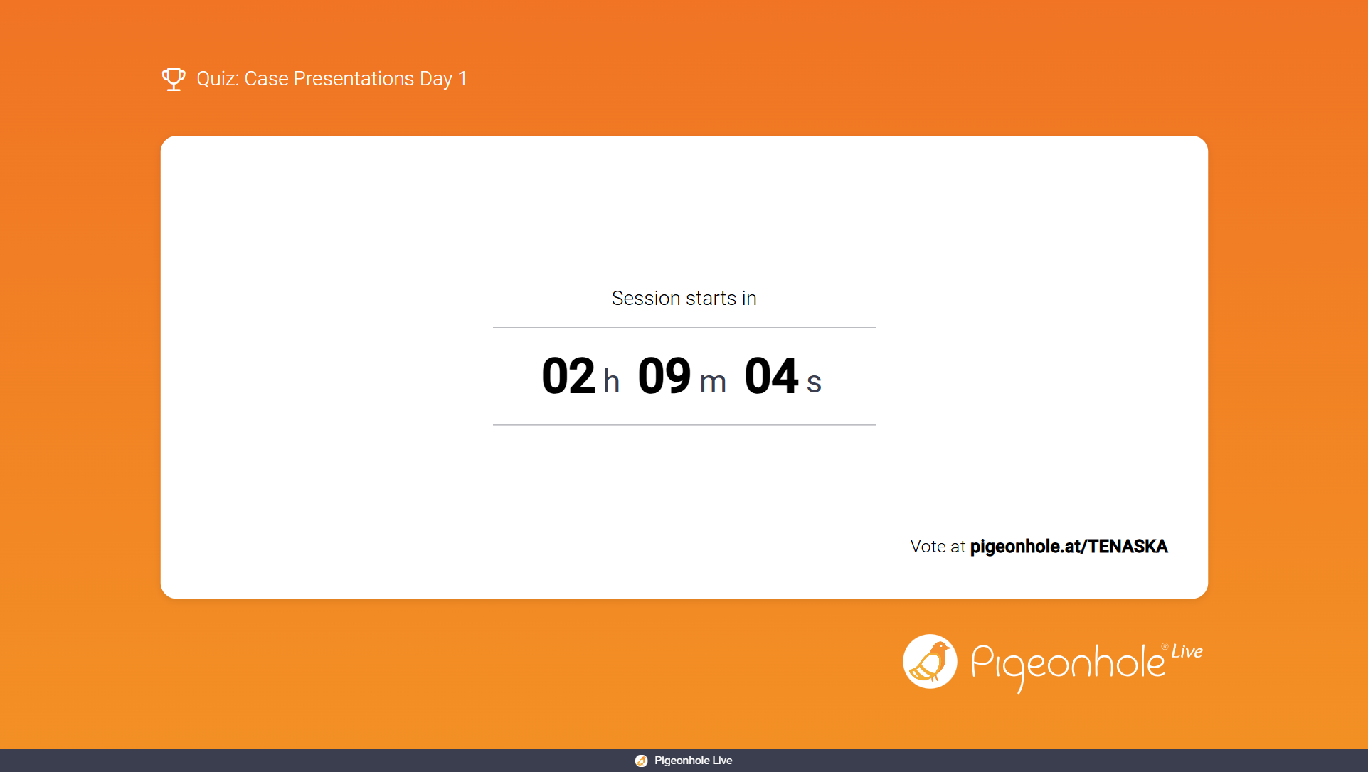

Slide 18
Case 5
Wanda presents to a primary care clinic for an urgent visit related to interpersonal stress and feelings of emptiness. During intake, the nurse notes intense emotional reactions to perceived minor frustrations, rapid shifts between idealizing and devaluing significant others, and the EHR shows repeated calls to the clinic seeking reassurance after conflicts with friends or partners. The patient reports a long history of unstable relationships, fear of abandonment, impulsive behaviors during emotional distress, and episodes of self‑injury during times of interpersonal conflict. Mood appears reactive to the environment rather than persistently depressed, and there is no evidence of psychosis or substance intoxication.

Slide 19
Question 6: Which observation most strongly supports a diagnosis of borderline personality disorder in this patient?
Consistent emotional suppression and social withdrawal
Chronic need for reassurance and difficulty making decisions independently
Pattern of unstable relationships with intense fear of abandonment and impulsivity
Fixed paranoid beliefs unrelated to mood or stressors

Slide 20


