Slide 1
General Principles of Psychiatric Assessment

Slide 2
Lecture objectives
Define what is meant by psychopathology.
Examine what (if anything) systematically distinguishes ‘mental’ from ‘physical’ illnesses.
Introduce the current diagnostic system used in psychiatry and describe its strengths and weaknesses.

Slide 3
Psychopathology: definition
Also commonly called mental disorders
Discrepancies between actual definition of ‘mental’ and its uses in medical contexts (more on this later)
“Psychopathology” or “mental disorder” usually refers to illnesses characterized by abnormalities of
  Emotion (AFFECT),
  Complex behavior, and/or (BEHAVIOR)
  Cognition (COGNITION)

Slide 4
Key Point #1
Psychopathology consists of a diverse group of illnesses marked by abnormal cognition, emotion, and/or behavior.

Slide 5
Do diseases come in two flavors: mental and physical?
Do mental disorders have mental manifestations while physical disorders have physical manifestations?
  Mental manifestations = symptoms
  Physical manifestations = signs
Are mental disorders those conditions marked by abnormal experiences (symptoms), while physical disorders are marked by abnormal findings (signs)?
Notes:
Mental manifestations (symptoms reported subjectively) and physical manifestations (signs observed “objectively”) are not necessarily confined to either “mental” or “physical” illnesses

Slide 6
Mental disorder / physical disorder distinction
Mental disorders?
Attention-deficit/
hyperactivity disorder
Trichotillomania
Alcohol use disorder
Physical disorders?
Fibromyalgia
Chronic fatigue syndrome
Migraine
Hypertension
Notes:
So-called “mental disorders” often have physical signs associated with them while so-called “physical disorders” often have subjective mental symptoms.

Slide 7
Genetic and Environmental Factors in Medicine
Disorder | Genetic | Environmental
Asthma | 70% | 30%
Obesity | 78% | 22%
Hypertension | 37-66% | 33-63%
Death from CAD | 33-57% | 43-67%
Disorder | Genetic | Environmental
Depression | 70% | 30%
ADHD | 73-90% | 10-27%
Anxiety | 37% | 63%
Autism | 80-90% | 10-20%
Notes:
“Medical” and “Psychiatric” syndromes have similar genetic and environmental contributions.

Slide 8
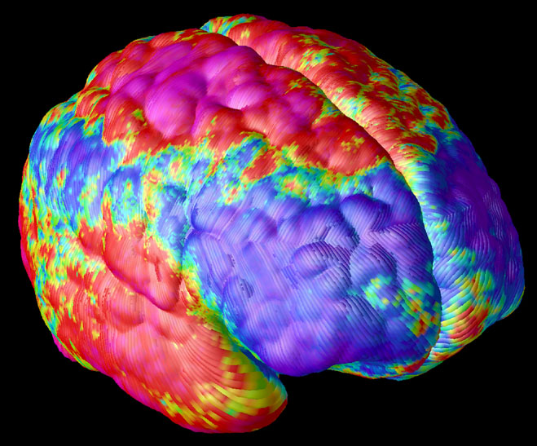
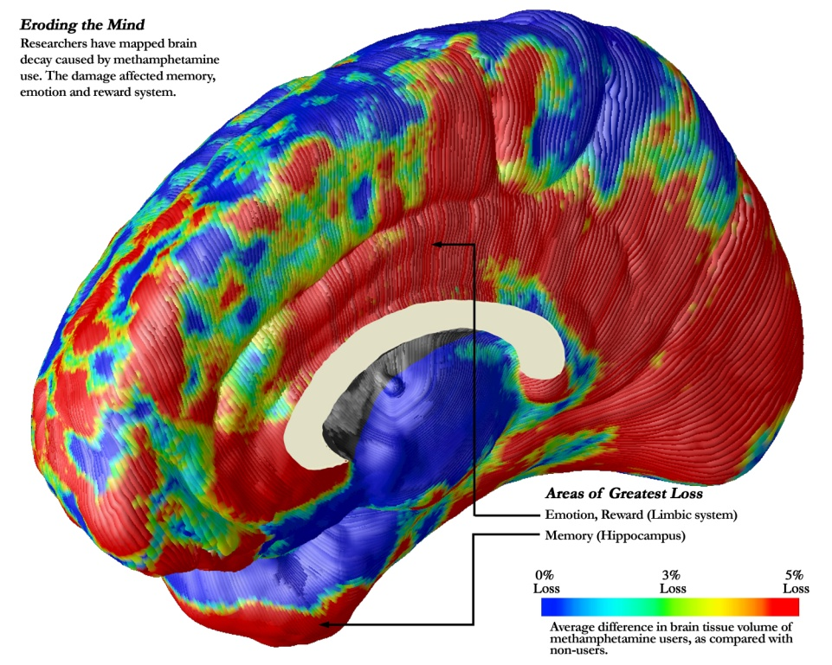
Psychiatric Disorders are
Brain Disorders
Schizophrenia
Methamphetamine Use Disorder
USC Imaging Center: http://igc.ini.usc.edu/
Notes:
Psychiatric disorders are brain disorders. These pictures show the neuronal loss with schizophrenia and methamphetamine use.

Slide 9
Distinguishing Mental from
Physical Illness
Mental illness / physical illness distinction has no clearly principled underpinnings.
This training will cover the neural bases of emotion, behavior, and cognition and their abnormalities specifically in relation to depression and anxiety.

Slide 10
Key Point #2
Attempts to demarcate ‘mental’ illness from ‘physical’ illness, fail.

Slide 11
Psychiatric nosology
Psychoanalytic (recent) past
  Little emphasis on diagnosis
  Accentuated division between psychiatry and rest of medicine
Modern “biological” psychiatry
  Led by psychopharmacological revolution
  Increased emphasis on diagnosis
    Broader range of choices for treatment
    “Re-medicalization” of psychiatry

Slide 12
DSM project
DSMs I and II
DSM III (1980)
  Purportedly “descriptive” and “atheoretical” with respect to etiopathogenesis
  Diagnoses based on explicit criteria, both cross-sectional (signs and symptoms) and longitudinal (course of illness)
DSM IV
DSM 5

Slide 13
DSM-5 Process
The APA prepared with a research evaluation that included a series of white papers and 13 scientific conferences supported by the National Institutes of Health.
The DSM-5 Task Force and Work Groups, made up of more than 160 clinicians and researchers, reviewed scientific literature and garnered input from a breadth of advisors as the basis for proposing draft criteria.

Slide 14
DSM-5 Process
The APA Board of Trustees appointed a Scientific Review Committee of mental health experts to review and provide guidance
A Clinical and Public Health Committee reviewed proposed revisions to address difficulties experienced with the clinical utility, consistency and public health impact of DSM-5 criteria.

Slide 15
DSM-5 Process
The reported goal in developing DSM-5 is an evidence-based manual that is useful to clinicians in helping them accurately diagnose mental disorders.
Decisions to include a diagnosis in DSM-5 were based on the collective clinical knowledge of experts in the field.

Slide 16
Overall changes between DSM-IV and DSM-5
Removal of the multi-axial system
Removal of GAF scores as metrics
A renaming of certain disorders
  And a change in names that previously supported a multi-axial system (like “general condition” which becomes “another medical condition”)
A subtle list toward dimensionality

Slide 17

Notes:
http://extras.mnginteractive.com/live/media/site36/2012/0316/20120316__titanic-film-1~p1.jpg

Slide 18

Notes:
http://images4.fanpop.com/image/photos/24200000/Titanic-Jack-and-Rose-jack-and-rose-dawson-24255854-1366-621.jpg

Slide 19
DSM-5 diagnostic categories
Neurodevelopmental disorders
Schizophrenia spectrum and other psychotic disorders
Bipolar and related disorders
Depressive disorders
Anxiety disorders
Obsessive-compulsive and related disorders
Trauma- and stressor-related disorders
Dissociative disorders
Somatic symptom and related disorders
Feeding and eating disorders
Sleep–wake disorders
Sexual dysfunctions
Gender dysphoria
Disruptive, impulse-control, and conduct disorders
Substance-related and addictive disorders
Neurocognitive disorders
Paraphilic disorders
Personality disorders

Slide 20
DSM diagnostic system
Benefits
  Provides standard nomenclature for clinical communication, research, and administrative functions
  Higher degree of diagnostic reliability (maybe?)
Drawbacks
  Questionable validity of many categories
  Reification of diagnostic categories – giving impression of greater understanding than is warranted

Slide 21
Key Point #3
The DSM diagnostic system has brought benefits along with significant problems.

Slide 22
Conclusions
Psychopathology consists of a diverse group of illnesses marked by abnormal cognition, emotion, and/or behavior.
Attempts at more principled definition or at demarcation of “mental illness” from ‘physical’ illness, fail.
The DSM diagnostic system has brought benefits along with some problems.

