Slide 1
Mental Status Examination

Slide 2
History Taking
Components of History
History of present illness (HPI)
Review of symptoms
Past psychiatric history
Substance use history
Medical/surgical history
Family history
Social/developmental history

Slide 3
Review of Symptoms
A MAP TO MEDS:
ADHD
Mood
Anxiety
Psychosis
Trauma
OCD
Medical
Eating
Developmental
Substance use

Slide 4
The Mental Status Exam
Appearance
Thought perceptions and content
Thought process
Cognition
Insight and Judgement
Behavior/Attitude
Speech
Mood
Affect
Notes:
Ask “golden question” to bystander or family: “Is this how they usually act, or is this a change in them?”

Slide 5
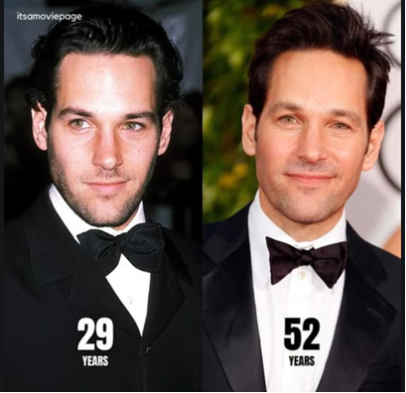
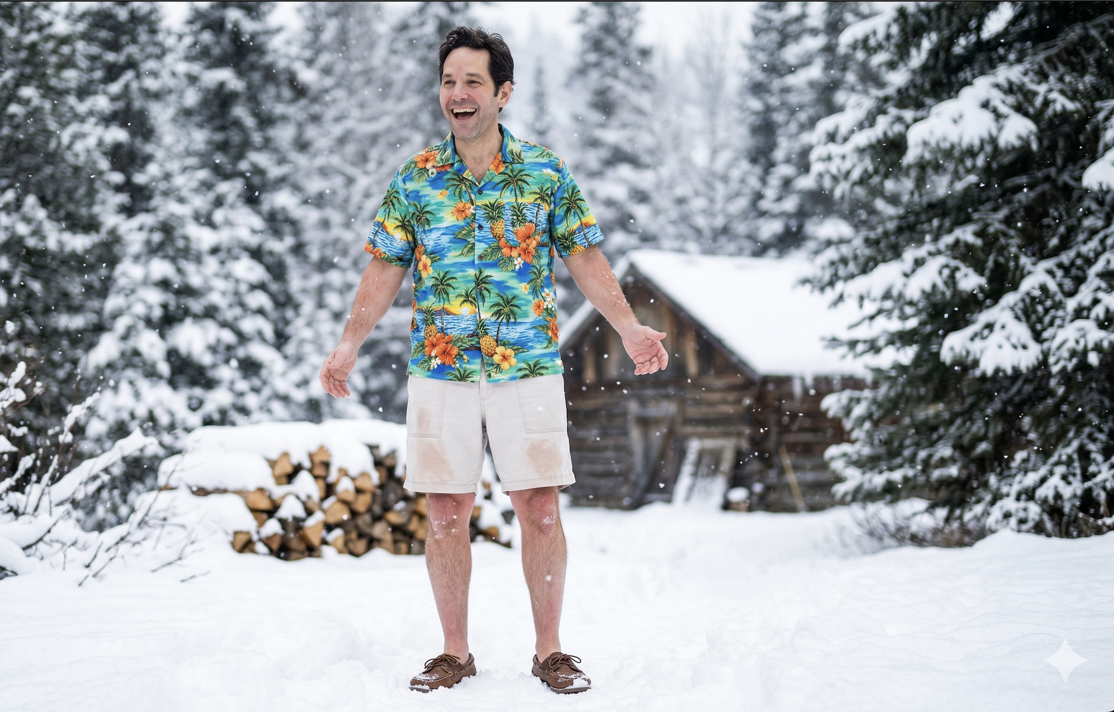
Appearance
Level of consciousness
Does the patient appear stated age?
Dress, grooming and hygiene
Facial expression
Notes:
Be objective and descriptive so that the reader could pick out the patient in a crowd

Slide 6
Behavior and Attitude
Behavior: physical and motor activity
motor activity (slowed, agitated, restlessness, tremor, tics, mannerisms)
posture and gait (hunched, rigid, normal)
abnormal movements (tardive dyskinesia, akathisia, catatonic features)
level of activity (hyperactive, hypoactive, normal)
Attitude: interpersonal style and approach during the interview
eye contact: normal, poor, intense, avoidant
cooperative vs. uncooperative
engaged vs. disengaged
friendly vs. hostile
guarded or suspicious
defensive
Notes:
Behavior
This describes the patient's physical and motor activity:
Appearance: Grooming, hygiene, dress appropriateness, physical condition
Motor activity: Psychomotor retardation (slowed movements), agitation, restlessness, tremors, tics, mannerisms
Eye contact: Normal, poor, intense, avoidant
Posture and gait: Hunched, rigid, normal
Abnormal movements: Tardive dyskinesia, akathisia, catatonic features
Level of activity: Hyperactive, hypoactive, normal
Facial expressions: Animated, flat, appropriate to content
Attitude
This refers to the patient's interpersonal style and approach toward the examiner and the interview process:
Cooperative vs. uncooperative
Engaged vs. disengaged
Friendly vs. hostile
Guarded or suspicious
Defensive
Evasive
Apathetic or indifferent
Submissive
Dramatic or histrionic
Playful or childlike
Seductive

Slide 7
Simulation/Practice
Mental Status Module:
https://psychmod.w3.uvm.edu/module/1
User ID :psychmod
Password: UVMmodules!@

Slide 8
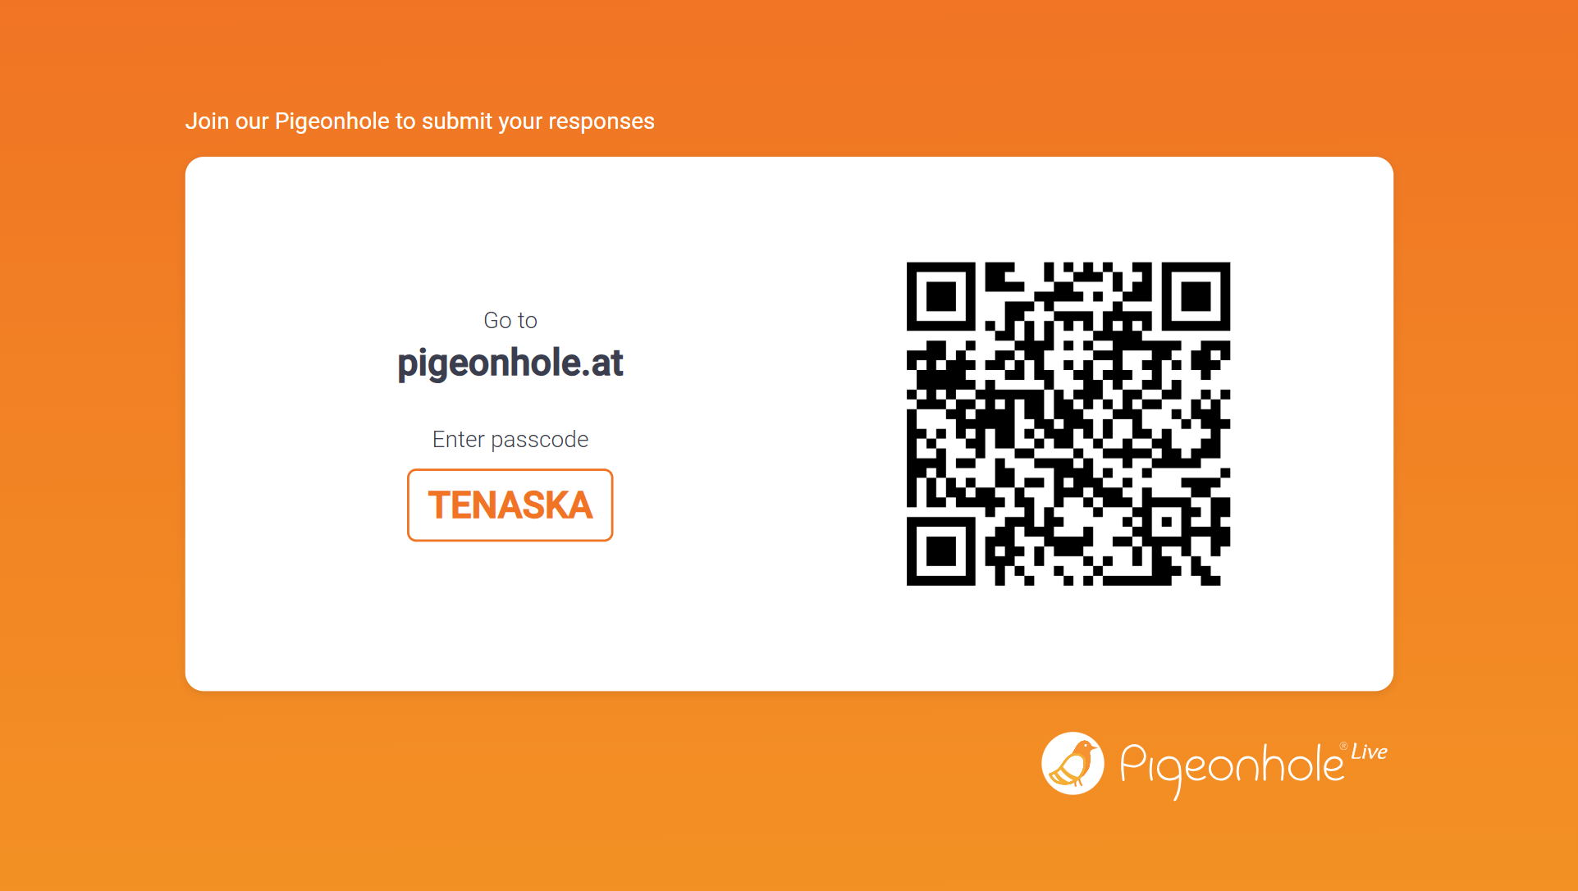

Slide 9
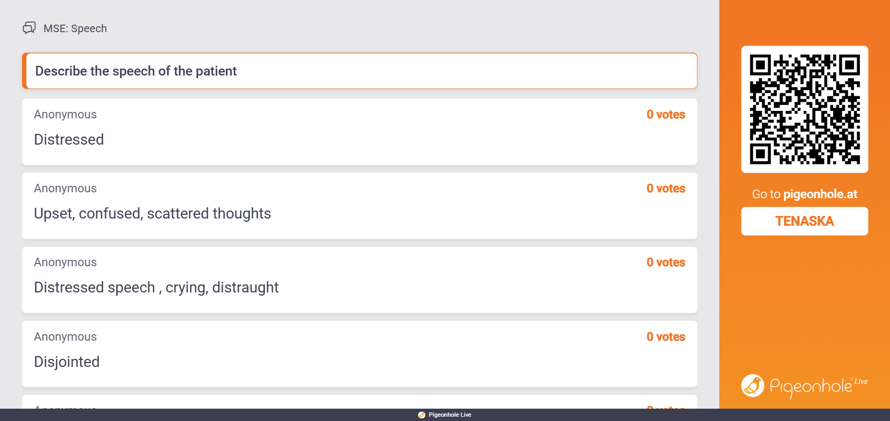
Speech Quiz

Slide 10
Speech
Volume: conversational volume, loud, soft/quiet, whispered
Tone: monotone, high/low pitched, prosody (melodic, flat), emotional quality (warm, cheerful, flat, angry, pleading, anxious, melancholic)
Rate: conversational pace, slow, rapid, pressured
Rhythm: smooth and regular cadence, dysarthric (slurred), stuttering, staccato
Fluency: words flow easily without hesitation, difficulty finding words
Quantity: spontaneous, answers are appropriately elaborate, talkative, paucity of speech, mutism, increased latency
Articulation: clear, articulate, mumbled, dysarthric
Notes:
how the person talks (not what they say)

Slide 11
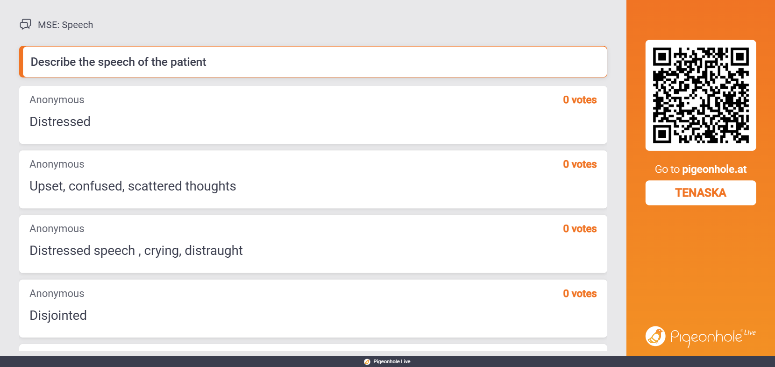
Speech Quiz

Slide 12
Mood
Patient’s own description of their internal feelings over time (days to weeks)
“How have you been feeling lately?”
“How would you describe your mood?”
“What’s your mood been like over the past week or two?”
Notes:
Module 1

Slide 13
Affect Quiz

Slide 14
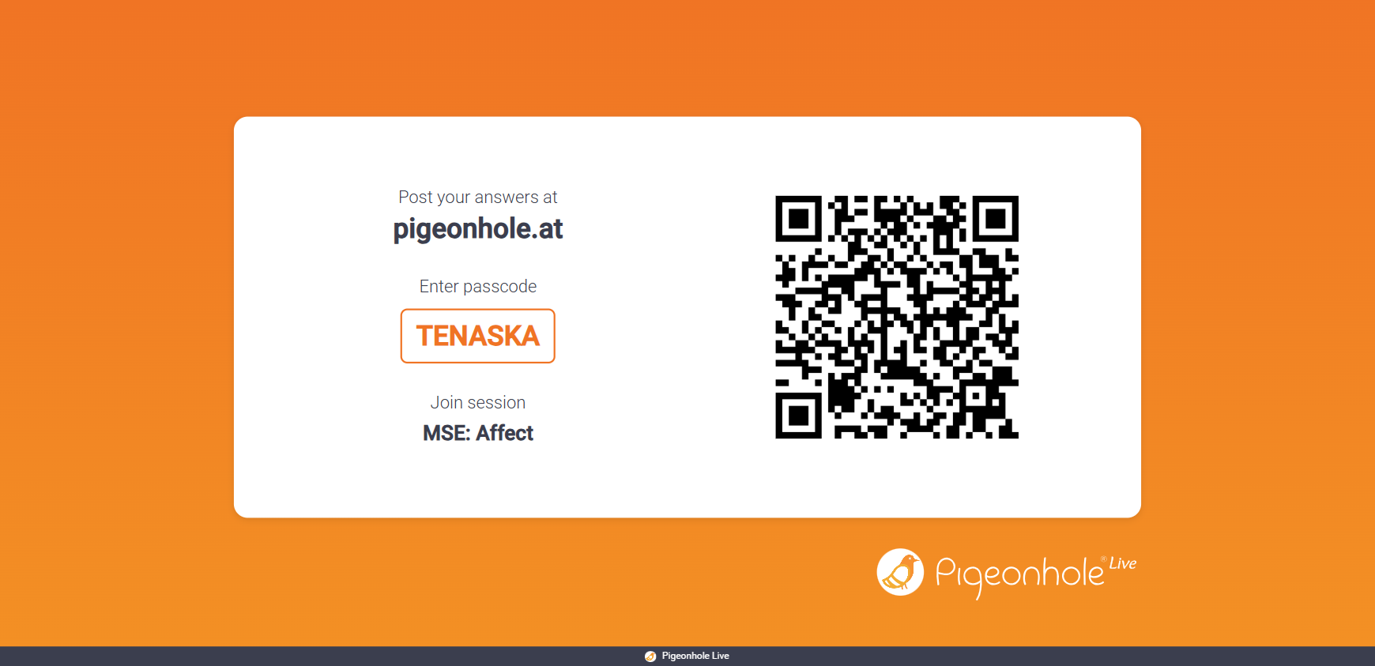
Affect Quiz

Slide 15
Affect
Content
Sad
Angry
Irritable
Tearful
Euphoric
Congruence
Congruent
Incongruent
Appropriateness
Inappropriate
Appropriate
Range Of Affect
Full range
Restricted
Blunted
Flat
Labile
Notes:
objective and observable

Slide 16
Affect Quiz

Slide 17
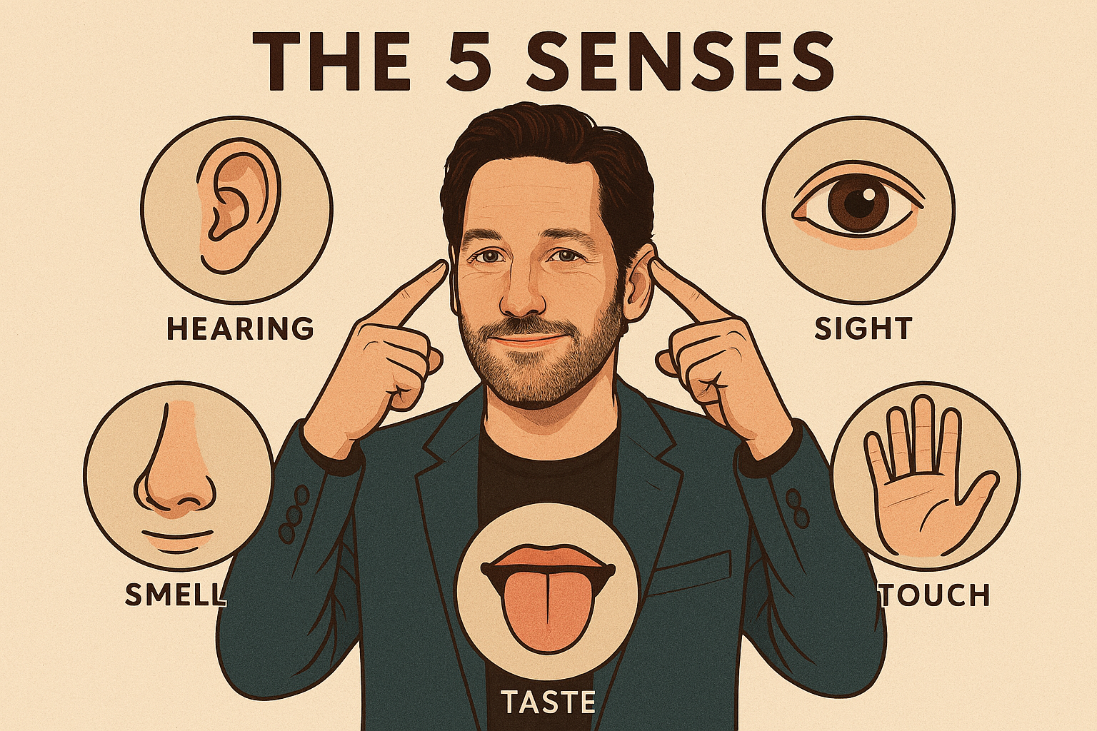
Perception
5 sensory domains:
visual
auditory
tactile
taste
smell
Notes:
perception module 5:
stereotyped olfactory hallucinations are typical of temporal lobe epilepsy
gustatory hallucinations may also precede a temporal lobe seizure, rare

Slide 18
Thought Content
Delusions (i.e., persecution, grandiosity, jealousy, reference, delusions of being controlled, systematized delusions)
Paranoia
Obsessions
Ideas of Reference
Grandiose Thoughts
Phobias, Cognitive distortions
Alogia: impoverished thinking and cognition, often seen in schizophrenia (one of the five A’s)
Self-harm, Suicidal Ideation ((ideation, intent, plan, means, deterrents, future orientation, attempt and previous attempts)
Homicidal Ideation
Notes:
Alogia: thinking process seems slow or empty. may include poverty of speech or content, thought blocking, and increase latency of response
Poverty of content: although speech is productive, the patient never actually answers the question. Content can be vague, overabstract or overconcrete, full of repetition, or stereotyped

Slide 19
Thought Process
Is it logical, goal-directed?
Associations (tight, tangential, flight of ideas, circumstantial, loosening, word salad)
Latency
Distractible
Thought blocking
Confabulation
Perseveration
Notes:
Thought process 2

Slide 20
Cognition
Orientation
Ability to focus
Test: Spell “WORLD” forwards and backwards
Time/Person/Place/Situation
Test: Date/Name/Location/Reason for visit
Memory
Recall
Test: Give 3 words, ask again in 5 minutes (STM), ask what they did 2-3 days ago (LTM)
Attention
Notes:
Field Tip: If they can't draw a clock set to 11:10, they have a serious cognitive deficit. Transport immediately for medical eval.
Also:
fund of knowledge (current events, historical events, relate to patient’s level of education)
Calculations: serial 7’s or making change (adjust difficulty for level of education)
Capacity to read and write: ask patient to read a short text, write a sentence
Visuospatial ability: ask patient to copy a figure (e.g., intersecting pentagons or draw a clock face)
Abstraction
commonalities between apple and orange
interpret a proverb (”grass is always greener”)

Slide 21
Higher Cognitive Function
Information and vocabulary (social/political awareness)
Calculation
Abstract thinking (proverbs, similarities)
Constructional Ability (i.e., figures - intersecting pentagons)

Slide 22
Insight & Judgment
Insight: how realistically a patient has assessed his or her illness
Do you think that you are ill? Do you think that you need treatment?
Judgment
If you ran out of your medication, what would you do? If you feel sick on the lithium, what would you do?

Slide 23
Thank you!

Slide 24
Standardized Field Scores
BMSE (Brief Mental Status Exam)
6 items
72% sensitive/95% specific for severe impairment in emergency settings
interRAI BMHS (Brief Mental Health Screener)
police-specific
predicts hospital transport and admission necessity
Dementia: Mini-Cog and Clock-Drawing Test
sensitivity typically at 0.75 or higher for detecting dementia
14 variables including self-injurious acts, abnormal thought processes, delusions, and hallucinations
Notes:
BMSE demonstrated 72% sensitivity and 95% specificity for identifying severely impaired individuals in emergency settings
he interRAI Brief Mental Health Screener (BMHS), designed specifically for police officers, uses 14 variables including self-injurious acts, abnormal thought processes, delusions, and hallucinations, and has been shown to predict hospital transport and admission.

Slide 25
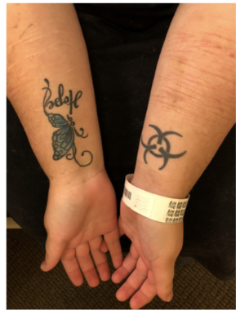
Appearance
Does the patient appear stated age?
Level of consciousness
Dress, grooming and hygiene
Facial expression
Unique characteristics (tattoos, scars, etc)
Source: UVM MSE simulation
Notes:
Be objective and descriptive so that the reader could pick out the patient in a crowd
The patient has multiple superficial horizonal cuts in various stages of healing on her inner forearms, as well as bilateral tattoos
Goal: Identify physical markers of self-neglect or acute distress
context is king “a person being disheveled is expected if they just survived a house fire
Patient found wearing a heavy winter coat in 90-degree heat, emitting strong body odor, appearing drowsy/lethargic

