Slide 1
Lightning Round
Name that Symptom

Slide 2
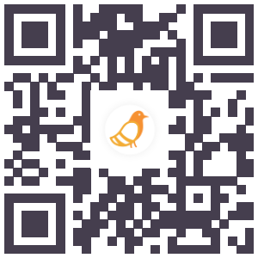
Go to
pigeonhole.at
Enter passcode
TENASKA

Slide 3
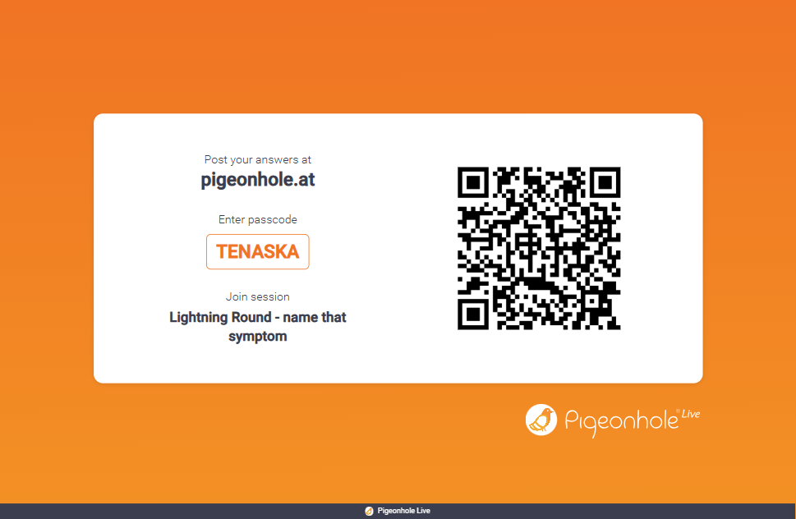
Behavior 1
https://psychmod.w3.uvm.edu/module/1

Slide 4
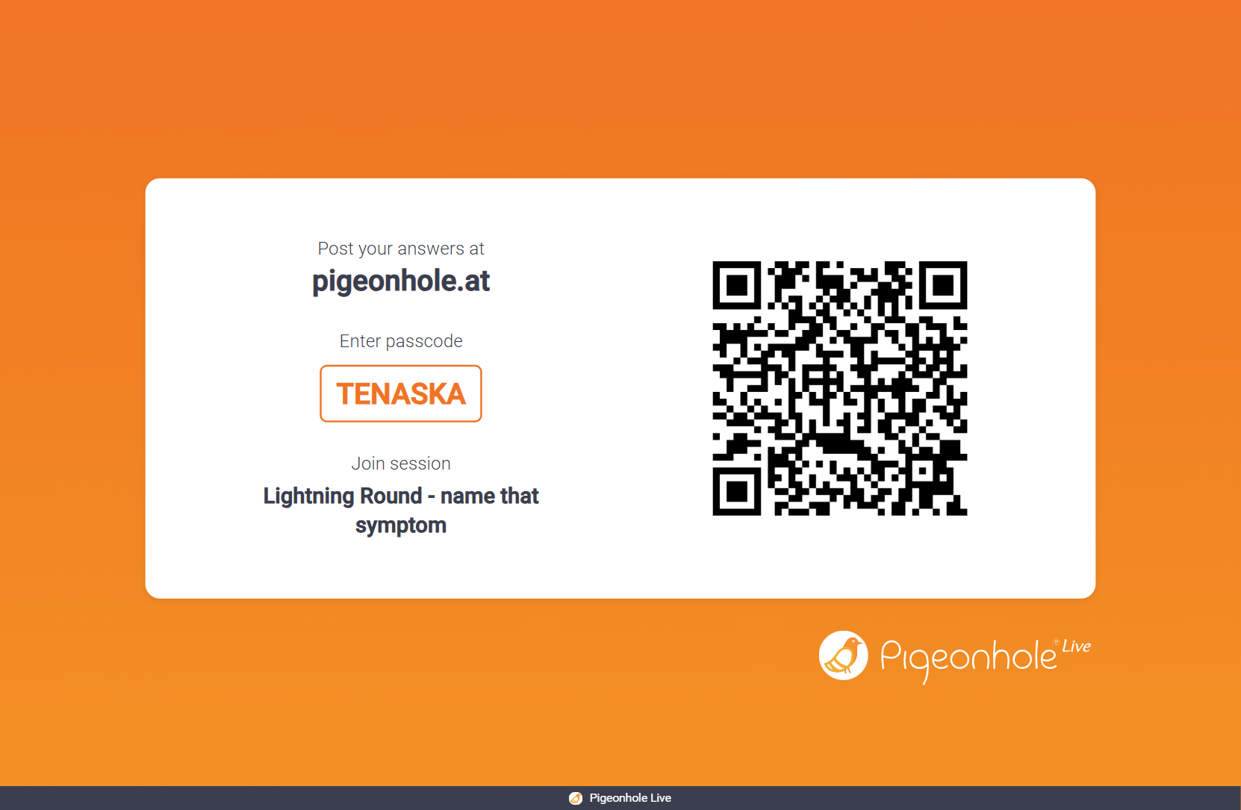
Behavior 2

Slide 5
Behavior 5

Slide 6
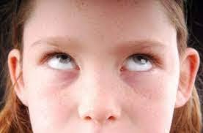


Slide 7
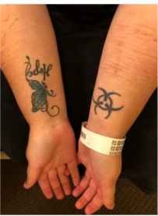

Slide 8
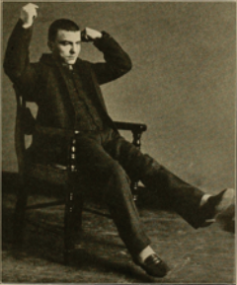

Slide 9


Slide 10
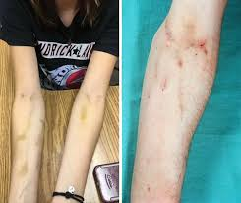

Slide 11


Slide 12


Slide 13

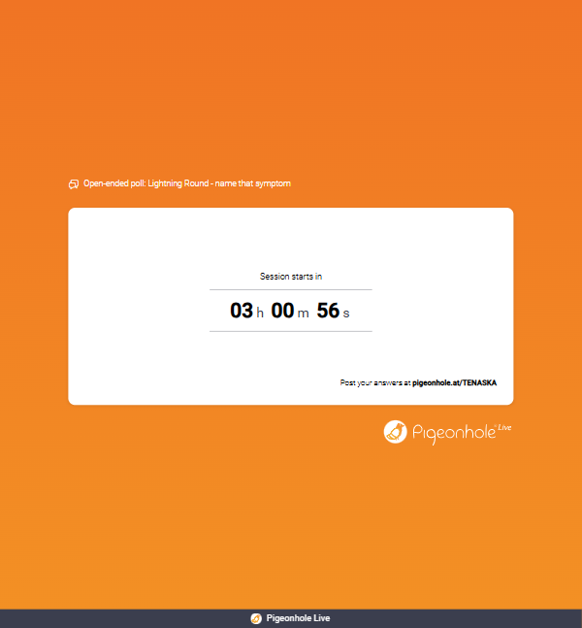

Slide 14
