Slide 1
De-escalation
David H. Rubin, MD
Director, Division of Professional and Public Education
Executive Director, MGH Psychiatry Academy & MGH Visiting
Assistant Professor of Psychiatry
Harvard Medical School
Massachusetts General Hospital

Slide 2

De-escalation

Slide 3

Predispositions to Explosive Behavior
Depression
Mood instability
Anxiety
Trauma
Immaturity
Impaired frustration tolerance
Disruptive behavior disorders
Intoxication

Slide 4

Power Struggles
Coercive Interactions
  Negative reinforcement paradigm
  Reciprocal interactions
  Methods of coercion escalate over time

Slide 5
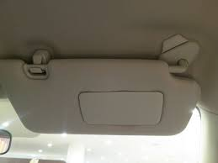
Negative Reinforcement
When a behavior is successful in decreasing a noxious stimuli, it is more likely to re-occur next time the noxious stimuli is presented.

Slide 6

Positive Reinforcement
When a behavior is followed by an experience that makes it more likely that the behavior will recur
A reinforcer can be anything
A reinforcer is person specific
Reward is in the eye of the beholder

Slide 7
Restraint/ Seclusion
Punish
Insist
Raise voice
Yes
NO
Argue
Refuse
Tantrum
Fight back

Slide 8

Managing Explosive Behavior is an Open Book Exam
Learn from the past
History of current crisis vs. history of current “state”

Slide 9
Positive Behavioral Strategies
Behavior systems should result in improved evidenced-based strategies
  Positive Attention
  Limit Setting
  Rewards
  Active Listening
  Selective “Ignoring”
  Effective Commands
  Problem-Solving

Slide 10



Active Listening
Core skill of supervision
  Mirroring
  Validating
  Empathizing
  No interrupting
  No advice giving
  No commentary
  No judgment

Slide 11

Active Listening
Mirroring
  Repeat what they say and then say
  “Is there more that I need to understand”
  Continue until they are done
Validating
  “Is there more that I need to understand”
  “No, that is it”
  “What you said makes sense to me”
Empathizing
  “Given what you said I understand how you feel”

Slide 12
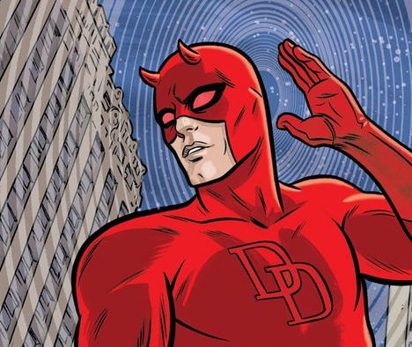
Why Does Active Listening Work
Listening takes you out of potential power struggles
You are listening, validating, and caring
Interrupting, advice giving, commenting, judging, teaches the patient no to listen.

Slide 13

Giving Effective Commands
Goal of the behavior system is to avoid giving commands at all
Avoid phrasing commands as questions
Break commands into single steps
Eliminate distractions in immediate environment
Speak in a firm, but calm voice
Ask to repeat commands to ensure accuracy

Slide 14
Principles of Verbal De-escalation
Technical
One voice should take the lead
Honesty
Avoid public splitting
Know your limits and tag out when mentally exhausted
Optimism that individual will regain control soon

Slide 15

Principles of Verbal De-escalation
Technical
Regulation of Affect
Consider employing a very limited range:
  Warm, enthusiastic and encouraging
              or
  Dispassionate, conveying a sense of mild boredom and regret
  Affect- negative or positive- can reinforce
  Arguing is still intimacy
  Dispassion is non-rewarding
C

Slide 16
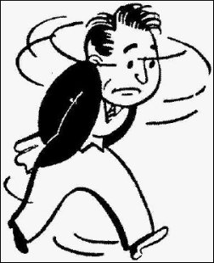


Situational Awareness
Pacing
Clenched Fists
Rapid speech
Withdrawal
Trust your instincts re: aggression

Slide 17
Verbal De-escalation
Finding the Middle Ground
A – Adult “Because I said so!”
B – Both: Collaborative Problem Solving
C – Child “Do whatever you want…”

Slide 18
Collaborative Problem Solving
  Conflicts are to be addressed in terms of competing concerns, not competing solutions.
  Instead of:
  “No you won’t… Yes I will!”
  Consider:
  “What are you worried about?...Here’s what I’m worried about.”

Slide 19
CPS
Step 1 – Elicit individual’s concern
Step 2 – Prove you have heard the individual’s concern
  Mirror, validate, empathize
  If nothing else, parrot
Step 3 – Articulate your concern
Step 4- Invite individual to resolve both concerns
Step 5- If individual can’t start a solution, offer suggestions
Step 6- Accept any solution that effectively addresses both concerns.

Slide 20
Thank you!

