Slide 1
Substance Use Disorders Phenomenology and Treatment

Slide 2
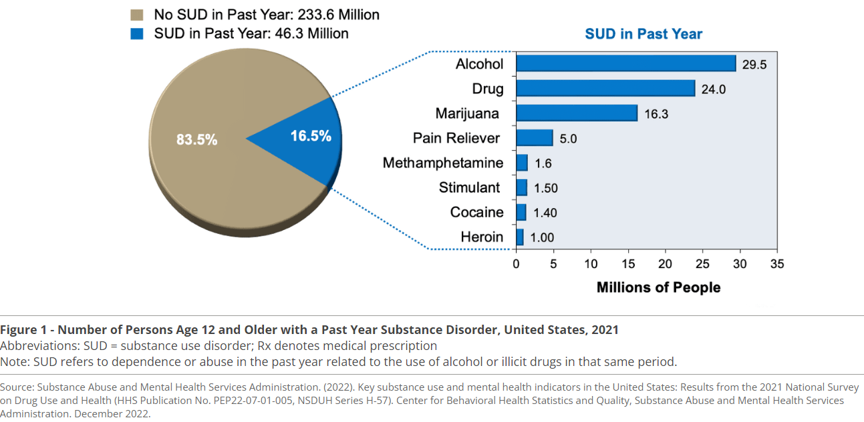
Epidemiology

Slide 3
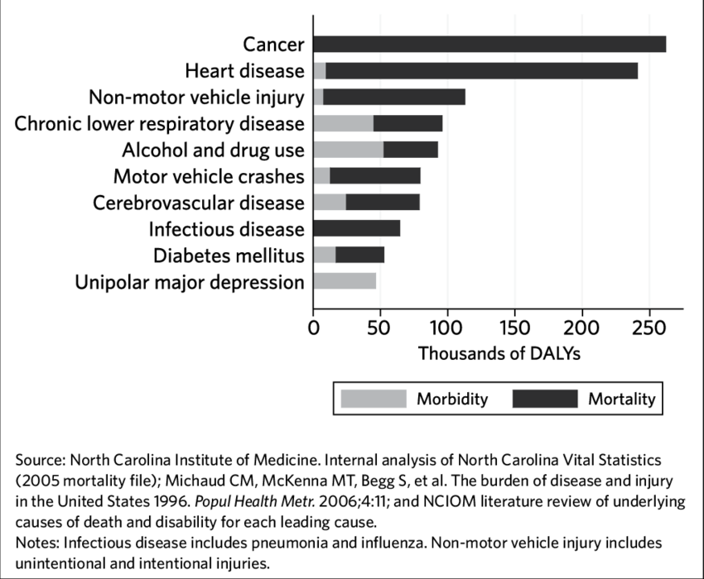
Substance Use Disorders and Disability

Slide 4
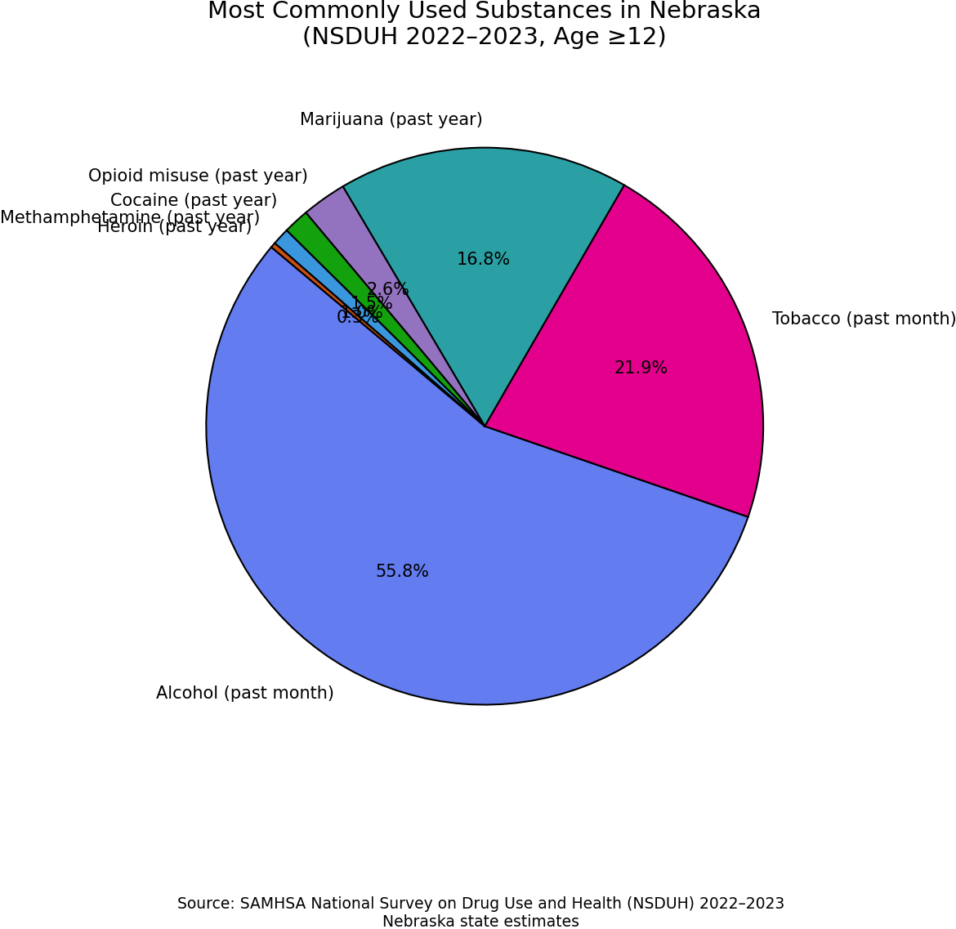
Nebraska

Slide 5
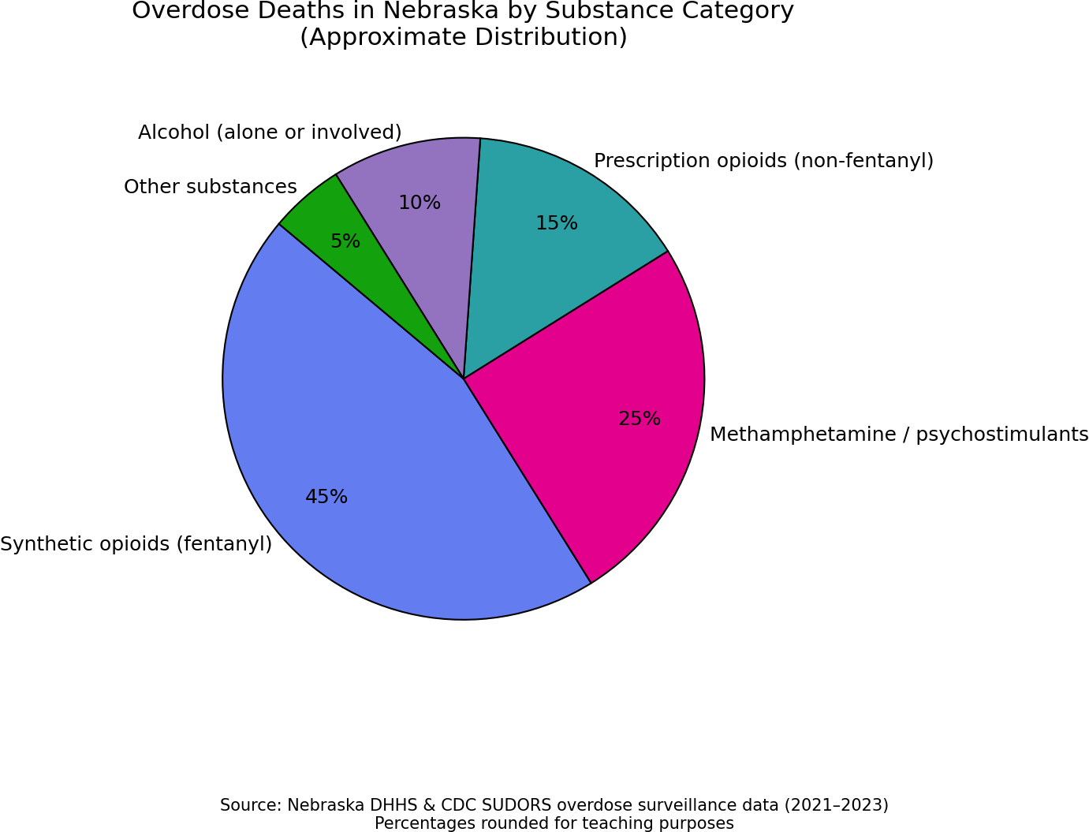
Nebraska

Slide 6
Diagnosis
A. Substance Use Disorders Criteria:
There are 11 symptoms for each substance class (except for caffeine) that are used to make a substance use disorder diagnosis.
The diagnosis is made along a continuum—mild, moderate, or severe—based on the number and severity of the symptoms.
Specify current severity based on the following guidelines:
Mild: Presence of 2 or 3 symptoms
Moderate: Presence of 4 or 5 symptoms
Severe: Presence of 6 or more symptoms
Symptoms include:
Substance is taken in larger amounts or over longer periods than was intended.
There is a persistent desire or unsuccessful effort to cut down or control substance use.
A great deal of time is spent in activities necessary to obtain substance, use substance, or recover from its effects.
Craving, or a strong desire or urge to use substance.
Recurrent use of the substance is resulting in a failure to fulfill major role obligations at work, home, or school.

Slide 7
Diagnosis
Continued use of substance despite having persistent or recurrent social or interpersonal problems caused or exacerbated by the effects of the substance.
Important social, occupational, or recreational activities are given up or reduced because of substance use.
Recurrent substance use in situations in which it is physically hazardous.
Substance use is continued despite knowledge of having a persistent or recurrent physical or psychological problem that is likely to have been caused or exacerbated by the substance.
Tolerance, as defined by either of the following:
  A need for markedly increased amounts of the substance to achieve intoxication or desired effect.
  A markedly diminished effect with continued use of the same amount of the substance.
Withdrawal, as manifested by either of the following:
  The characteristic withdrawal syndrome for that substance (see additional criteria in DSM-5).
  The substance is taken to relieve or avoid withdrawal symptoms.

Slide 8
Key Places on the Decision Tree
Are we treating SUD or are we dealing with SUD while treating other things?
What is the potential for withdrawal?
How are they otherwise medically?
How are their supports?
Where is the patient in terms of their understanding of the disorder and their desire to change?

Slide 9
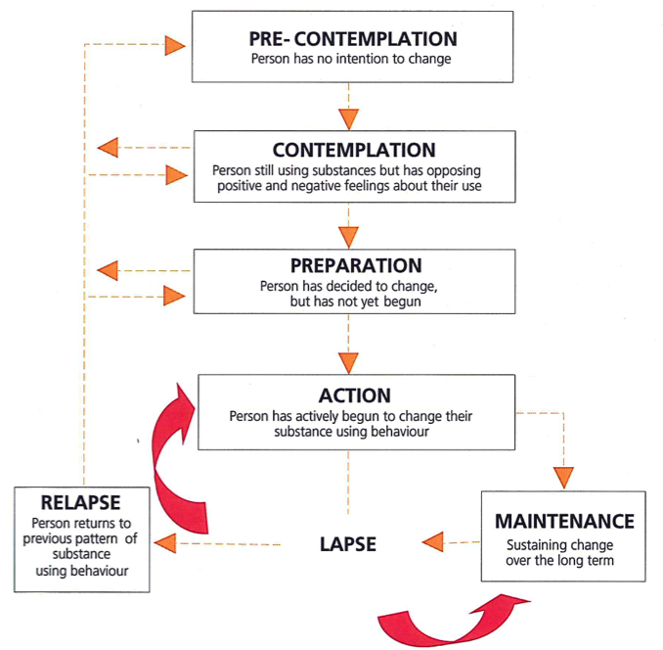

Slide 10
Alcohol
Intoxication | Withdrawal
Slurred speech | Tremors (“shakes”)
Poor coordination / unsteady gait | Anxiety, nervousness, irritability, agitation
Impaired judgment /Slowed reaction time | Sweating and/or fever
Reduced inhibition / risk‑taking behavior | Nausea and vomiting
Drowsiness, sedation, confusion | Headache, Sensitivity to light or sound
Flushed skin | Insomnia or disturbed sleep
Nausea or vomiting | Rapid heart rate (tachycardia), elevated BP
Memory impairment / blackouts | Hallucinations (visual, auditory, or tactile)
Blurred or double vision, nystagmus | Seizures or Delirium tremens (severe)
Hypoglycemia (especially in diabetics)
Respiratory depression (severe cases)
Loss of consciousness or coma (severe cases)

Slide 11
Cannabis
Intoxication | Withdrawal
Euphoria or feeling “high” | Irritability or anger
Relaxation | Anxiety or nervousness
Altered perception of time | Restlessness
Impaired attention and concentration | Insomnia
Short‑term memory impairment | Vivid or unpleasant dreams
Poor coordination / slowed reaction time | Decreased appetite
Increased appetite (“munchies”) | Weight loss
Dry mouth | Headache
Red, bloodshot eyes | Sweating
Tachycardia | Depressed mood
Anxiety or panic | Cravings for cannabis

Slide 12
Opioids
Intoxication | Withdrawal
Euphoria | Dysphoria (low or irritable mood)
Analgesia (pain relief) | Muscle aches
Sedation or drowsiness | Restlessness
Constricted pupils (miosis) | Dilated pupils (mydriasis)
Slowed reaction time | Anxiety
Impaired attention or judgment | Insomnia
Slurred speech | Yawning and rhinorrhea
Nausea or vomiting | Nausea or vomiting
Constipation | Diarrhea
Itching (pruritus) | Abdominal cramping
Respiratory depression | Tachycardia

Slide 13
Stimulants (Cocaine; Methamphetamine)
Intoxication | Withdrawal
Euphoria | Dysphoria or depressed mood or suicidality
Increased energy | Fatigue
Increased alertness | Psychomotor slowing
Decreased appetite | Increased appetite
Insomnia | Hypersomnia
Talkativeness | Social withdrawal
Anxiety or agitation | Anxiety
Paranoia | Irritability
Psychosis (hallucinations or delusions) | Vivid, unpleasant dreams
Tachycardia and hypertension | Bradycardia or fatigue‑related low energy
Dilated pupils (mydriasis) | Cravings for stimulants
Hyperthermia

Slide 14
Hallucinogens
Intoxication | Withdrawal
Altered perception (visual or auditory) | Fatigue and insomnia
Visual hallucinations | Depressed mood
Distorted sense of time | Anxiety and irritability
Euphoria | Poor concentration
Anxiety or panic | Anhedonia
Paranoia | Headache
Synesthesia (blending of senses) | Decreased appetite
Impaired judgment | Cravings (psychological)
Pupillary dilation (mydriasis) | Flashbacks (HPPD*)
Tachycardia and hypertension | Depersonalization or derealization
Nausea | Generally no severe physical withdrawal
Psychosis (especially PCP or high doses)

Slide 15
Synthetic cannabinoids
Synthetic cannabinoids are far more potent and unpredictable than natural cannabis
Intoxication commonly causes severe psychiatric and neurologic symptoms, including seizures and psychosis
Withdrawal does occur, unlike classic cannabis, and can resemble sedative‑hypnotic or stimulant withdrawal
Management is primarily supportive, often requiring benzodiazepines and close monitoring

Slide 16
Kratum
What: Herbal product (Mitragyna speciosa)
MOA: Partial µ‑opioid agonist (+ adrenergic/serotonergic)
Unique features: Low dose = stimulant, high dose = opioid‑like
Intoxication: Euphoria, analgesia, sedation, N/V, tachycardia
Withdrawal: Mild opioid‑like → dysphoria, insomnia, aches, diarrhea
Key Pearls:
  Not on routine UDS and Minimal respiratory depression alone but increased risk with opioids, benzos, alcohol
  Opioid‑like symptoms + negative UDS ± stimulant features → think KRATOM

Slide 17
Suspected Intoxication
Predominant CNS depression (sedation, slurred speech)
Predominant CNS activation (agitation, tachy)
Pinpoint pupils
Resp depression
Opiates
Stimulants
Dilated pupils, diaphoresis
Ataxia, nystagmus, sweet smell
Alcohol
Hallu-cinogens
Hallucinations, autonomic instability
Memory impairment, red eyes
THC
Synthetics
Severe agitation, psychosis, seizures
Mixed or unclear → suspect co-ingestion

Slide 18
