Slide 1
Check in

Slide 2
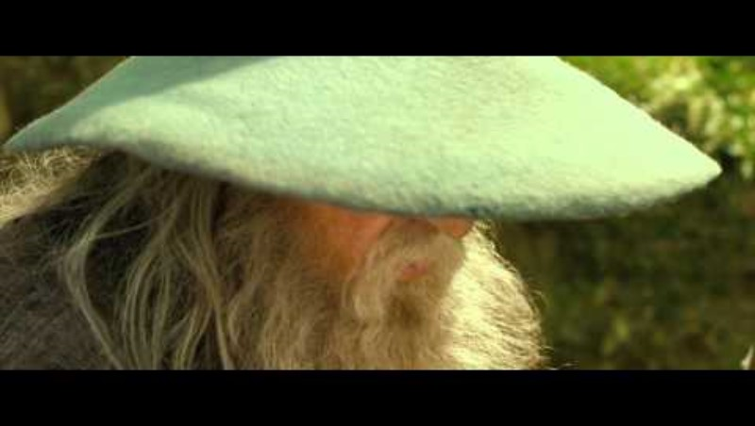

Slide 3
Resources
Assessment scales: https://floridabhcenter.org/adult-assessment-scales/
https://clarksonregional.com/educational-resources-and-guides/
Mghcme.org

Slide 4
