Slide 1
Medical Mimics

Slide 2
Medication Side Effects
Medication | Mimic
Steroids | Mania, anxiety, irritability
Caffeine/Nicotine | Mania, ADHD, anxiety
Antihistamine | Hypersomnia, irritability, anxiety, delirium
Levothyroxine | Anxiety
Isotretinoin | Psychosis
Levetiracetam | Mania, psychosis, irritability
Interferon | Depression, mania
Beta-agonist inhalers | Anxiety
Dopamine agonists | Psychosis
Anticholinergics | Delirium
Dextromethorphan | Hallucinations

Slide 3
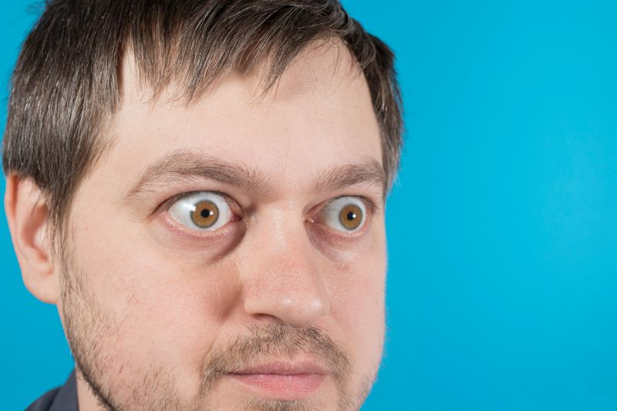
Hyperthyroid

Slide 4
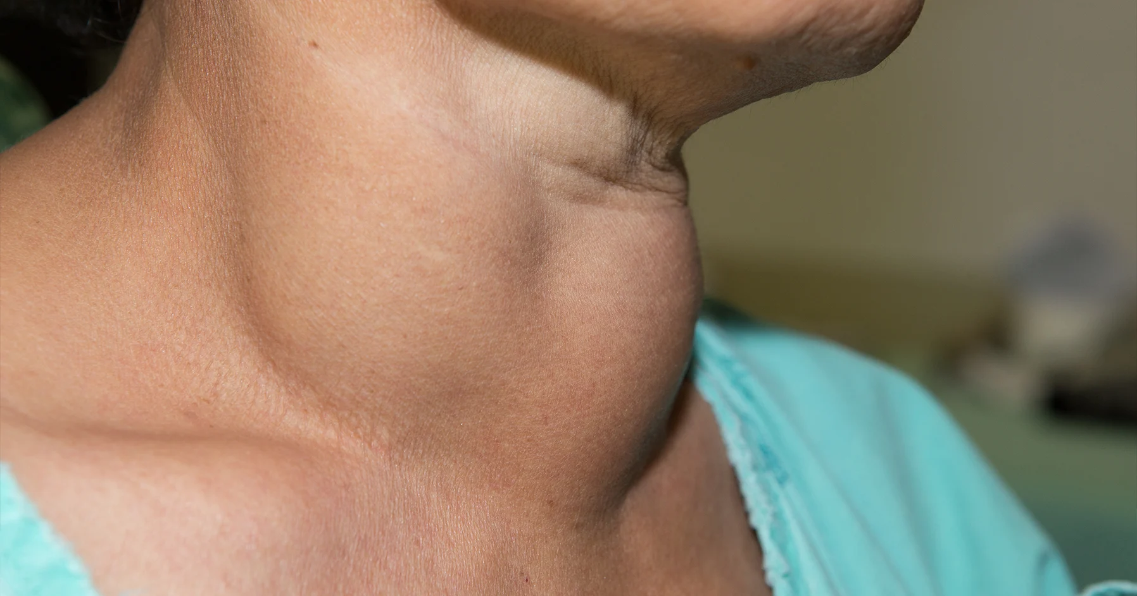
Hypothyroid

Slide 5
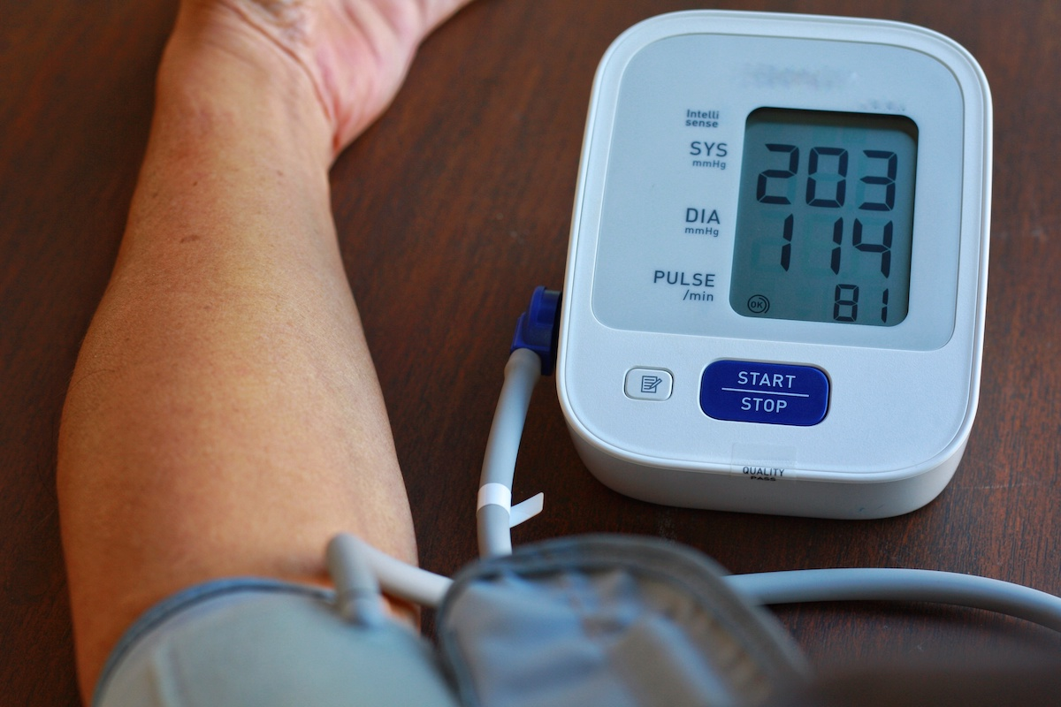
Hypertensive encephalopathy

Slide 6
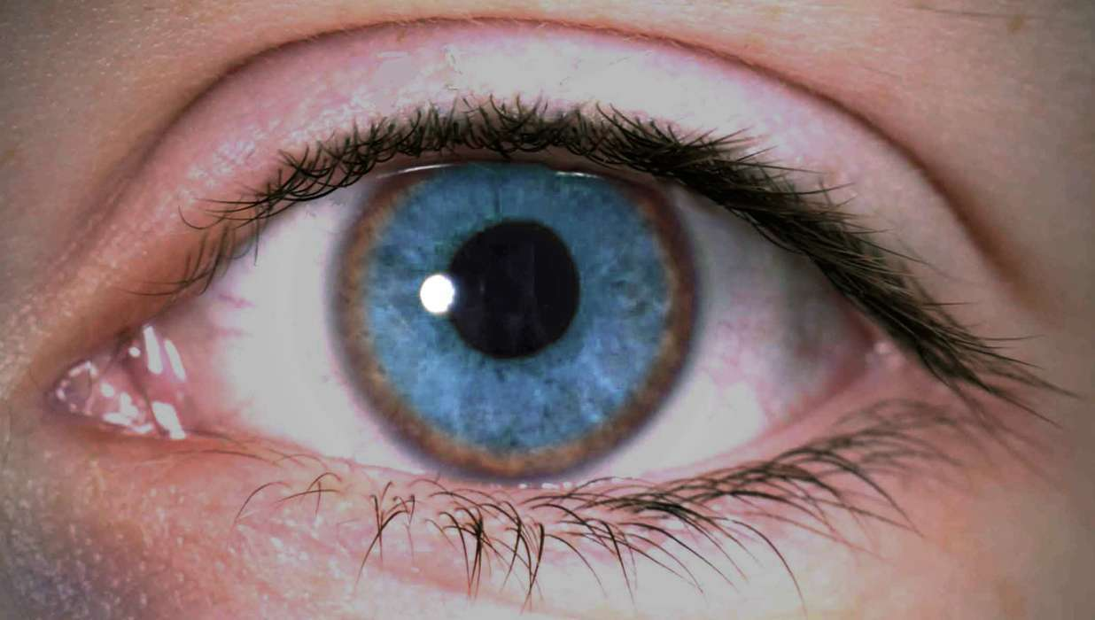
Wilson Disease

Slide 7

Seizures

Slide 8
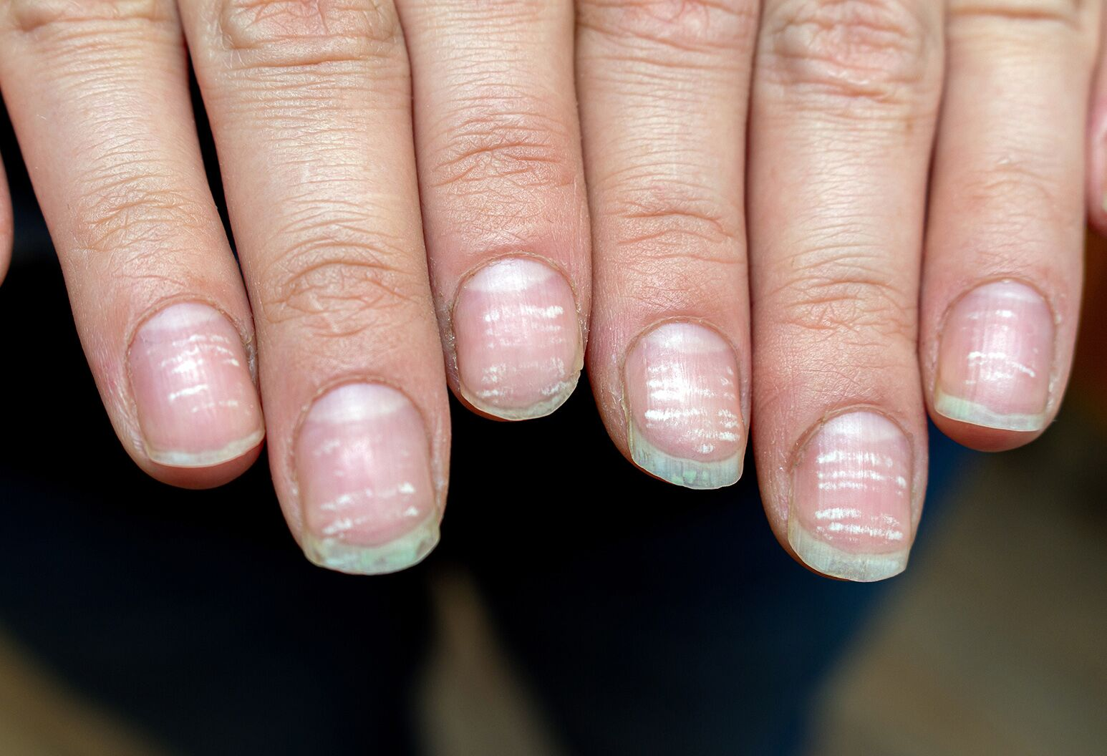
Anemia

Slide 9
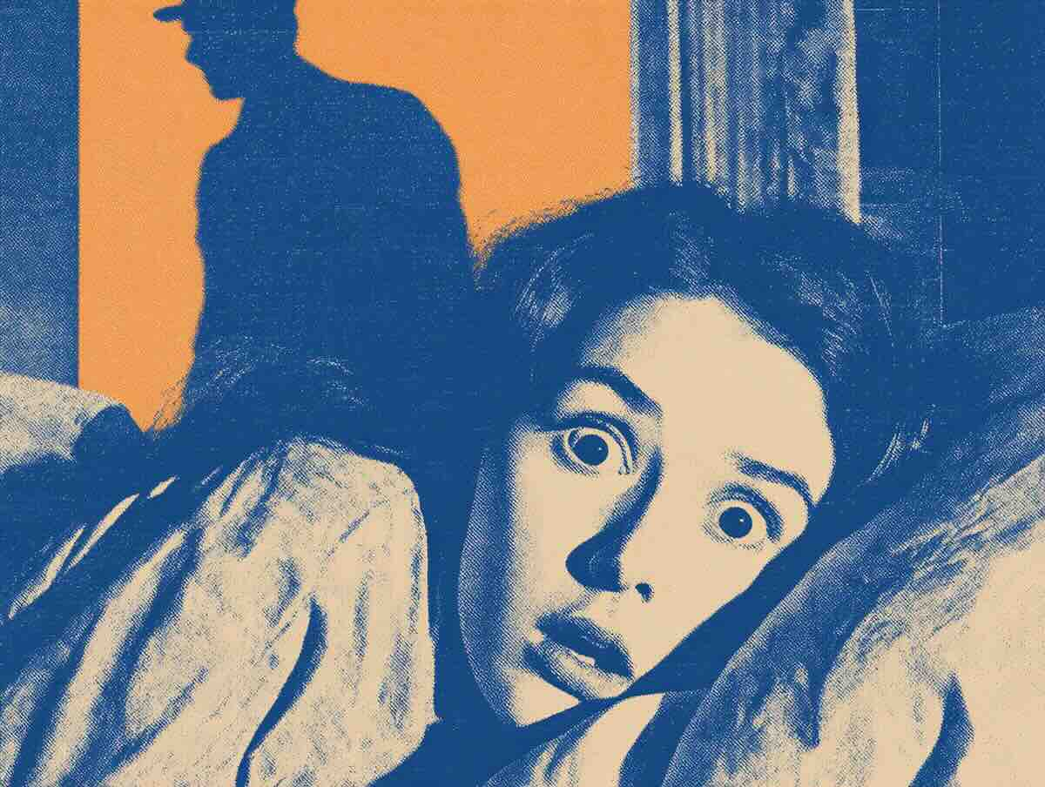
Hypnogogic/pompic hallucinations

Slide 10

Delirium

Slide 11
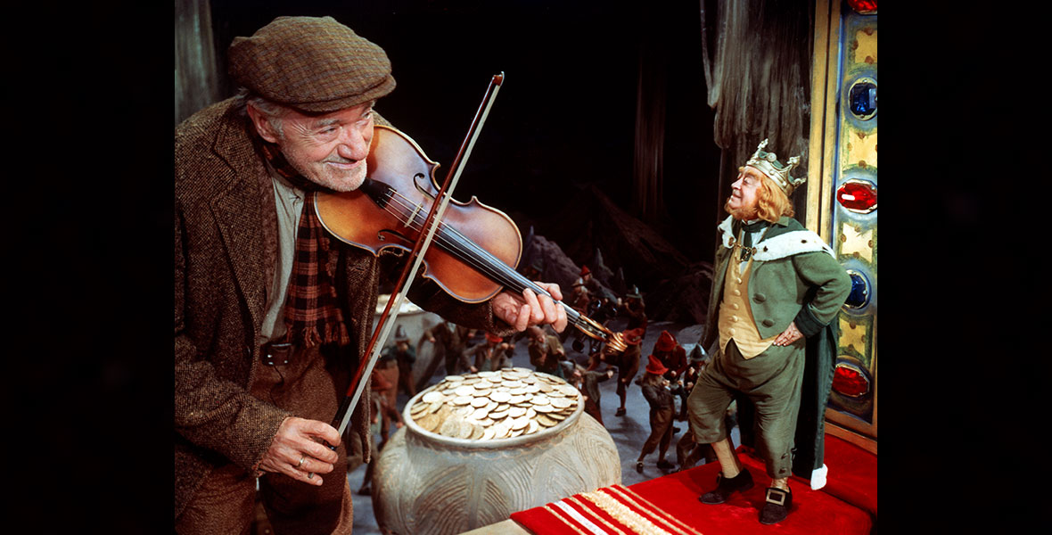
Macular Degeneration

