Slide 1

WHAT’S
MY
DIAGNOSIS?

Slide 2


Slide 3
Case 1
I am 23-year-old woman with a recent traumatic event that occurred after a night at the ballpark that occurred 5 months ago. I have been having worsening feelings of anxiety, fear of going out alone at night, recurring nightmares of the event and consequent poor sleep, and a feeling of edginess or tension that has been impairing me in my work as a barista.
What’s my diagnosis?

Slide 4
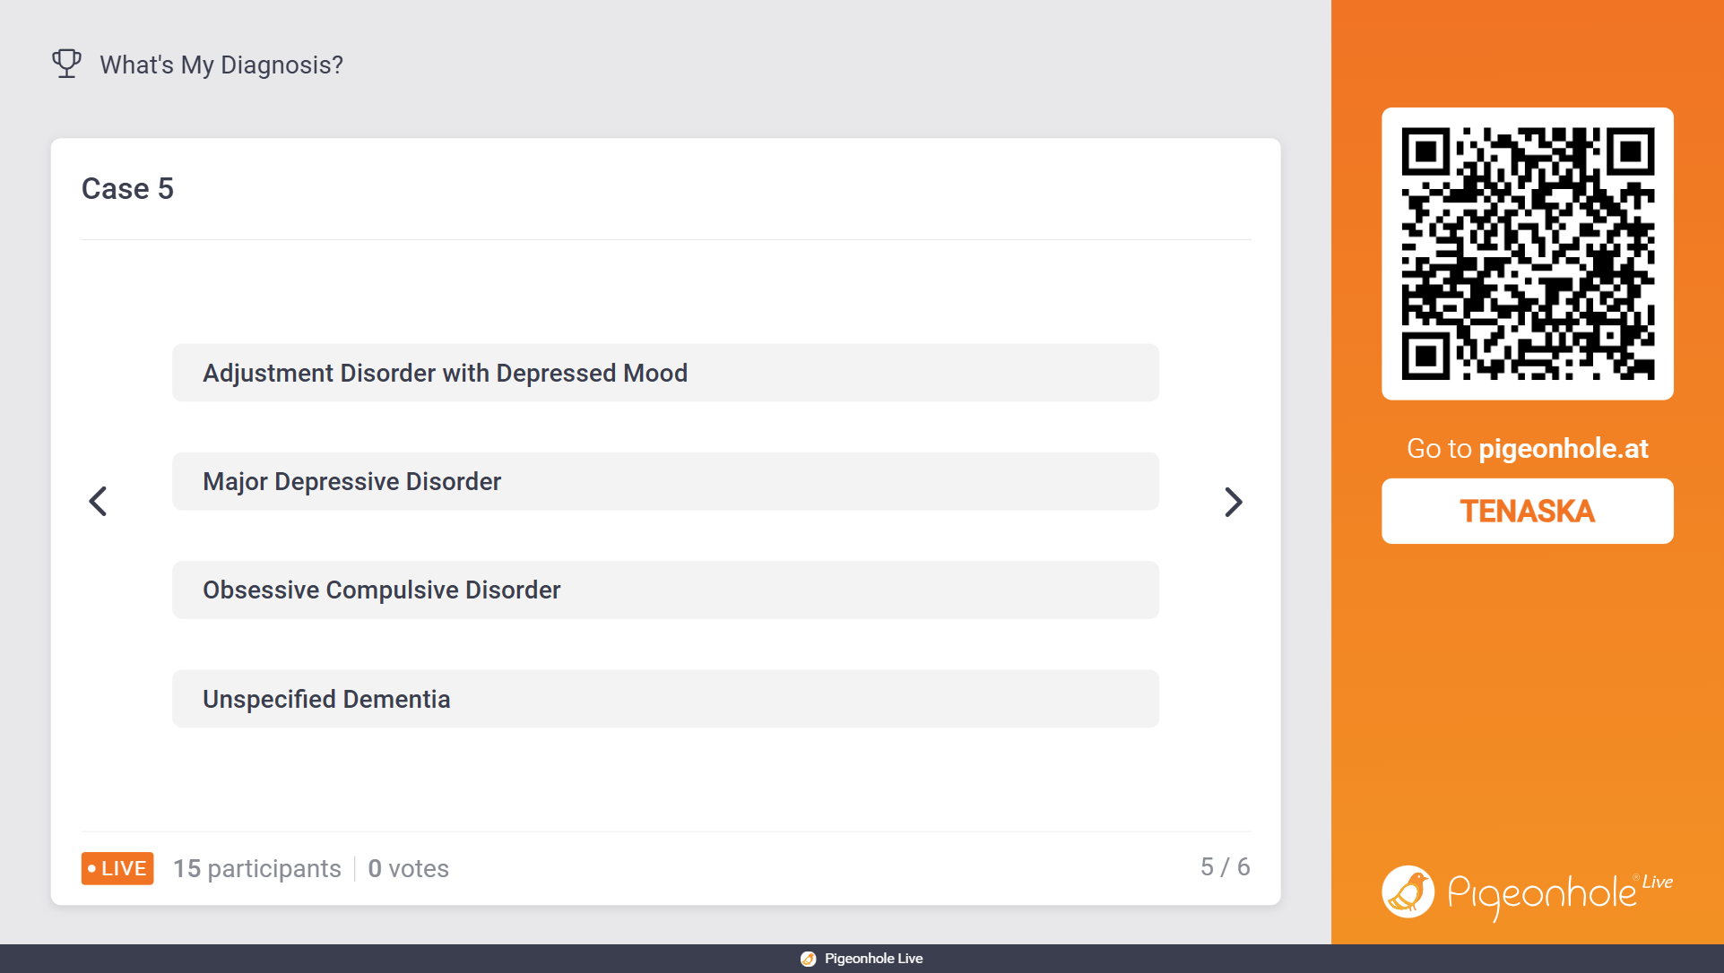

Slide 5
Case 2
I am a 53-year-old man who lost my job 7 months ago after stealing from the till. I was not charged but have since been worried that I am going to do something else bad. I find myself worried about the smallest things most days than not. I have been more irritable with my family. I constantly feel tense and have a hard time winding down for sleep. I cannot control the thoughts or feelings. I have not been using substances.
What’s my diagnosis?

Slide 6


Slide 7
Case 3
I am a 19-year-old college student who has struggled with my thoughts for the past 7 years. Initially, I was able to keep them at check – they were mostly thoughts whereby I would count the numbers of words in a sentence when someone was talking. I didn’t tell anyone that I did that, and it never got in the way of anything. In the past year, however, the thoughts have become more intrusive and they are starting to bother me.
What’s my diagnosis?

Slide 8


Slide 9
Case 4
I am a 40-year-old middle manager who has been trying to get into a leadership position at my work, but have been hampered by my inability to present at important meetings. I am well prepared for the meeting, but as the time of the meeting approaches, I find myself getting more and more nervous, to the point of paralysis. At this point, I am resolved to never be promoted and am looking at other jobs, but I fear the interview and being evaluated. At home and with my friends, I have no fears of speaking.
What’s my diagnosis?

Slide 10


Slide 11
Case 5
I am a 65-year-old man who was spending my usual Wednesday evening at the Rotary with friends. I have been going there for about 35 years and am well known, having been the previous president. I was collecting money for a raffle and, in the midst of the confusion of a fire alarm, ended up pocketing the money. This led to an investigation, and I was temporarily suspended two nights ago. I have not been able to forgive myself for my “stupidity”, am not sleeping, and have been talking with my wife about how life isn’t worth living. My wife brings me in, quite concerned. No history of previous psychiatric illness. Cognitive exam is age-appropriate.
What’s my diagnosis?

Slide 12
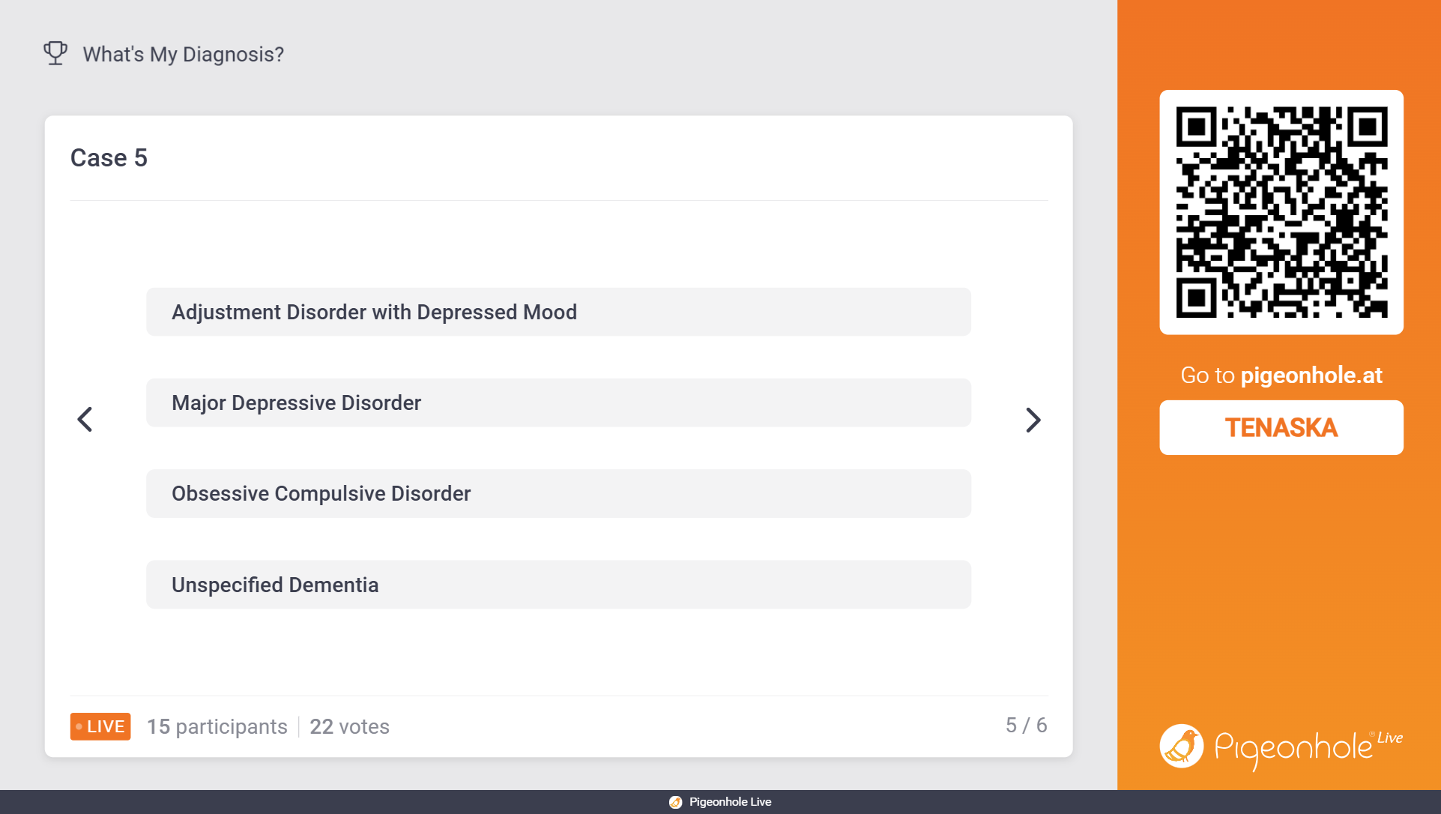

Slide 13
Case 6
I am a 25-year-old woman with a family history of my mother being hospitalized psychiatrically for unknown reasons. I present with a 6-month history of 2-3 week periods of low mood, decreased interest, decreased energy, poor sleep, and weight loss. Over the past 6 months I have lost about 15 pounds without trying. In between these episodes I feel fine. I am brought in by my partner because over the past week I have been increasingly more disorganized at home. I have not paid my bills this month and instead sent money to a TV preacher who I do not usually follow. I say that he has been speaking to me directly through the TV. I have not been sleeping but remain energetic. My behavior in the office can best be described as frenetic and outlandish.
What’s my diagnosis?

Slide 14
