Slide 1
Can one person make a difference?

Slide 2
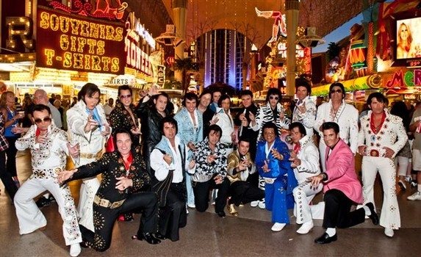
Number of Elvis Impersonators
85000
177

Slide 3
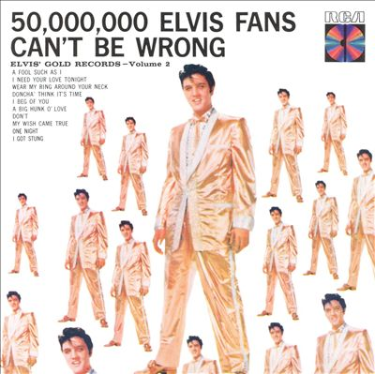
Number of Elvis Impersonators
85000
By year 2040, there will be over 16 million Elvis
Impersonators
By year 2075, less than 100 years after his death,
100% of the world will be Elvis Impersonators
P(t) = P₀e^{rt}
177

Slide 4
Overall Conclusions
What you are doing is extraordinary
What you are doing will make a difference
The practice of psychiatry is no more frightening than your usual day job
There is nothing mysterious or magical about psychiatry

Slide 5
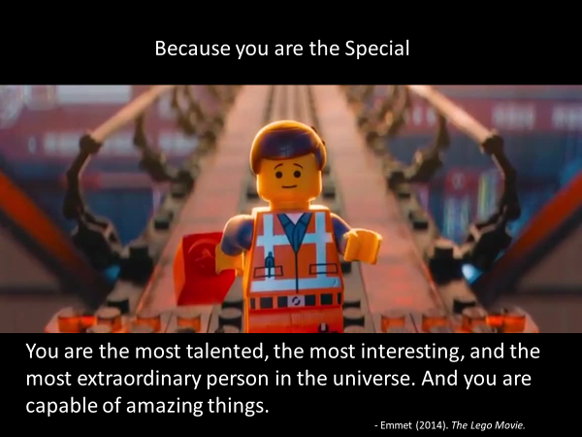

Slide 6
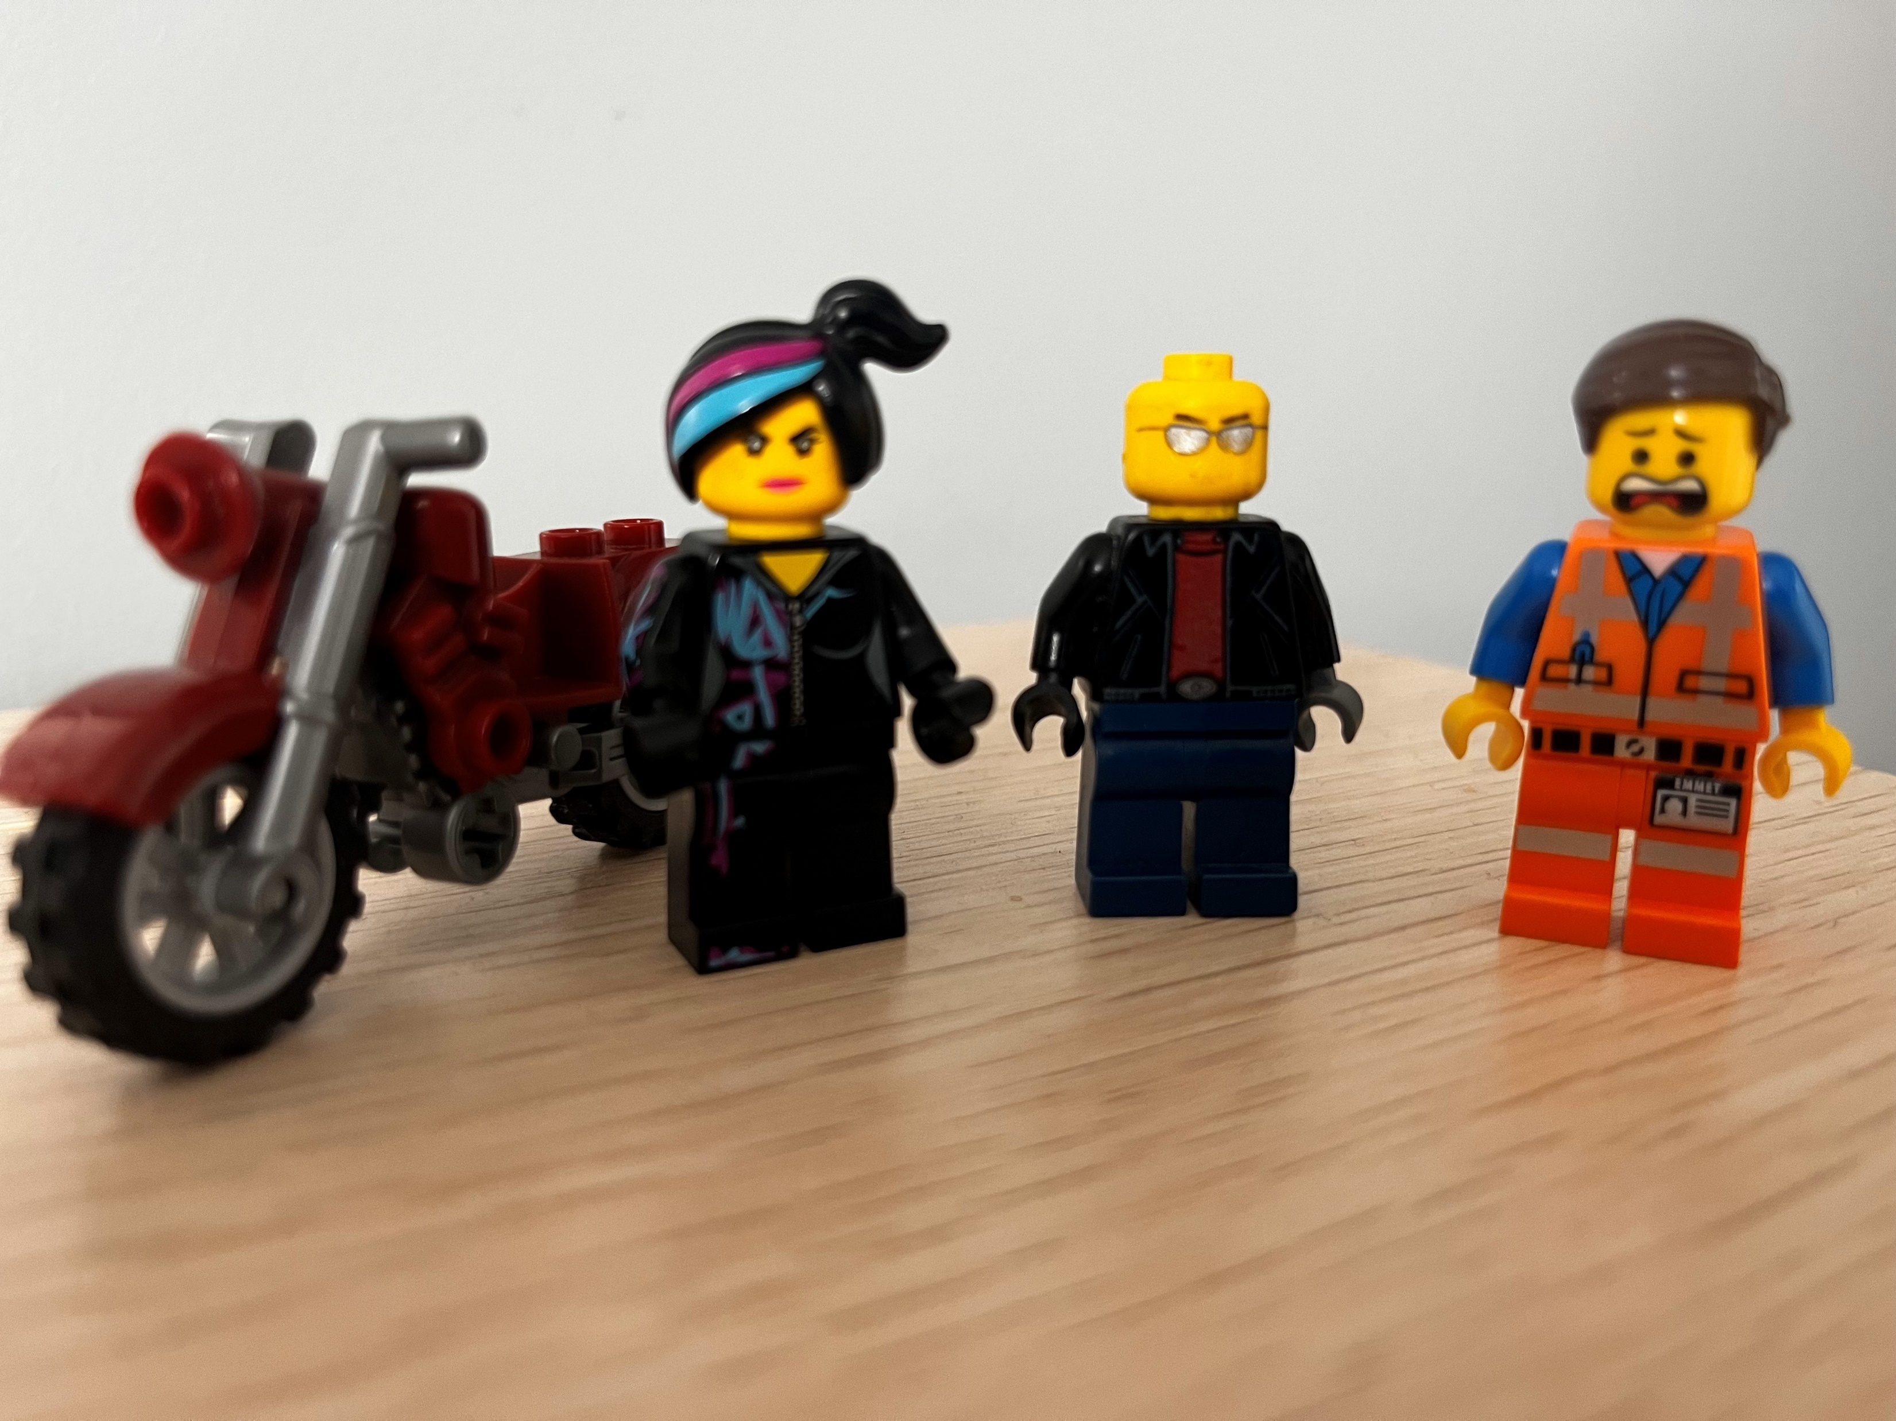
Thank You!!!

