Slide 1
Assessment and Treatment of ADHD

Slide 2
Epidemiology
prevalence of ADHD is between 3% and 8% of school-aged children
prevalence in boys being 3-fold to 6-fold higher than in girls
estimated that between 50% and 70% of will continue to be symptomatic as adults

Slide 3

PEARL: Only a minority outgrow ADHD

Slide 4
ADHD –
Areas of Impairment
Inattention
Impulsivity
Hyperactivity
Notes:
Looks different and plays out different

Slide 5
Diagnosis
Symptoms of Inattention
Careless
Difficulty sustaining attention in activity
Doesn't listen
No follow-through
Avoids/dislikes tasks requiring sustained mental effort
Can't organize
Loses important items
Easily distractible
Forgetful in daily activities
Symptoms of Hyperactivity/Impulsivity
Squirms and fidgets
Can't stay seated
Runs/climbs excessively
Can't play/work quietly
"On the go"/"driven by a motor"
Talks excessively
Blurts out answers
Can't wait turn
Intrudes/interrupts others
6/9 core symptoms (5/9 if 17+) for 6 months, starting before age 12, and causing significant impairment at home, at school, and/or in peer relations.

Slide 6

PEARL: ADHD has 3 subtypes…only 1 is found in nature

Slide 7

PEARL: ADHD isn’t just a school disorder

Slide 8
ADHD Assessment
Medical history review
If medical history is unremarkable, laboratory or neurological testing is not indicated
Neuropsychological Evaluation
Life history
Mental status exam
Rating scales
Assess for comorbidity
Notes:
Importance of early diagnosis
Collaboration between teachers, parents, and healthcare professionals
Individualized Education Programs (IEPs) and 504 Plans

Slide 9
Differential Diagnostic Considerations
Learning Disorders
Anxiety Disorder
Depression
Obsessive-Compulsive Disorder
Bipolar Disorder
Psychosis
Autism Spectrum Disorder
Tics/Tourette’s
Sleep Apnea and other sleep disorders
Speech and Language Disorder
Attachment Issues
Hearing Issues
Vision Issues
Pain
Substance use (intoxication/withdrawal)

Slide 10

PEARL: High IQ delays diagnosis

Slide 11
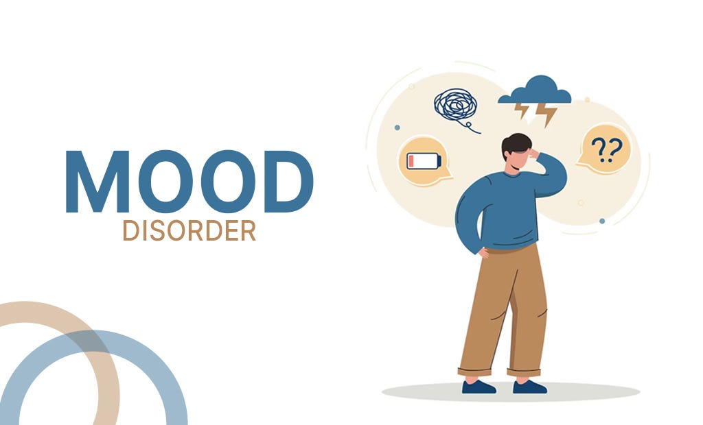
PEARL: ADHD is not a mood disorder

Slide 12
Common Classroom Accommodations
Minimize distractions
Preferential seating
Increase distance between desks
Extended time
Breaks (movement/brain)
Separate location
Assistive technology
Designated note-taker
Break long assignments into smaller chunks
**Accommodations need to be specific to the student and environment.
There is no ‘one size fits all’**
Notes:
Allow student to run errands or stand at times

Slide 13
Common Classroom Supports
Preview upcoming information (visual and auditory channels)
Provide assignments/expectations and other information (syllabus, charts for organization) in writing
Given ample notice for project/assignment deadlines
Post a written schedule for daily routines and rules
Keep instructions simple, clear, and concrete
Demonstration of understanding
Notes:
Allow student to run errands or stand at times

Slide 14
Academic Skills Interventions
Organization skills training/executive functioning coaching
Homework support
Training adaptive skills (e.g. note taking, social skills)

Slide 15
Helping them Organize
Minimize distractions in working environment
Encourage organizational system
  Recommend binders / dividers
  Color-coded folders/tabs
Provide planners and supervise writing down of assignments
Allow student to keeps sets of books / resources at home
Private signal/cue to help student stay on task/redirect
Wrap-up/Check-in

Slide 16
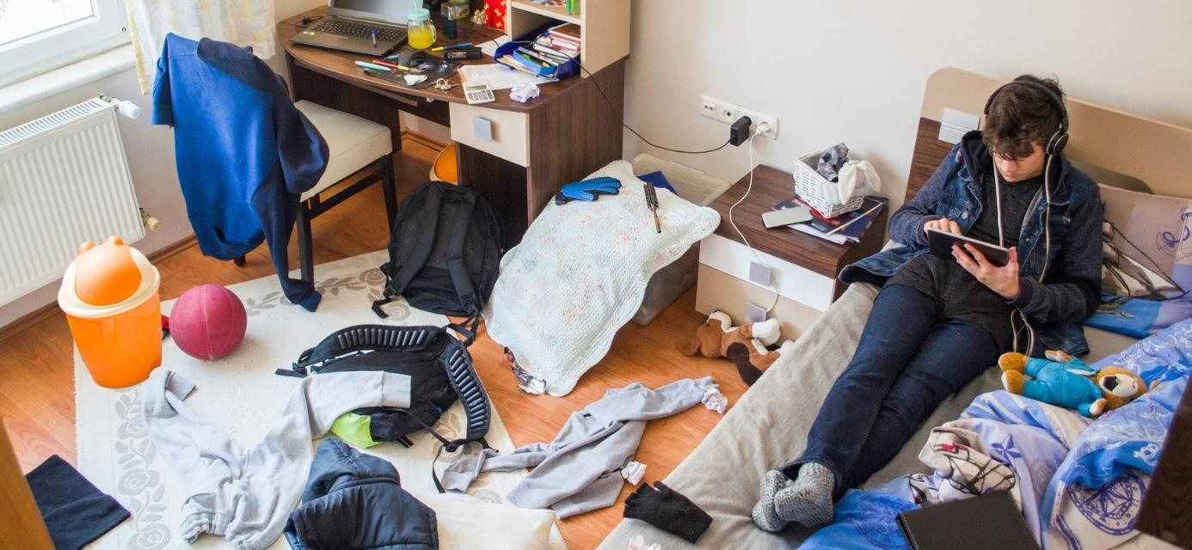
PEARL: Ask about the bedroom floor

Slide 17
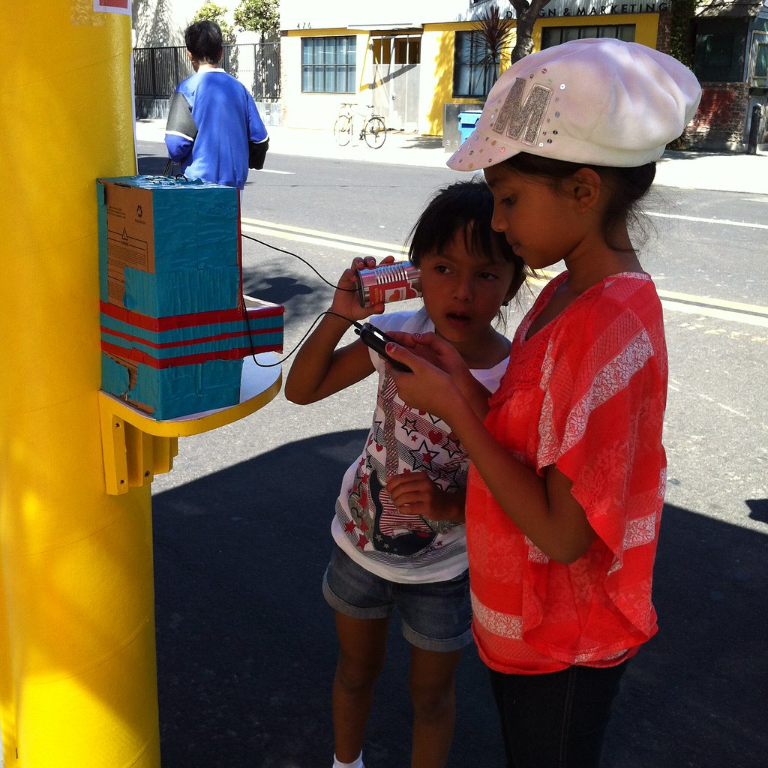
Communication is Key
Get their attention
Eye contact
Non-verbal cues
Give advanced notice to transitions
Give two choices
Frequent praise
Facial Expression
This Photo by Unknown Author is licensed under CC BY-NC-ND
Notes:
Before speaking to your child, try and get their attention. It can be difficult for a child with ADHD to try and carry on doing a task while also listening to someone speaking. Getting their attention first means they can stop what they are doing and encourages them to listen to you while talking to them.
Use EXPRESSION! Try to use facial expressions and gestures when speaking to your child; this emphasises what you are saying and gives your child clues to what you mean. This also increases your child’s understanding of non - verbal communication by linking words with gestures and faces. Also try to keep your voice lively to hold your child’s attention.

Slide 18
Facial Expression…
Facial expressions and gestures
  Emphasize what you are communicating
  Offer clues to what you mean/clarification
  Increase understanding of nonverbal communication; connecting by linking words with gestures with faces
  Engagement - captures attention
Notes:
Before speaking to your child, try and get their attention. It can be difficult for a child with ADHD to try and carry on doing a task while also listening to someone speaking. Getting their attention first means they can stop what they are doing and encourages them to listen to you while talking to them.
Use EXPRESSION! Try to use facial expressions and gestures when speaking to your child; this emphasises what you are saying and gives your child clues to what you mean. This also increases your child’s understanding of non - verbal communication by linking words with gestures and faces. Also try to keep your voice lively to hold your child’s attention.

Slide 19
Communication Cont’d
Avoid asking too many questions at once
Give time to respond
Use simple repetitive language
Use the young person’s own words
Model the right way to communicate

Slide 20

PEARL: All attention is not created equal

Slide 21
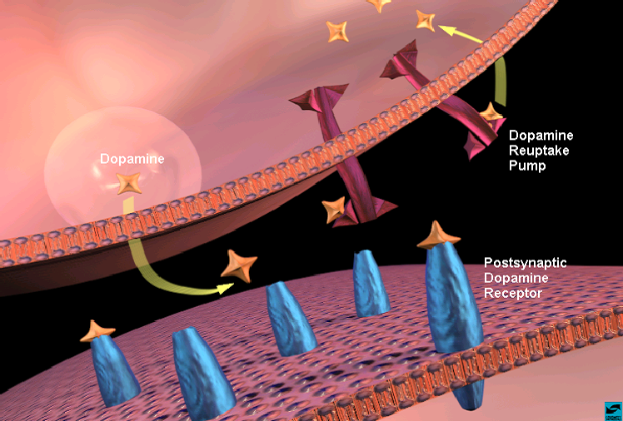
ADHD Treatments Primarily Affect Catecholamines
Adapted from NIDA presentation:The Brain & the Actions of Cocaine, Opiates, and Marijuana

Slide 22
Dopamine
Reuptake Pump
Dopamine
Dopamine Receptor

Slide 23
Dopamine
Reuptake Pump
AMP
Dopamine
AMP, MPH
Dopamine Receptor

Slide 24
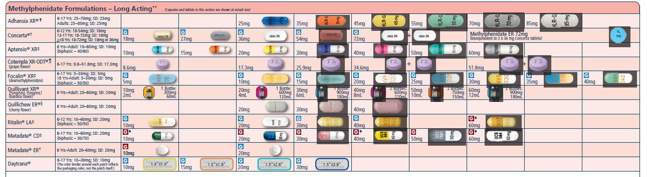
Medications used for ADHD

Slide 25
Rough Comparison* of Long-Acting Stimulant Serum Concentrations
*Data interpolated from published studies.

Slide 26
Safety of Stimulants:
Common Reactions
Headache, upper respiratory tract infection, abdominal pain, vomiting, loss of appetite, insomnia, increased cough, pharyngitis, sinusitis, dizziness, irritability, dysphoria

Slide 27
Safety of Stimulants:
Common Reactions
Of the problematic reactions:
  Loss of appetite can be partly mitigated by dosing with or after breakfast
  Insomnia can be partly mitigated by the use of longer acting once daily medications
  Most of the other side effects decreased by either waiting or decreasing the dose

Slide 28
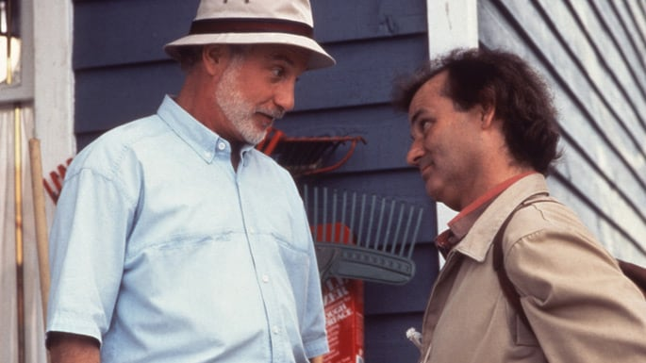
PEARL: You can’t take a vacation from your problems…even for the weekend

Slide 29
Safety of Stimulants: Adverse Events
Weight loss and slowed longitudinal growth
New onset of tics or Gilles de la Tourette
Liver toxicity
Sudden cardiac death
Substance abuse

Slide 30

Nonpharmacologic interventions for ADHD

Slide 31
Risk of Untreated ADHD
Frustration
Low self-esteem
Relationships challenges
Poor academic performance
Substance abuse and misuse
Accidents and injuries
Depression/demoralization
Anxiety
School refusal/dropout
School disciplinary actions
Legal issues
Notes:
Identification + early intervention (school’s role)
30% of adolescents with untreated ADHD fail to complete high school, compared with 10% of those without ADHD.

Slide 32
Untreated
ADHD
School failure
Suspension
Expulsion
School refusal
Dropout
Unemployment/Underemployment
Legal issues
Incarceration
Poorer mental health
Poorer physical health
Substance use and addiction

Slide 33


PEARL: The adult life of untreated ADHD is different than treated ADHD

