Slide 1
Bipolar Disorder and Psychosis
Notes:
"Psychotic disorders are among the most serious psychiatric conditions you will encounter. They carry substantial mortality risk, and your intervention can be life-saving.”
"The ED is often the first point of contact for individuals developing psychotic disorders—30.5% had a mental health ED visit in the 3 years before their first psychosis diagnosis. [8] Your recognition and compassionate response can connect patients to early intervention that improves outcomes."

Slide 2
Bipolar Disorder: prevalence and mortality
Bipolar disorder affects ~8 million adults in the US and ~40 million worldwide
Suicide risk in bipolar disorder is 20-30 times higher than the general population
15-20% of people with bipolar disorder die by suicide
Life expectancy is reduced by 12-14 years in bipolar disorder
Notes:
1.Diagnosis and Treatment of Bipolar Disorder: A Review.
The Journal of the American Medical Association. 2023. Nierenberg AA, Agustini B, Köhler-Forsberg O, et al.
2.ED Visits for Schizophrenia Spectrum Disorders During the COVID-19 Pandemic at 5 Campus Health Systems.
JAMA Network Open. 2023. Singh P, Nawaz S, Seiber EE, et al
3.Bipolar Disorder.
Lancet. 2025. Singh B, Swartz HA, Cuellar-Barboza AB, et al
ED Trends:
ED visits for schizophrenia spectrum disorders increased 15% during the COVID-19 pandemic [2]
30.5% of individuals with a first psychotic disorder had a mental health ED visit within 3 years prior to diagnosis
4.Mental Health Service Use Before First Diagnosis of a Psychotic Disorder.
JAMA Psychiatry. 2024. Tempelaar W, Kozloff N, Mallia E, Voineskos A, Kurdyak P
The average delay from symptom onset to correct diagnosis is 6 years—six years of suffering that proper assessment could shorten
First-episode psychosis has a critical window—early intervention in the first 3 years dramatically improves long-term outcomes

Slide 3
Bipolar Disorder
Mood disorder characterized by episodes of depression and elevated mood
Two main types:
  Bipolar I: Full manic episode (7+ days of DIGFAST or severe enough to require hospitalization) + depressive episodes. Psychotic features common.
  Bipolar II: Hypomanic (4+ days, noticeable but not severe) + depressive episodes. No psychosis.
Manic/hypomanic episodes are the defining feature, but depression is the most common presentation
70-80% of symptomatic time consists of depressive episodes
Notes:
1.Diagnosis and Treatment of Bipolar Disorder: A Review.
The Journal of the American Medical Association. 2023. Nierenberg AA, Agustini B, Köhler-Forsberg O, et al
Prevalence: [1][3]
Lifetime prevalence: ~2% globally; 4.4% in the US (bipolar I and II combined)
12-month prevalence: Bipolar I 0.4%, Bipolar II 0.3%
Equal prevalence in males and females for bipolar I
Peak onset: Ages 15-25 years
Critical Finding: The time between first depressive episode and bipolar diagnosis is approximately 9 years—early recognition is crucial

Slide 4
Bipolar I
Mania:
“I haven’t slept in three days and am going to solve world hunger”
Cannot function at work
May have psychotic features
Often requires hospitalization
Vieta et al. Nature Reviews Disease Primer 2018
Notes:
What you might see in mania:
Extremely energetic, "wired," or agitated
Talking rapidly, jumping between topics
Grandiose claims ("I'm going to solve world hunger")
Irritable, argumentative, or aggressive
Engaging in risky behaviors (driving recklessly, spending money)
Not sleeping but not tired

Slide 5
Bipolar II
Hypomania:
Coworkers notice: “Wow, Sarah is really on fire this week!”
Patient feels great, productive, creative
Sleeping 5 hours instead of 8
Still going to work, paying bills, functioning in life
Vieta et al. Nature Reviews Disease Primer 2018
Notes:
Why you must ask: Patients love hypomania. They feel incredible. They won't volunteer this information. When you see someone for depression, always ask:
"Have you ever had periods where you felt the opposite—where you had lots of energy, needed less sleep, felt on top of the world?"
If they say yes, you've potentially identified bipolar disorder, which changes everything about treatment

Slide 6
Prescribing trends
Rhee, Olfson, Nierenberg, Wilkerson. AJP 2020

Slide 7
Epidemiology of Schizophrenia
Life prevalence of 1%
Male to female ratio: 1.4/1
Average age of onset 16-25 years old
  Earlier in men, later in women
Genetic factors
  Overall genetic heritability is 65-80%
  Not a single gene disorder, more than 100 different loci are identified
  Advanced paternal age (>45 yo, 2x risk, >50yo, 3x risk for schizophrenia)
Environmental factors – viral exposure in gestation, starvation in prenatal period
Social factors¹- immigration, sexual trauma, bullying, major social stressors (losses/transitions)
1. McGrath JJ et al. Am J Psychiatry 2011;168;1235.

Slide 8
Morbidity and mortality
Schizophrenia is associated with a 20 year decrease in life expectancy¹ and a 4 fold increase in mortality²
  Premature mortality is due to cardiovascular dz, respiratory dz, infections and cancers³
Even in first episode psychosis (FEP), cardiac and metabolic abnormalities are present early on⁴
Related to underlying illness, unhealthy lifestyle, antipsychotic meds, inadequate medical care
1. Druss et al. Med Care 2011;599-604. 2. Revier at al. J Nerv Ment Dis 2015;379-386. 3. Olfson et al. JAMA Psychiatry 2015;1172-1181. 4. Correll et al. JAMA Psychiatry 2014;1350-1363.

Slide 9
DSM 5 diagnostic criteria: Schizophrenia
Two or more symptoms for one month (at least one *):
  *Delusions: fixed, false beliefs
    Delusions of grandeur, control, persecution, somatic
  *Hallucinations
    Classically auditory
  *Disorganized speech: tangentiality, loosening of associations, word salad
  Disorganized or catatonic behavior: odd, irrational, purposeless activity
  Negative symptoms
    The A’s: Affect (blunted), Alogia, Asociality, Avolition, Anhedonia
Decreased level of functioning in one or more major area
At least 6 months duration
Notes:
The American Psychiatric Association defines schizophrenia in the DSM-5 using six diagnostic criteria (A through F) that must all be met. [1]
Criterion D requires that schizoaffective disorder and depressive or bipolar disorder with psychotic features have been ruled out because either: 1) no major depressive or manic episodes have occurred concurrently with active-phase symptoms, or 2) if mood episodes have occurred during active-phase symptoms, they have been present for a minority of the total duration of the active and residual periods. [1]
Criterion E requires that the disturbance is not attributable to the physiological effects of a substance (e.g., a drug of abuse, a medication) or another medical condition. [1]
Criterion F specifies that if there is a history of autism spectrum disorder or a communication disorder of childhood onset, the additional diagnosis of schizophrenia is made only if prominent delusions or hallucinations, in addition to the other required symptoms of schizophrenia, are also present for at least 1 month (or less if successfully treated). [1]
The diagnosis involves recognizing a constellation of signs and symptoms associated with impaired occupational or social functioning, as no single symptom is pathognomonic of the disorder.

Slide 10
Cognitive symptoms
Cognitive performance is 1-2 SD below age matched controls¹
Affective areas: attention, executive function, memory, processing speed, social cognition²
Cognitive decline is nearly universal, present before the onset of psychosis, and worsens during the illness ^{3, 4, 5}
Cognitive impairment is specific to schizophrenia; not seen in bipolar disorder or depression ^{4, 5, 6}
1. Keefe et al, Schizophr Bull 2007. 2. Nuechterlein et al, Schizophr Res 2004. Kahn et al, JAMA Psych 2013. 4. Mollon et al, JAMA Psychiatry 2018. 5. Zanelli et al, Am J Psychiatry 2019. 6. Meier et al, Am J Psychiatry 2014

Slide 11
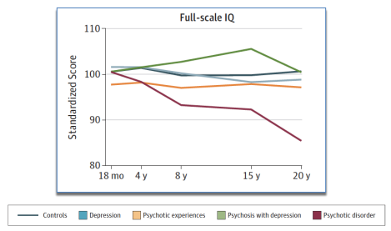
Course of Cognitive Development from Infancy to Early Adulthood in the Psychosis Spectrum
Kraepelin: Dementia Praecox
Early and Progressive deterioration
Each episode leads to further deterioration
Compare to bipolar disorder, which has full inter-episode recovery of function
Mollon et al, JAMA Psychiatry 2018;270 -279.

Slide 12
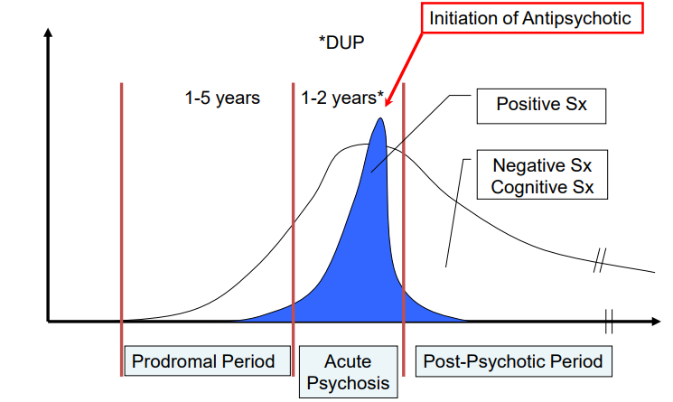
Stages of illness
Based on Häfner, ABC Schizophrenie studie
Notes:
First break psychosis (late teens to late 20’s)
Opportunity to build initial relationship with mental health system
Often have family system in place
Best likelihood for longitudinal symptom recovery
First episode clinics
Family and patient teaching, anticipatory guidance
First decade
May still have family involvement
May have system level involvement
More likely to seek independence, balancing dependence
‘Middle Age’ (Mid 30’s-Late 50’s)
Family may be less present
May have DMH involvement
Depending on severity of illness, goals may be symptom reversal vs symptom control
Late Stages: (Late 50’s or early 60’s-onward)
Greater impairment, longer course of psychotic episodes, more vulnerable neural substrate
Higher risk of longer term care, dementia, poorer ADLs/IADLs
Depending on severity of illness, goals may be symptom reversal vs symptom control

Slide 13

Medication Non-adherence
Between 50 -75% patients with schizophrenia exhibit full or partial non-adherence to pharmacological treatment (Rummel-Kluge, 2008)
Keith and Kane, 2003
  Within 7-10 days of medication initiation, 25% are noncompliant
  50% are off medication after 1 year
  Up to 75% after 2 years

Slide 14
Psychotic Disorders spectrum
Disorder | Duration | Key Features
Brief Psychotic Disorder | 1 month | Full recovery expected
Schizophreniform Disorder | 1-6 months | May progress to schizophrenia
Schizophrenia | ≥6 months | Chronic course, functional decline
Schizoaffective Disorder | Variable | Psychosis + mood episodes (concurrent or independent)
Delusional Disorder | ≥1 month | Only delusions, functioning preserved
Bipolar I with Psychotic Features | During mood episodes | Psychosis only during mania/depression
Notes:
9.Psychotic Disorders.
The New England Journal of Medicine. 2018. Lieberman JA, First MB

Slide 15
Thank you!

Slide 16
Bipolar Disorder/ Manic Symptoms
A. Distinct period of abnormally and persistently elevated, expansive, or irritable mood, lasting at least 1 week (or any duration if hospitalization is necessary)
B. During the period of mood disturbance, 3 (or more) of the following symptoms have persisted (4 if mood is only irritable) and have been present to a significant degree: DIG FAST
    Distractibility – easily distracted by irrelevant stimuli
    Indiscretion/Impulsivity – poor judgment, risky behaviors (spending sprees, sexual indiscretions)
    Grandiosity – inflated self-esteem, unrealistic beliefs about abilities
    Flight of ideas or racing thoughts, rapid speech
    Activity increase - goal-directed activity or psychomotor agitation
    Sleep disturbance – reduced need for sleep (feels rested after 3 hours)
    Talkativeness – pressured speech, difficult to interrupt
Psychotic features can occur during mania
Notes:
Hypomanic episode: Elevated/irritable mood + increased energy lasting ≥4 consecutive days
Psychotic symptoms do NOT occur in hypomania by definition
highlight that mania is episodic and a change from baseline
behavior is out of character
the person is energetic, euphoric, but disorganized – great ideas that are not going to lead to anything productive
DIG FAST
Distractibility
Irritability and agitation
Grandiosity
Flight of ideas, racing thoughts
Activities that are pleasurable
Sleep disturbance
Talkative
(pink jumpsuit woman)
🌪️ DIG FAST – Core Symptoms of Mania
D – Distractibility
Definition: Inability to maintain focus; attention is easily pulled away by irrelevant or external stimuli.
Example: While talking about a project, the patient interrupts themselves to comment on a bird outside or the color of your shirt.
I – Irritability and Agitation
Definition: The patient may appear angry, impatient, or restless rather than euphoric. Agitation may be motor (pacing, hand-wringing).
Example: Becomes angry when interrupted or challenged, snaps at loved ones, or appears on edge and fidgety.
G – Grandiosity
Definition: Inflated self-esteem or unrealistic beliefs about abilities, power, or importance.
Example: Believes they have a "special mission from God" or that they are uniquely qualified to run a company despite no experience.
F – Flight of Ideas / Racing Thoughts
Definition: Rapid, loosely connected thought process that feels uncontrollable to the person.
Example: Patient jumps from topic to topic without finishing ideas: “I love painting. Did you see that TV show last night? I should start a fashion line.”
A – Activities with painful consequences
Definition: Engaging impulsively in pleasurable but risky behaviors without regard for consequences.
Example: Reckless spending, unprotected sex, gambling sprees, sudden business investments, or dangerous driving.
S – Sleep (decreased need)
Definition: The person feels rested with significantly less sleep than usual.
Example: Sleeps 2–3 hours per night for several days but reports feeling “energized” and not tired.
T – Talkativeness / Pressured Speech
Definition: Speech is rapid, difficult to interrupt; the person may talk nonstop or move quickly from topic to topic.
Example: You ask one question and receive a 15-minute monologue with little room to interject.
📝 Diagnostic Note
These symptoms must occur during a distinct period of abnormally elevated, expansive, or irritable mood, lasting at least 1 week (or any duration if hospitalization is required).
≥3 symptoms needed if mood is elevated/expansive; ≥4 if mood is only irritable.

Slide 17
Recognizing Psychosis: 5 Domains of abnormalities
Delusions
Persecutory ("They're trying to poison me")
Hallucinations
Negative Symptoms
Diminished emotional expression, avolition, alogia, anhedonia, asociality
Grandiose ("I have special powers")
Referential ("The TV is sending me messages")
Erotomanic, nihilistic, somatic
Auditory most common in schizophrenia (voices commenting, commanding)
Visual more suggestive of medical/substance cause
Disorganized Thinking (Speech)
Derailment, tangentiality, incoherence, "word salad"
Grossly Disorganized or Abnormal Motor Behavior
Unpredictable agitation, catatonia, bizarre postures
Notes:
Delusions - Fixed false beliefs not amenable to change
Hallucinations - Perception-like experiences without external stimulus

Slide 18
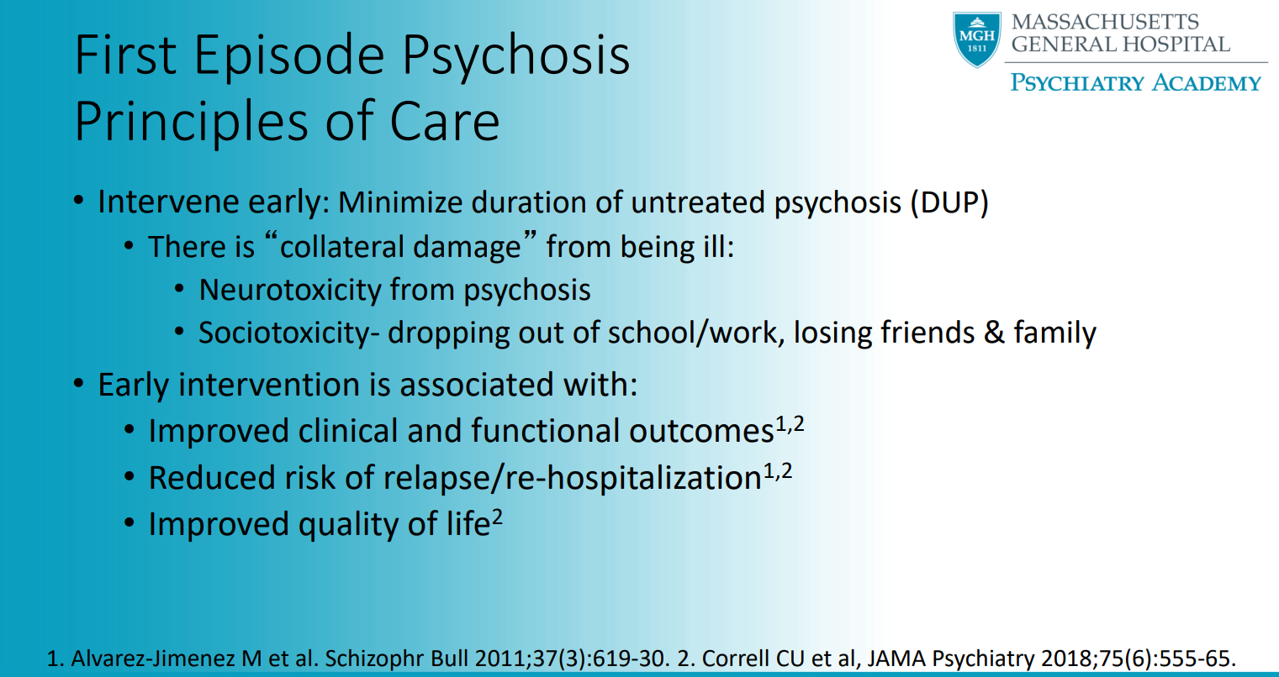

Slide 19
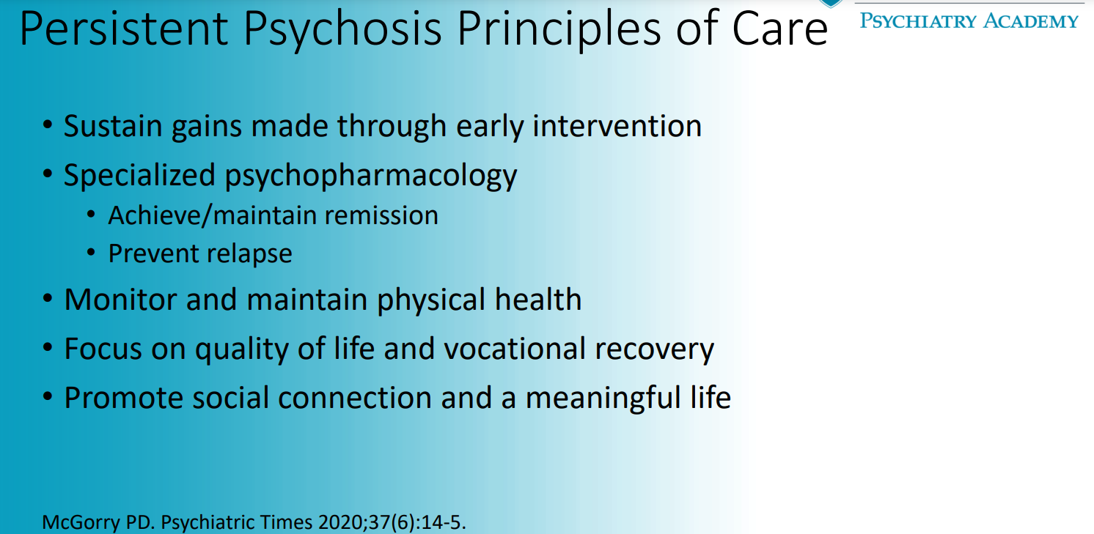

Slide 20
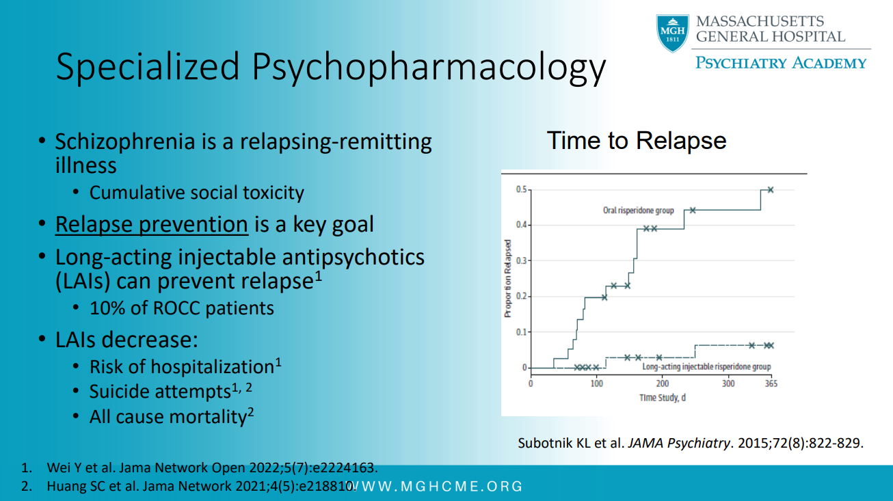

Slide 21
Treatment-resistant schizophrenia
One third of patients with schizophrenia
Failure to respond to two adequate trials of first-line antipsychotics
Distinct biological subtype
Poor response to first-line antipsychotics
  Majority: resistant at presentation starting from a first episode
  Minority: develops resistance over time
Timely clozapine treatment is key

Slide 22
Anosognosia
Profound unawareness of illness
“There is nothing wrong with me”
Coined by the Hungarian neurologist who described patients with paralysis of one side of body following stroke who did not know they were paralyzed.

Slide 23
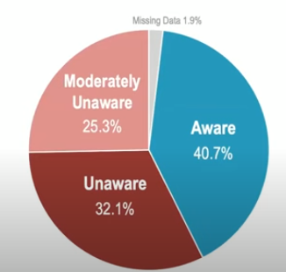
Percentage of patients with schizophrenia with unawareness of mental disorder
Neurobiology
  Moderate to strong correlation between executive (frontal lobe) dysfunction and poor insight
  Brain structural abnormalities
    Reduced gray matter in the prefrontal cortex
Amador XF et al. Awareness of illness in schizophrenia and schizoaffective and mood disorders. Arch Gen Psychiatry. 1994 Oct;51(10):826-36.

Slide 24
DSM-5-TR Schizophrenia and
Other psychotic disorders Published in 2022
“Unawareness of illness” is a symptom of schizophrenia itself rather than a coping strategy. It is comparable to the lack of awareness of neurological deficits following brain damage termed anosognosia.
Includes unawareness of symptoms and may be present through the entire course of schizophrenia.
This symptom is the most common predictor of non-adherence to treatment. It has been found to predict higher relapse rates, increased number of involuntary treatments, poorer psychosocial function, and a poor course of illness (Lysaker et al. 2018).

Slide 25
Therapeutic alliance is key
  We never win on the strength of our argument.
  We win on the strength of our relationship!

Slide 26
Common presentations- course of illness
First break psychosis (late teens to late 20’s)
  Opportunity to build initial relationship with mental health system
  Often have family system in place
  Best likelihood for longitudinal symptom recovery
  First episode clinics
  Family and patient teaching, anticipatory guidance
First decade
  May still have family involvement
  May have system level involvement
  More likely to seek independence, balancing dependence

Slide 27
Common presentations- course of illness
‘Middle Age’ (Mid 30’s-Late 50’s)
  Family may be less present
  May have DMH involvement
  Depending on severity of illness, goals may be symptom reversal vs symptom control
Late Stages: (Late 50’s or early 60’s-onward)
  Greater impairment, longer course of psychotic episodes, more vulnerable neural substrate
  Higher risk of longer term care, dementia, poorer ADLs/IADLs
  Depending on severity of illness, goals may be symptom reversal vs symptom control

Slide 28
Levels of outpatient need
Ability to do Activities of Daily Living
  Bathing, Dressing, Eating
Ability to do Instrumental Activities of Daily Living
  Finances, Cooking, Transportation
Ability to navigate healthcare system
  medications, appointments
Ability to safely navigate society interpersonally
  Relationships, organizations, employment

Slide 29
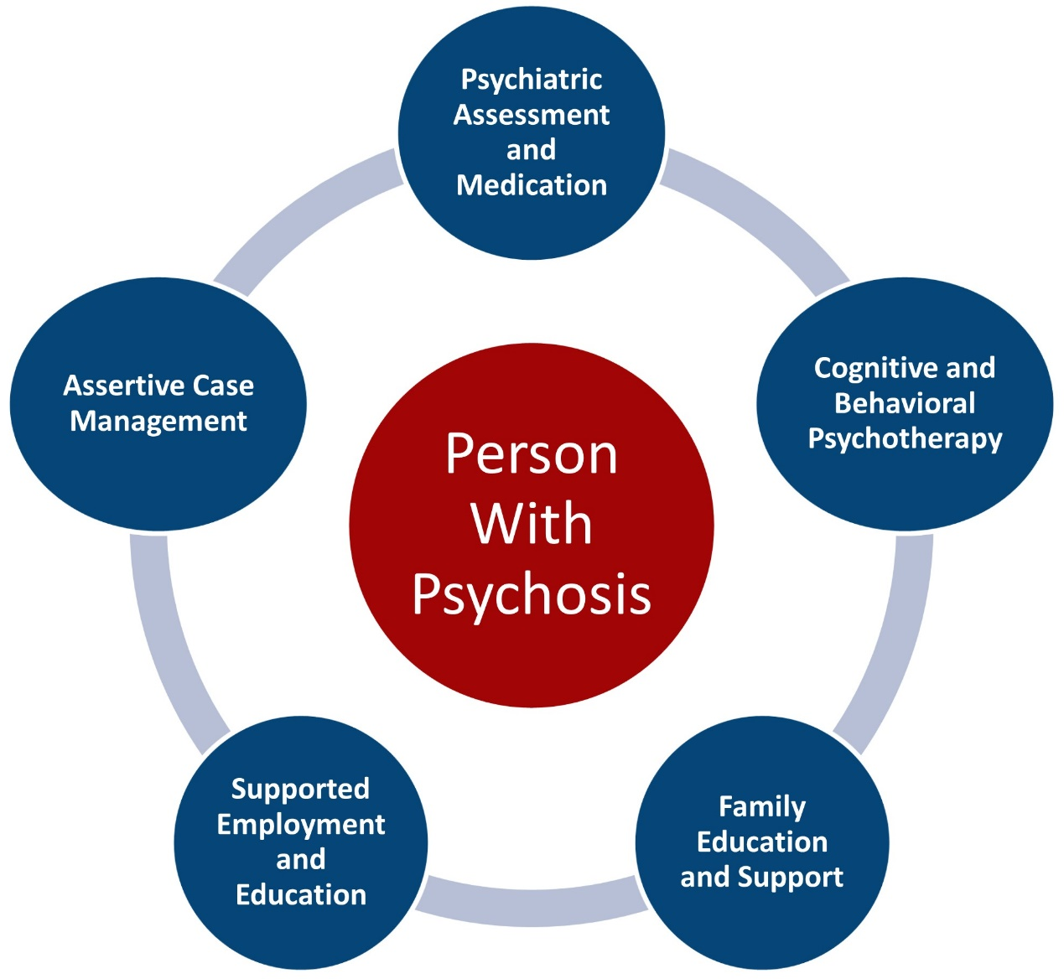
Coordinated Specialty Care
Figure – NIH RAISE-ETP

