Slide 1
Break – Back at 10:20

Slide 2
Bipolar and Psychosis Pearls

Slide 3

Bipolar is the 2nd most heritable of all psychiatric diagnoses

Slide 4

Episodes of mania and psychosis are frequently forgotten

Slide 5
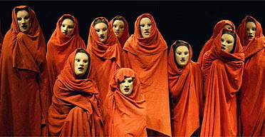
Voices are not random

Slide 6

Better prognosis with schizophrenia in developing world than in developed world

Slide 7

Schizophrenia was always 1% of population…until now

Slide 8

If you truly followed guidelines for bipolar…you’d never use a substance

Slide 9

Affective psychosis has a better prognosis

Slide 10
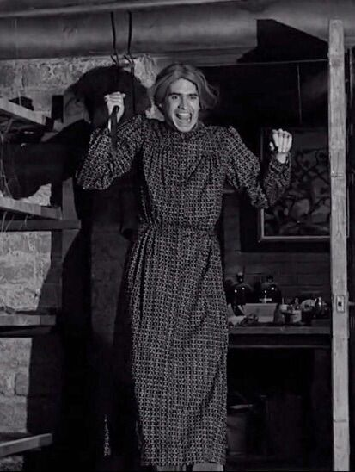
Violence against people in schizophrenia is most likely to be against the mother

Slide 11

People with schizophrenia are more likely to be victims than perpetrators of violence

Slide 12
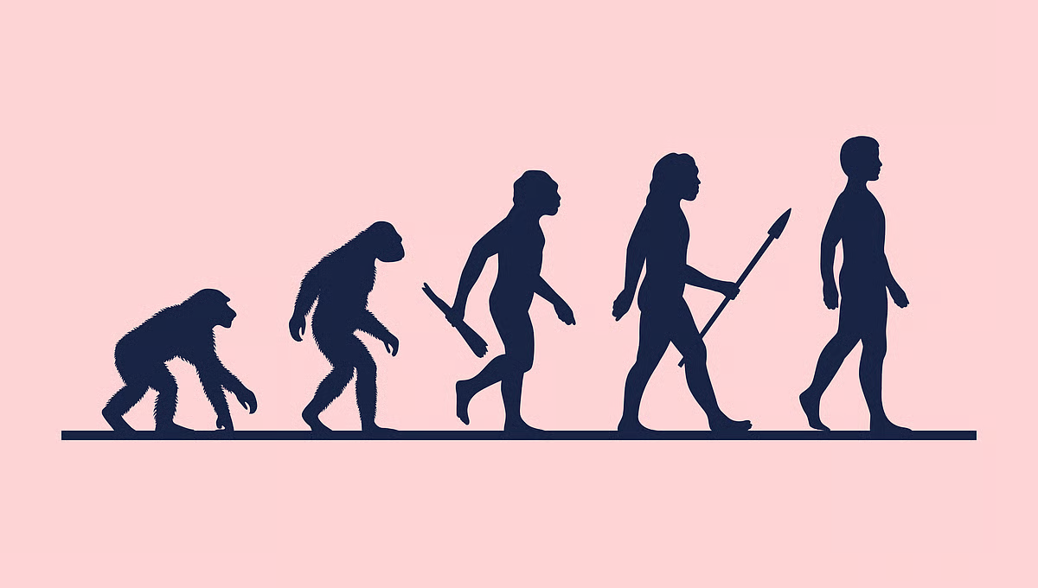
Thought process deteriorates in order

Slide 13
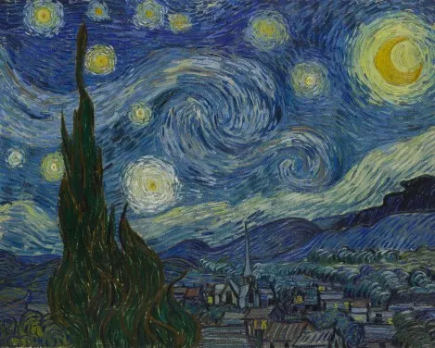
Creative people with bipolar disorder are most creative when euthymic

Slide 14

Homelessness most often transient and unrelated to schizophrenia

Slide 15

Psychosis is as much about disorganized thought as it is about hallucinations

Slide 16
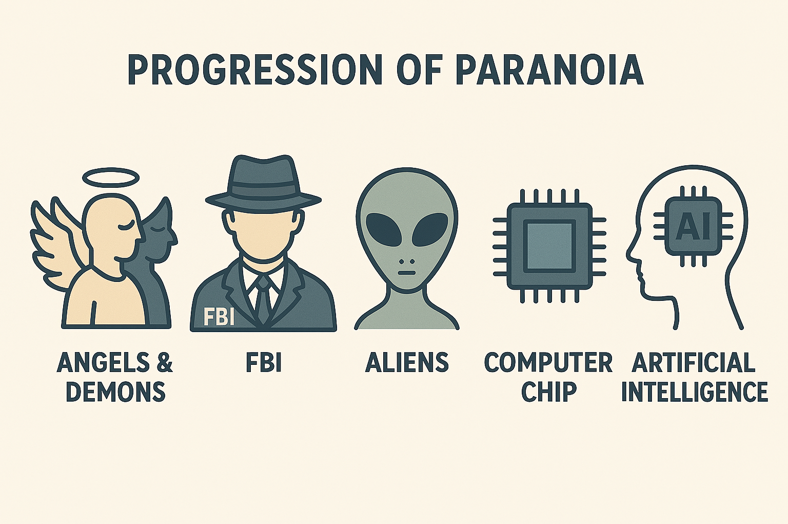
Psychosis starts vague and gets more specific

