Slide 1
Anxiety and the Neuroscience of the Fear Response

Slide 2
Stress Response
“Men are disturbed not by things, but by the views which they take of them.” - Epictetus, Greek philosopher
“It is not what happens to you that matters, but how you take it” - Hans Selye, father of modern endocrinology

Slide 3


Slide 4


Slide 5
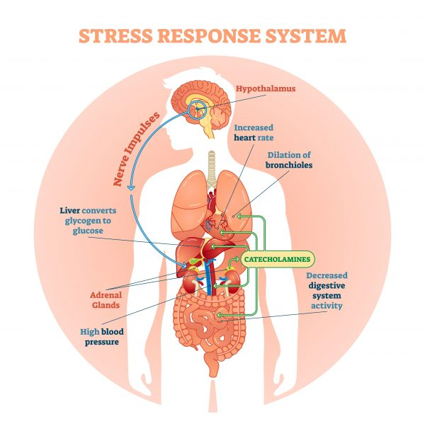

Slide 6

It’s not the leopard chasing us anymore...

Slide 7
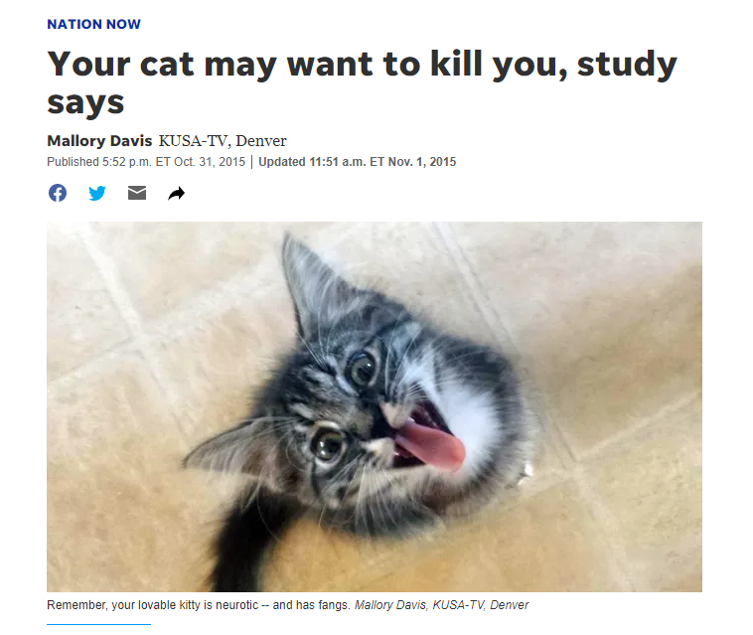

Slide 8
What is the Stress Response?
Stress is commonly defined as a state of real or perceived threat to homeostasis.
Maintenance of homeostasis in the presence of aversive stimuli (stressors) requires activation of a complex range of responses involving the endocrine, nervous, and immune systems, collectively known as the stress response.
(Smith and Vale, 2006)

Slide 9
Divisions of the Nervous System
CNS
PNS
Brain
Spinal
cord
Somatic
Autonomic
Sympathetic
Parasympathetic

Slide 10
Rapid Response to Stress
Adrenal medulla releases epinephrine and norepinephrine
These increase heart rate, increase blood pressure, dilate pupils, increase respiratory rate, increase glucose use by the muscle, increase awareness
Fight, Flight, or Freeze
This occurs within seconds

Slide 11
Features of Anxiety
Sympathetic Nervous System
Subjective feelings of danger, threat
Urge to flee
Pupil dilation
Muscle contraction
Increased HR
Decreased GI mobility
Decreased libido
Increased vigilance

Slide 12
Learning Theory
Anxiety disorder theory often involves principles of learning
  Classical conditioning: pairing of unconditioned and conditioned stimulus
  Operant Conditioning: OCD example

Slide 13
Anxiety Sensitivity
Exaggerated response to physiological alterations associated with anxiety and fear
Initiates positive feedback loop which leads to more anxiety and fear
Cognitive bias towards threat
Temperamentally based
Target of psychotherapy

Slide 14
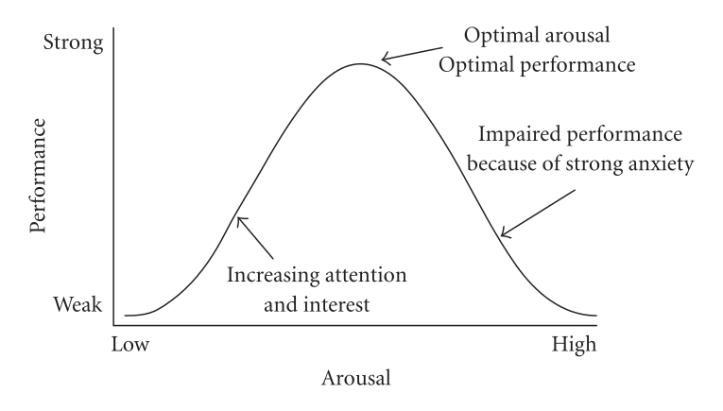
Stress and Resilience
Yerkes and Dodson (1908)

Slide 15
Stress Inoculation
Squirrel monkeys exposed to repeated, short maternal separations show some immediate signs of distress, which are slowly reduced over time.
These monkeys show diminished HPA activation in response to subsequent acute stressors and are better able to regulate negative emotional arousal to later acute stressors.

Slide 16
Three concepts that people perceive as resulting from stressful life events
Changes in self-concept
Relationships with social networks
Personal growth and life priorities

Slide 17

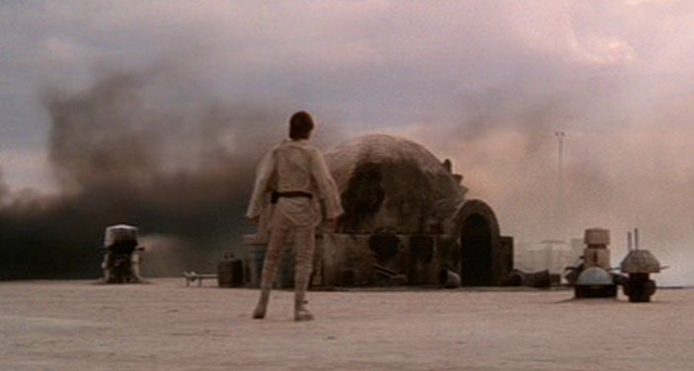




Slide 18



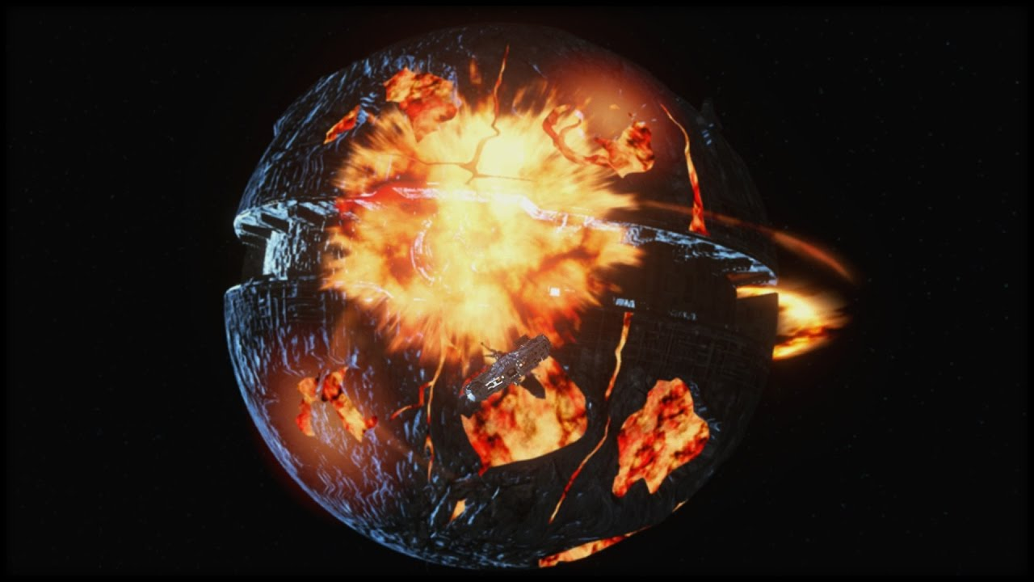


Slide 19
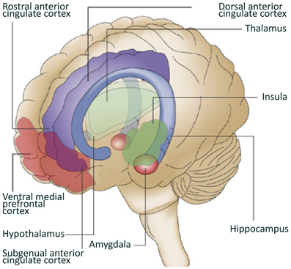
Circuits of Resilience
van der Werff et al (2013)

Slide 20
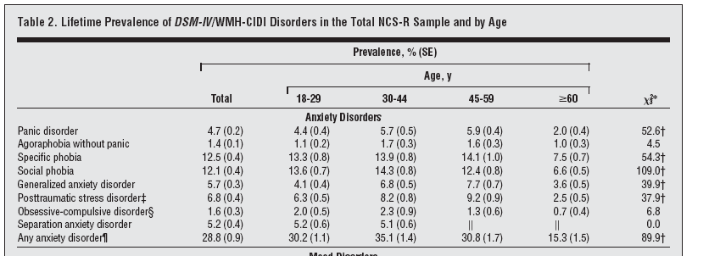
Prevalence of Adult Anxiety Disorders
From Kessler et al., Arch Gen Psych, 2005
Notes:
no matter how you slice it, any age, any gender, if you’re given the choice, anxiety is always the most common psychiatric disorder. most pervasive mental illness
Inside out 2
Fear circuitry -

Slide 21
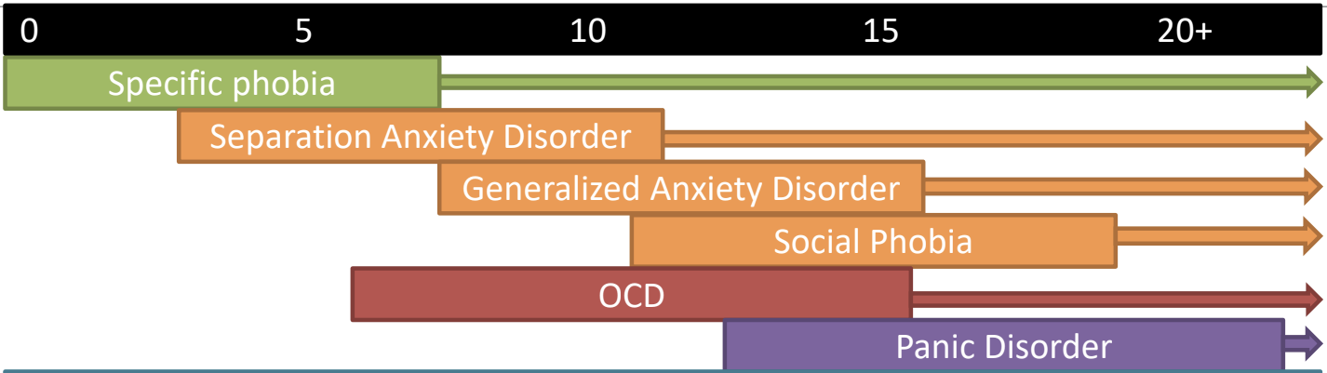
Anxiety and OCD Typical Age of Onset
age
Notes:
Mean age of onset of 6yo, among the 1st psychiatric conditions to emerge, precede or put at risk for other MH disorders
Development of anxiety linked with…during certain development periods
Neurobiology
Temperament – behavioral inhibition (parenting styles matter here)
Psychological factors (e.g., fear learning)
Parent factors – parent w/ d/o higher risk
Cognitive risk factors
Threat bias
Learned behaviors (Avoidance)
Intolerance of uncertainty (cognitive bias that determines how an individual perceives and reacts to uncertain situations)

Slide 22
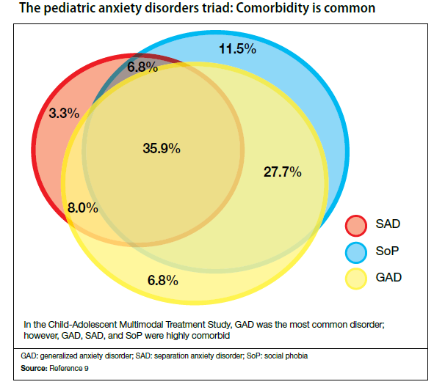
Anxiety Disorders Often Occur Together
Strawn et al., 2012
Notes:
genetically really closely related to social anxiety and separation anxiety.
control and avoidance
panic distinct
ocd distinct
common to all anxiety:
Hypervigilant - chronically scanning environment - external and internal - for anything different.
Reactivity to novel situations - Constantly looking for something that is new, and
Biased interpretation of experiences as threatening - have a threat bias.
ADHD kid might say new things is cool. Anxious kid might see normal new exp and say not for me - I’m going to avoid, it might go bad.
Scanning, reacting, and perceiving the world as threatening, so avoid. Triggered are nl developmental exp, so when can’t avoid get catastrophic, temper tantrums. Parents try to make them comfortable, accommodating fearfulness. Then youngster doesn’t get chance to develop coping strategies through trial and failure, which is how we learn.
(my add: biased interpretation of experiences as threatening and/or catastrophic if they do not go as planned
Avoidant coping
Catastrophic reactions
parental accommodation
midline physical symptoms

Slide 23



Slide 24
Anxiety Assessment Instruments
In primary care sensitivity to detecting cases is low (44.5%) whereas general practitioners’ ability to correctly identify noncases as not having the disorder is high (speciﬁcity 90.8%) (Olariu et al, 2015)
This is consistent with results for depression (sensitivity 50.1%; specificity 81.3%) Mitchell et al 2009
The percentage of under recognition is even higher when diagnoses are unassisted by instrumentation, with a drop of almost 50% in sensitivity levels with respect to assisted diagnoses
Notes:
the people you are pretty certain don’t have anxiety, you’re right
when you’re not sure, your gut might not be enough.

Slide 25
Anxiety Assessment Instruments
Patient Health Questionnaire-4 (PHQ-4)
Hospital Anxiety and Depression Scale (HADS) *
Beck Anxiety Inventory (BAI) *
Generalized Anxiety Disorder-7 (GAD-7) *
State Trait Anxiety Inventory (STAI) *
Mood and Anxiety Symptoms Question. (MASQ)
Anxiety Screening Question. (ASQ-15)
Anxiety Disorders Diagnostic Question. (ADDQ)
Zung Anxiety Scale *
Penn State Worry Questionnaire
Adult Behavior Checklist/Adult Self Report
2-5 min
5-10 min
10-15 min
Rose & Devine (2014)
Notes:
The Four Questions on the PHQ-4:
Anxiety Symptoms:
Feeling Nervous, Anxious, or On Edge:
"Feeling nervous, anxious, or on edge?"
Not Being Able to Stop or Control Worrying:
"Not being able to stop or control worrying?"
Depression Symptoms:
Little Interest or Pleasure in Doing Things:
"Little interest or pleasure in doing things?"
Feeling Down, Depressed, or Hopeless:
"Feeling down, depressed, or hopeless?"

Slide 26
              Thank you!

