Slide 1
PTSD

Slide 2
Case
Tony, a 43-year-old entrepreneur experienced a serious trauma and presented 10 days post‑trauma with intrusive memories, emotional numbness, sleep disturbance, exaggerated startle response, avoidance of driving, and prominent dissociative symptoms such as feeling detached and unreal, while remaining largely functional. When he returned three months later, his symptoms had persisted and worsened, including recurrent nightmares, ongoing avoidance, hypervigilance, irritability, negative beliefs about safety, and significant impairment in work and relationships.

Slide 3


Slide 4
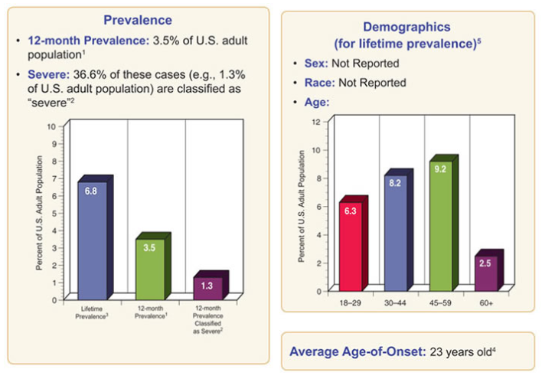
Prevalence of Adult PTSD
From Kessler et al., Arch Gen Psychiatry, 2005

Slide 5
Comorbidity
Other Anxiety Disorders
Depression
Personality Disorders
Sleep Disorders

Slide 6
What Symptoms Are Being Targeted?
Intrusion. For example, nightmares, unwanted thoughts of the traumatic events, flashbacks, etc.,
Avoidance. For examples, avoiding places, people, conversations that might be triggers.
Negative alterations in cognitions and mood. For example, negative beliefs about self or the world, persistent fear, guilt, or shame, inability to experience positive emotions.
Alterations in arousal and reactivity. For example, sleep problems, exaggerated startle, hypervigilance.

Slide 7
Acute Stress Disorder vs. PTSD
Feature | Acute Stress Disorder (ASD) | Post‑Traumatic Stress Disorder (PTSD)
Onset | Begins 3 days to 1 month after trauma | Begins ≥1 month after trauma (may have delayed expression)
Duration | Symptoms last less than 1 month | Symptoms persist more than 1 month
Purpose of Diagnosis | Identifies early trauma response and risk for PTSD | Diagnoses chronic or persistent trauma response
Trauma Exposure | Direct, witnessed, or indirect exposure to actual or threatened death, serious injury, or sexual violence | Same trauma exposure criteria as ASD
Symptom Clusters | 9+ symptoms from any category (intrusion, negative mood, dissociation, avoidance, arousal) | Symptoms required across 4 specific clusters (intrusion, avoidance, negative cognitions/mood, arousal)
Dissociation | Prominent and required symptom option (e.g., depersonalization, derealization, amnesia) | May occur but not required
Functional Impairment | Causes distress or impairment but often time‑limited | Causes clinically significant distress or impairment
Course | May resolve spontaneously or transition to PTSD | Often chronic without treatment
Treatment Focus | Early intervention, psychoeducation, symptom stabilization | Trauma‑focused psychotherapy (e.g., CPT, PE, EMDR)

Slide 8
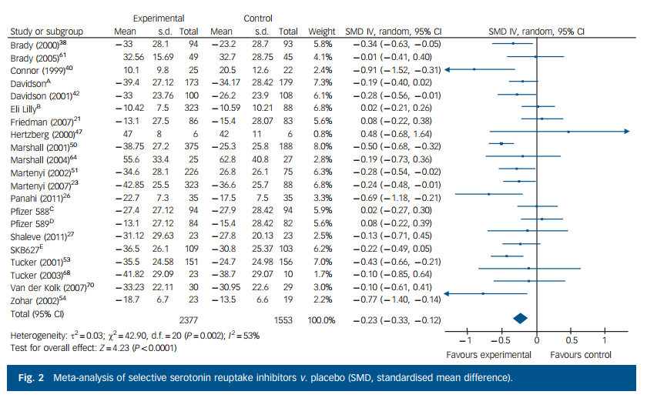
SSRIs
Hoskins et al. (2015)

Slide 9
Other Agents
Prazosin*
  Dosing during the day in addition to bedtime for nightmares shows a significant reduction in daytime intrusive PTSD symptoms and nightmares (Raskind et al. 2013)
    Mean doses were:
      Men: 4 mg midday and 17 mg at HS
      Women: 2 mg midday and 7 mg at HS
D-cycloserine*
  Still in trials. Appears to reduce some of the startle reactivity and reduces cortisol reactivity in animal models
* No FDA indication for PTSD.

Slide 10
Medication Options for PTSD in adults
1st Line
  SSRIs (sertraline, paroxetine, fluoxetine*) – with psychotherapy
2nd Line
  Other novel and traditional antidepressants*; anticonvulsant/mood stabilizers*; second generation AP medications* (if cycling mood or psychotic symptoms)
Not recommended
  Traditional APs*, benzodiazepines*
* = no FDA indication for PTSD
Friedman et al., 2000

Slide 11
Trauma‑focused CBT (TF‑CBT) and Prolonged Exposure (PE)
TF‑CBT and Prolonged Exposure PE are among the most strongly supported treatments for PTSD
Emphasize direct engagement with trauma memories and reminders to reduce fear and avoidance
Core Components:
  Psychoeducation about PTSD
  Skills training (e.g., breathing, emotion regulation)
  Imaginal exposure (recounting traumatic memories)
  In‑vivo exposure (gradual confrontation with avoided situations)
Evidence Base:
  Demonstrated large and sustained reductions in PTSD symptoms
  Effective across military, civilian, and disaster‑exposed populations
  Recommended as first‑line treatments in major clinical guidelines

Slide 12
Cognitive Processing Therapy
CPT is a structured, trauma‑focused cognitive therapy targeting maladaptive trauma‑related beliefs.
Typically delivered over 12 sessions, individually or in groups.
Core Components:
  Identification of “stuck points” related to trauma (e.g., safety, trust, blame)Cognitive restructuring through written and verbal exercises
  Trauma narrative may be included but is not required
Evidence Base:
  Strong empirical support from randomized controlled trials
  Comparable efficacy to PE
  Effective for PTSD with comorbid depression and guilt/shame

Slide 13
Eye Movement Desensitization and Reprocessing (EMDR)
EMDR integrates elements of exposure and cognitive therapy with bilateral stimulation (e.g., eye movements).
Focuses on processing traumatic memories to reduce emotional distress.
Core Components:
  Identification of distressing memories
  Concurrent bilateral stimulation while recalling trauma
  Installation of adaptive beliefs
Evidence Base:
  Numerous RCTs show EMDR is effective and well‑tolerated
  Comparable outcomes to TF‑CBT and PE
  Recognized as a first‑line PTSD treatment by international guidelines

Slide 14
Additional Evidence-Based Treatments
Exposure Therapy (NET): Especially effective for survivors of multiple or complex traumas (e.g., refugees)
Brief Eclectic Psychotherapy for PTSD (BEPP): Combines CBT, psychodynamic, and exposure techniques
Clinical Considerations:
  Trauma‑focused therapies outperform non‑trauma‑focused approaches
  Treatment choice should consider:
    Patient preference
    Comorbid conditions
    Cultural context
    Therapist training and availability
Bottom Line: Trauma‑focused psychotherapies are the gold standard for PTSD treatment

Slide 15
Screening tools for PTSD
Tool | Setting | Time | Use
PC‑PTSD‑5 | Primary care | <1 min | Initial screening
PCL‑5 | Primary/specialty care | 5–10 min | Severity & monitoring
IES‑R | Early trauma/research | ~10 min | Trauma impact
CAPS‑5 | Mental health | 45–60 min | Diagnosis

Slide 16
Clinical Responsibilities to Traumatized Patients
Recognize trauma‑related patterns
Normalize reactions (“Many people experience this after trauma”)
Reduce stigma
Encourage follow‑up and continuity of care
Coordinate referrals and reinforce treatment plans

