Slide 1
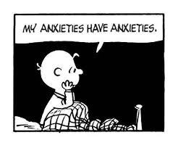
Psychotherapies for Depression and Anxiety
Notes:
Why Therapy Matters
Over 280 million people live with depression globally
Over 50% of individuals don’t respond to medications alone
Psychotherapy can be first-line, adjunctive, or long-term maintenance
Builds patient insight, coping, and behavior change​
Comparative Evidence
Meta-Analysis (Cuijpers et al., 2021):
~41% response rate to psychotherapy vs. 17% in usual care
No major differences between types
Combined treatment (therapy + meds) often superior​

Slide 2
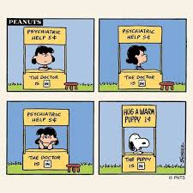
Psychotherapies for Depression:
Overview
Treatment Guidelines for Adults with Depression
Common Factors in Psychological Treatments
Psychotherapies for Depression: Overview and evidence
  Supportive Psychotherapy
  Psychodynamic Psychotherapy
  Interpersonal Psychotherapy
  Cognitive Behavioral Therapy
  Third-Wave Psychotherapies (DBT, MBCT, ACT)
  Problem-Solving Therapy
Notes:
something they can use tomorrow
therapy is operator dependent
use these approaches as tools

Slide 3
Psychotherapies for Depression:
Overview
Treatment Guidelines for Adults with Depression
Common Factors in Psychological Treatments
Psychotherapies for Depression: Overview and evidence
  Supportive Psychotherapy
  Psychodynamic Psychotherapy
  Interpersonal Psychotherapy
  Cognitive Behavioral Therapy
  Third-Wave Psychotherapies (DBT, MBCT, ACT)
  Problem-Solving Therapy
Notes:
Interpersonal Therapy (IPT)
Focus: Improving interpersonal relationships and communication patterns.
Goal: Address relationship difficulties, grief, or role transitions that may be contributing to depression.
Effectiveness: Particularly effective for depression related to interpersonal stress or life changes.
Slide 6: Interpersonal Therapy (IPT) for Depression
The Focus of IPT:
Identifying and improving problematic interpersonal relationships or social functioning that contribute to depression.
Exploring four key areas:
Grief and loss
Role transitions (e.g., becoming a parent, changing jobs)
Interpersonal conflicts
Social isolation
Example:
A patient struggling with the loss of a loved one may benefit from IPT to address grief and find ways to cope and improve social support.

Slide 4
Therapy Guidelines Snapshot
Meta-analysis of 228 RCTs examining psychotherapy for depression response and remission rates (Cuijpers et al., 2021)
  41% of patients respond to psychotherapy compared with 17% in usual care
  About 33% of patients remit compared with 9% - 17% in control conditions
  No significant differences in response rates among specific therapies
  More than 50% of individuals do not respond
Evidence of enduring effects:
  CBT (Cuijpers, 2013)
  Behavioral activation (Dobson et al., 2008)
  Long-term dynamic psychotherapy (Fonagy, 2015)
Notes:
therapies are operator dependent (vs. meds – if you take it it is what it is). therapy is not necessarily therapy
because of that, rates in the community likely lower
Treatment Guidelines Snapshot
APA (2019) & CANMAT (2016):
First-line for mild-to-moderate depression
As effective as medication for many patients
No one “best” therapy — matched to patient preference, symptoms, and resources
Objectives:
The primary goal was to determine the overall effects of psychotherapy on response rates (the proportion of individuals who show significant improvement in symptoms) and remission rates (the proportion of individuals whose symptoms reduce to a level considered clinically minimal) for individuals with depression.
Key Findings:
Overall Effectiveness:
Psychotherapy was found to have a moderate-to-large effect on depression compared to control groups (e.g., waitlist, usual care, or placebo interventions).
The effect sizes for both response and remission rates were statistically significant, indicating that psychotherapy is an effective treatment for depression.
Response Rate:
The response rate (i.e., the proportion of participants showing a clinically significant improvement) for psychotherapy was found to be around 50-60%, depending on the type of psychotherapy.
Remission Rate:
The remission rate (i.e., the percentage of participants who no longer meet criteria for depression) was found to be around 30-40%.
Type of Psychotherapy:
Cognitive Behavioral Therapy (CBT) was one of the most commonly studied forms of psychotherapy, and it showed particularly strong evidence for effectiveness.
Other forms of therapy, such as Interpersonal Therapy (IPT) and psychodynamic therapy, also showed moderate effects, though they were less frequently studied in comparison to CBT.
Comparison to Other Interventions:
Psychotherapy was compared favorably to other common treatments, including medication and combined therapy (psychotherapy + medication). In some cases, psychotherapy was as effective as medication for treating depression, particularly in mild to moderate cases.
Long-Term Effects:
The long-term effects of psychotherapy were also positive, with many individuals maintaining or even improving their outcomes months or even years after treatment.
Moderators of Effectiveness:
Factors that appeared to influence the effectiveness of psychotherapy included the type of depression, severity of depression, and the therapist's experience.
In general, psychotherapies were most effective for individuals with mild to moderate depression and for those who were actively engaged in the treatment process.
Conclusion:
Cuijpers et al.'s 2021 meta-analysis demonstrated that psychotherapy is a highly effective treatment for depression, with significant response and remission rates. While cognitive-behavioral therapy (CBT) stands out as the most studied and effective form of psychotherapy, other therapeutic approaches such as interpersonal therapy (IPT) and psychodynamic therapy also show promising results. Additionally, psychotherapy is often comparable to medication in terms of efficacy, making it a viable option for treating depression, particularly in those seeking non-pharmacological treatments.
This comprehensive analysis supports the continued use and expansion of psychotherapy as a first-line treatment for depression, either alone or in combination with medication, depending on the specific needs of the patient.

Slide 5
Evidence-Based Common Factors
Common Factor | Key Role
Therapeutic Alliance | Foundation of trust and collaboration
Empathy | Enhances safety and emotional validation
Patient Expectations | Boosts motivation and commitment
Engagement | Increases active learning and change
Feedback Use | Allows real-time tailoring of treatment
Therapist Competence | Ensures adaptability and appropriate intervention
Notes:
Therapeutic alliance – most powerful predictor of outcomes – agreement to therapy goals, collaboration on tasks, emotional bond (trust, warmth, empathy)
Empathy – Therapist's ability to deeply understand and reflect the patient’s emotional experience, Enhances engagement, trust, and disclosure
Patient expectations - The belief that therapy will help Instills motivation and a future orientation, Correlated with early improvement
Patient involvement and engagement - Active participation leads to better adherence and outcomes, Includes completing homework, being open, and following through on goals
Use of feedback - Tracking symptoms and progress (e.g., PHQ-9, session rating scales), Adjusting treatment based on feedback improves effectiveness, Helps identify alliance ruptures early
Therapist competence - Skilled therapists adjust their approach based on the individual Competence includes both technical skills and interpersonal effectiveness
The paper by James O. Prochaska, John C. Norcross, and Louis E. Diclemente in 2011, titled "Common Factors in Therapy: An Overview", summarizes the core elements that contribute to effective psychotherapy, regardless of the specific therapeutic approach or technique used. These "common factors" are the shared ingredients across various forms of therapy that contribute to positive outcomes. Here's a summary of the key common factors for effective therapy from this paper:
1. Therapeutic Alliance (Working Alliance)
Key Point: The relationship between therapist and client is the most widely recognized and researched factor that contributes to therapy success.
Description: A strong therapeutic alliance is characterized by trust, respect, empathy, and collaboration. It involves the client feeling understood, supported, and safe within the therapeutic relationship.
Impact: A positive therapeutic alliance is consistently found to be a predictor of better treatment outcomes. It provides a secure base for clients to explore and address difficult issues.
2. Client Expectations and Hope
Key Point: Clients’ expectations about therapy and their hope for change are important contributors to success.
Description: When clients expect therapy to help them and feel hopeful about the process, they are more likely to actively engage in therapy and achieve positive outcomes. This is often referred to as the placebo effect or the expectancy effect, where belief in the efficacy of treatment can itself drive improvements.
Impact: Positive expectations and hope are associated with greater motivation to engage in therapy, increased persistence, and a willingness to confront difficult emotions or behaviors.
3. Empathy and Understanding
Key Point: The therapist’s empathy and capacity to understand the client’s experiences are critical for effective therapy.
Description: Empathetic listening, validation, and understanding the client’s perspective without judgment allow the client to feel heard and supported. Empathy fosters an environment where the client can process emotions and experience therapeutic change.
Impact: Empathy enhances the therapeutic alliance, builds trust, and helps clients feel comfortable expressing their innermost thoughts and feelings.
4. Encouragement of Emotional Expression
Key Point: Effective therapy encourages clients to express their emotions and experiences openly.
Description: Therapy is more likely to succeed when clients can express their feelings, particularly emotions they may have repressed or avoided. Emotional expression leads to catharsis, processing, and greater self-awareness.
Impact: Emotional processing in therapy helps clients confront underlying issues, reduce psychological distress, and develop more adaptive coping strategies.
5. Client Involvement and Engagement
Key Point: Active involvement and engagement by the client are crucial for therapy to be effective.
Description: Clients who actively participate in therapy, including attending sessions regularly, completing homework assignments, and applying therapeutic concepts outside of sessions, are more likely to achieve better outcomes.
Impact: High levels of engagement lead to greater commitment to change, more opportunities for learning and growth, and more meaningful therapeutic progress.
6. Instillation of Hope and Meaning
Key Point: Therapy is most effective when it provides the client with a sense of hope and meaning about their struggles.
Description: The therapist can instill hope by focusing on the client’s strengths, emphasizing positive change, and helping the client find meaning in their difficulties. Clients who believe that change is possible are more likely to make meaningful progress.
Impact: Clients with hope and meaning tend to be more resilient, able to face challenges, and more motivated to continue therapy and adopt new behaviors.
7. Cultural Sensitivity and Contextual Understanding
Key Point: The therapist's cultural sensitivity and understanding of the client’s social and cultural context is essential.
Description: Therapists need to be aware of and respectful toward the client’s cultural background, values, and life experiences. This sensitivity enhances the relationship and ensures that the therapy is relevant and respectful of the client's identity.
Impact: When therapy is culturally responsive, clients feel understood and accepted, and the therapeutic process becomes more effective in addressing issues that are relevant to their life experiences.
8. Therapist’s Competence and Professionalism
Key Point: The therapist’s skill level, competence, and professionalism are key factors in determining therapy outcomes.
Description: A therapist’s expertise in the chosen therapeutic modality, along with their ability to adapt techniques to fit the client’s needs, significantly impacts success. Professionalism includes not only technical expertise but also ethical behavior, reliability, and appropriate boundaries.
Impact: Competent therapists are more effective in applying the right interventions, handling challenges in therapy, and maintaining a productive therapeutic environment.
9. Use of Feedback
Key Point: Feedback from the therapist to the client, as well as feedback from the client to the therapist, plays an important role in the effectiveness of therapy.
Description: Regular feedback helps both the therapist and client assess progress, clarify misunderstandings, and adjust the treatment approach as needed. Feedback fosters a sense of collaboration and ensures that the therapy is on track.
Impact: Feedback helps clients stay engaged, recognize their progress, and address any obstacles that may arise during the course of treatment.
10. Cognitive and Behavioral Change
Key Point: Most therapeutic approaches facilitate cognitive and/or behavioral change to improve mental health.
Description: Therapies often focus on changing unhelpful thoughts, beliefs, or behaviors. Cognitive-behavioral interventions, for example, encourage clients to challenge distorted thinking and engage in more adaptive behaviors.
Impact: Cognitive and behavioral changes lead to shifts in how clients perceive themselves and the world, which can reduce symptoms of mental health disorders, enhance coping skills, and improve overall functioning.
Conclusion:
In Norcross’ 2011 paper, he emphasizes that effective therapy relies on a set of common factors that transcend specific therapeutic techniques or modalities. These factors include the therapeutic alliance, client expectations, empathy, emotional expression, and therapist competence, among others. While different therapeutic approaches may vary in the methods they use, these shared factors are universally critical in promoting client engagement, hope, change, and growth. This integrated understanding of therapy highlights the importance of relational, emotional, and cognitive components in creating an environment conducive to healing and transformation.
By focusing on these common factors, therapists can enhance the effectiveness of treatment, regardless of the specific technique or model they are using.
There are several common factors that can increase the likelihood that therapy will be effective in treating depression. These factors can be related to the therapist, the patient, and the specific context in which therapy is delivered. Here are the key factors that have been identified in research as contributing to better treatment outcomes for depression:
1. Therapeutic Alliance (Quality of the Therapeutic Relationship):
A strong therapeutic alliance—the collaborative and trusting relationship between the therapist and the client—is consistently identified as one of the most important predictors of therapy success.
Emotional support, empathy, and understanding from the therapist, along with active collaboration on treatment goals, are essential.
When patients feel heard, validated, and understood, they are more likely to engage in therapy and experience positive outcomes.
2. Patient Engagement and Motivation:
Active participation and engagement in therapy, including attending sessions regularly, completing assignments, and being open to the therapeutic process, significantly increase the chances of a successful outcome.
Motivation to change is another key factor. Patients who are motivated to work on their depression and who believe in the potential of therapy are more likely to achieve positive results.
Hope and optimism about treatment can enhance motivation, even in cases of severe depression.
3. Treatment Match (Personalization of Therapy):
The therapy approach should be tailored to the individual's needs, preferences, and the nature of their depression.
For example, Cognitive Behavioral Therapy (CBT) is often highly effective for individuals who are more cognitively oriented, while therapies like Interpersonal Therapy (IPT) may be better for those struggling with relationship issues or life stressors.
Personalized interventions that address specific symptoms, life circumstances, and underlying causes (e.g., trauma, unresolved grief, or chronic stress) often lead to better outcomes.
4. Severity of Depression:
Mild to moderate depression tends to respond better to psychotherapy compared to severe depression, though therapy can still be beneficial for severe cases, especially when combined with medication.
Early intervention is key—those who seek help earlier in the course of depression tend to have better outcomes than those with chronic or treatment-resistant depression.
5. Therapist Factors:
Therapist competence (knowledge of evidence-based interventions and clinical expertise) plays a crucial role in treatment success.
Experience and training in specific therapeutic modalities, such as CBT, IPT, or psychodynamic therapy, enhances treatment effectiveness.
Warmth, empathy, and flexibility from the therapist help foster a positive relationship and create a safe environment in which the patient can explore and work through their issues.
6. Social Support and External Factors:
Strong social support (family, friends, community) can enhance the effectiveness of therapy by providing emotional and practical support outside of therapy sessions.
Social networks can help reduce isolation and promote engagement in treatment.
Life circumstances, such as stable housing, employment, or a supportive partner, can also make therapy more effective by reducing external stressors that might exacerbate depression.
7. Cognitive and Behavioral Change:
Successful therapy for depression often involves cognitive restructuring (challenging and changing negative thinking patterns) and behavioral activation (increasing engagement in pleasurable or meaningful activities).
People who are able to identify and alter unhelpful thought patterns and reconnect with rewarding activities often experience significant improvements in mood and functioning.
8. Duration and Consistency of Therapy:
Consistency in attending sessions and staying engaged throughout the course of treatment is critical. Longer-term therapy tends to yield better results than brief interventions for those with more persistent or complex depression.
Although some individuals may benefit from short-term, focused interventions, others may require more extended therapy (e.g., 20 or more sessions) to achieve lasting change.
9. Comorbid Conditions:
The presence of comorbid conditions (such as anxiety, PTSD, or substance use disorders) can complicate depression treatment but does not necessarily predict poor outcomes. Therapy tailored to address both depression and the comorbid condition simultaneously (e.g., CBT for depression and anxiety) can improve effectiveness.
Addressing both symptoms and the underlying factors contributing to depression (e.g., trauma, chronic stress, or low self-esteem) enhances the likelihood of recovery.
10. Treatment Fidelity:
Adherence to evidence-based treatment protocols can improve effectiveness. Therapies that follow established guidelines (e.g., CBT or IPT manuals) are more likely to result in better outcomes than non-specific or unstructured approaches.
Supervision and feedback for therapists also ensure they remain focused on the most effective techniques for treating depression.
11. Expectancy and Placebo Effect:
Expectancy—the belief that therapy will help—is another key factor. Patients who believe that psychotherapy will improve their depression often experience better outcomes, in part due to a placebo effect (a psychological phenomenon where improvement occurs simply because individuals expect it).
Encouraging hope and a sense of self-efficacy can also improve treatment success by boosting patients' belief that they can overcome their depression.
12. Addressing Underlying Stressors:
Treatment that helps individuals manage or reduce ongoing life stressors—such as work stress, financial difficulties, or interpersonal conflicts—often leads to better depression outcomes.
Addressing unresolved trauma or historical emotional pain is also crucial in preventing relapse, particularly for those with complex forms of depression.
13. Self-Care and Lifestyle Factors:
Teaching and encouraging patients to engage in self-care behaviors, such as improving sleep hygiene, nutrition, exercise, and mindfulness practices, can enhance the impact of therapy.
Exercise in particular has been shown to have a powerful antidepressant effect and can improve the effectiveness of psychotherapy.
In summary, therapy for depression is most effective when there is a strong therapeutic alliance, active patient engagement, a good match between the treatment and the patient’s needs, and when the therapy is delivered by a skilled therapist. Other factors, such as life stressors, social support, and comorbid conditions, also play a critical role in the success of treatment. Combining evidence-based approaches with a personalized and holistic treatment plan greatly increases the likelihood of achieving long-term improvements in depression.
Carl Marci's work on empathy in therapy has been highly influential in understanding how the therapeutic relationship and the emotional connection between therapist and patient can enhance treatment outcomes. As a psychiatrist and researcher, Marci has integrated psychobiology, neuroscience, and psychotherapy to study the role of empathy in clinical settings, particularly in the context of emotion regulation and attachment. His work highlights how empathic understanding by the therapist can facilitate the therapeutic process, promote emotional healing, and improve clinical outcomes.
Here are some of the key elements of Carl Marci's contributions to the study of empathy in therapy:
1. Empathy and the Brain: Neurological Foundations
Marci’s research emphasizes the neurobiological basis of empathy. He has shown how the therapist's ability to engage with the patient emotionally is not just a psychological or relational skill but also has biological underpinnings.
He points to research in neuroscience that identifies brain regions such as the mirror neuron system (which helps people "mirror" or resonate with another person's emotions) and the oxytocin system (related to bonding and empathy) as key to the experience of empathy in therapeutic contexts.
Marci has argued that neuroimaging studies reveal that the emotional attunement between the therapist and the client (which occurs when the therapist truly understands and resonates with the client’s emotional state) activates brain circuits that are involved in emotional regulation, attachment, and trust.
2. Empathy and Emotional Regulation
A central theme in Marci’s work is how empathy in therapy helps regulate emotions. He argues that empathic attunement from the therapist enables the patient to experience a sense of emotional safety and validation, which in turn helps the patient manage and process difficult emotions.
In psychotherapy, empathy creates a context in which patients feel comfortable expressing and exploring their emotions, including difficult or repressed feelings, because they sense that the therapist understands them without judgment.
This emotional safety facilitates the emotional processing required for therapeutic change, particularly in emotionally focused therapies or therapies that involve trauma processing.
3. Therapist Attunement and Nonverbal Cues
Marci has also explored the role of nonverbal communication in empathy. He suggests that therapists not only demonstrate empathy through verbal exchanges but also through body language, tone of voice, and facial expressions.
Research has shown that nonverbal attunement (i.e., the therapist mirroring the patient's emotional state through gestures, posture, or tone) can help the patient feel understood and validated at a deep level, often even before explicit verbal communication occurs.
For example, when a therapist subtly adjusts their facial expressions or body language to mirror the patient’s feelings (known as mirroring), it can help the patient feel more emotionally connected and understood, thus strengthening the therapeutic bond.
4. Empathy and Attachment Theory
Marci's work is closely aligned with attachment theory, which suggests that the therapeutic relationship can function as a secure base for patients, especially those with attachment-related difficulties.
Through empathic understanding, the therapist can provide a "secure attachment figure" in the therapeutic context, allowing patients to explore difficult emotions in a safe environment.
Patients with early attachment disruptions or trauma may have difficulty forming trust or expressing emotions. Marci’s research suggests that the therapist's empathy can help repair these attachment disruptions, thereby supporting emotional regulation and psychological healing.
5. Empathy and Therapeutic Outcomes
Marci's work supports the idea that empathy is not just a nice-to-have in therapy, but a critical component for achieving positive treatment outcomes. Empathy enhances client engagement, motivation for therapy, and therapeutic alliance—all of which are key predictors of success.
His research indicates that empathetic engagement by the therapist can lead to greater patient satisfaction, reduced symptoms of depression, and improved overall functioning.
Empathy is linked to positive emotional experiences in therapy that foster emotional processing, which, in turn, contributes to symptom reduction, emotional regulation, and the resolution of internal conflicts.
6. The Role of Empathy in Treatment of Trauma
In trauma-focused therapies, Marci has emphasized that empathy is crucial for the healing process, especially for clients with histories of attachment trauma, abuse, or neglect.
Empathy in this context helps clients re-establish a sense of trust and safety within the therapeutic relationship, which is foundational for processing traumatic memories and emotions.
Through empathy, the therapist helps the client regulate overwhelming emotions, confront past trauma, and begin to integrate their emotional experiences in a way that is healing rather than re-traumatizing.
7. The Empathy-Attunement-Change Model
Marci has proposed that the therapeutic relationship (especially the empathic bond between therapist and patient) is not only a context for healing but also the active agent of change. His model emphasizes that the process of attunement (deep emotional resonance and understanding) between therapist and patient creates the conditions necessary for therapeutic change to occur.
The empathy-attunement-change model suggests that when a therapist accurately reads a patient's emotional state and responds with appropriate empathy, it creates a transformational moment where the patient feels understood and capable of change.
8. Empathy as a Tool for Therapist Self-Regulation
Marci has also noted that therapists themselves need to be able to self-regulate emotionally in order to provide empathic responses. In other words, therapists must be aware of their own emotional states and responses so that they can remain attuned to their patients without becoming overwhelmed or emotionally enmeshed.
Effective empathy requires emotional resilience from the therapist, who must balance their own emotional responses while staying emotionally available and receptive to the patient's feelings.
Conclusion
Carl Marci’s work on empathy in therapy underscores the neurobiological, psychological, and interpersonal aspects of empathic engagement. He emphasizes that empathy is not merely an emotional or cognitive skill but a powerful tool that facilitates emotion regulation, attachment healing, and therapeutic change. By focusing on the brain mechanisms behind empathy, the therapist’s attunement, and the emotional safety it creates, Marci has contributed to a deeper understanding of how empathy in the therapeutic relationship is central to improving mental health outcomes, particularly for individuals with attachment issues, trauma histories, or emotion regulation difficulties.

Slide 6
Skills building
Full therapy courses take time, but individual techniques can be used in minutes.
Therapies with Field-Applicable Components:
  Cognitive Behavioral Therapy (CBT): Cognitive restructuring, behavioral activation
  Dialectical Behavior Therapy (DBT): Mindfulness, Distress tolerance
  Acceptance and Commitment Therapy (ACT): Present-moment awareness, values clarification
  (Motivational Interviewing (MI)

Slide 7
Cognitive Behavioral Therapy (CBT)
How we think affects how we feel and behave
Thoughts
Feelings
Behaviors
How we feel affects how we think and behave
How we behave affects how we think and feel
Notes:
CBT in Practice
Example: Patient avoids socializing due to “I’m boring”
Intervention: Identify cognitive distortion, reframe thought, plan gradual exposure
Homework: Activity schedule, thought log
Patient:
35-year-old professional, recently passed over for a promotion at work.
Triggering Event:
Didn't get a promotion after months of hard work.
🔹 Thoughts
"I’m not good enough."
"They don’t see my value."
"I’ll never advance in my career."
"I should have known this would happen."
These are automatic negative thoughts, often distorted through personalization, overgeneralization, and fortune telling.
🔹 Feelings
Discouraged
Defeated
Ashamed
Unmotivated
Anxious about the future
These emotions reflect both primary loss-related sadness and secondary feelings of shame or failure.
🔹 Behaviors
Begins arriving late to work
Avoids team meetings
Stops engaging in previously enjoyed hobbies
Withdraws from friends and family
Eats irregularly, skips workouts, drinks more wine at night
These avoidance and withdrawal behaviors may provide temporary relief but reinforce a depressive cycle.
🔄 How the Cycle Reinforces Itself
Avoidance at work reduces visibility and performance, which may further confirm the belief "I’m not valued here," increasing hopelessness and discouragement.

Slide 8

Detective Thinking:
Catch, Check, Change (CCC)
Notes:
Catch
Mindfulness
Check / Complicate Thinking
Cognitive Distortions
Change
Focus on what is effective
Daily dose of C’s
- Champion check: what you did well the day before – person to the right did well
- Moe and Joe or hallway example – “diss” story – “burn” story
- SUDs up
- Think positive, feel positive
- Detective thinking – does a detective make a decision – looks for clues. Be like a detective – check the evidence.

Slide 9

Cognitive: Detective Thinking /
Catch, Check, Change
OR
Notes:
CBT Technique - Cognitive Restructuring (Thought Challenging)
The ABC Model: [9]
A - Activating event (what happened)
B - Belief (what you thought about it)
C - Consequence (how you felt/acted)
Quick Thought Challenge Questions:
"What went through your mind just then?"
"Is there another way to look at this?"
"What would you tell a friend in this situation?"
"What's the evidence for and against this thought?"
"What's the worst that could happen? Could you cope with it?"
Field Application:
Patient: "Nobody cares about me. I'm completely alone."
You: "I hear that you're feeling very alone right now. That's a painful feeling. Can you think of anyone who has shown they care about you, even in a small way?"
Evidence: Cognitive restructuring produces moderate effect sizes (d = 0.5-0.9) for immediate anxiety reduction. [11]

Slide 10
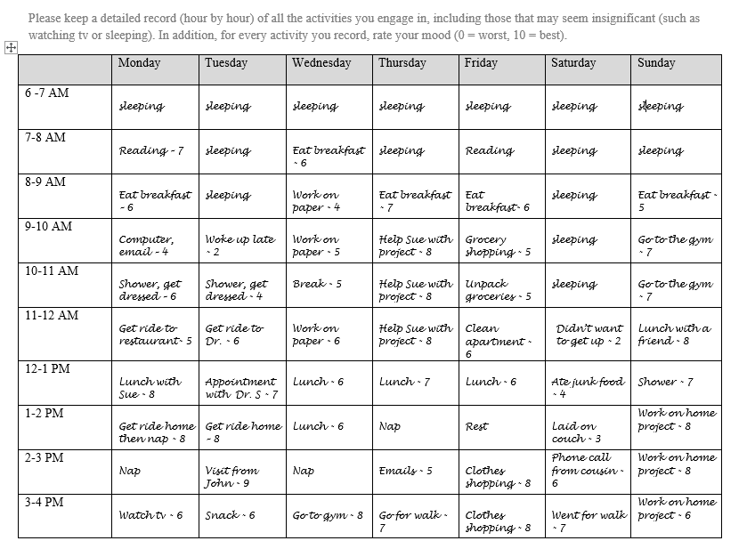
Behavioral: Behavioral activation for depression
‘Fake it ‘til you make it
Daily Activity Record
Increase engagement in activities/increase sense of mastery/ decrease avoidance and isolation
Daily activity and mood monitoring
Goal setting (using specific, measurable, actionable goals)
Identifying pleasurable activities
Approaching tasks that have been avoided
Notes:
depression wants a collection of behaviors – it’s going to try to shut down your world to reinforce it through thoughts (I’m useless, I’m worthless, no one will notice if I’m not there) – need to challenge this
4.Management of Depression in Adults: A Review.
The Journal of the American Medical Association. 2024. Simon GE, Moise N, Mohr DC.
12.Behavioural Activation Therapy for Depression in Adults.
The Cochrane Database of Systematic Reviews. 2020. Uphoff E, Ekers D, Robertson L, et al.
SLIDE 11: CBT Technique - Behavioral Activation
What is Behavioral Activation? [12]
A brief psychotherapeutic approach that seeks to:
Increase access to positive reinforcers of healthy behaviors
Reduce avoidance behaviors that limit positive reinforcement
Address barriers to activation
The Depression-Inactivity Cycle:
Depression → Withdrawal → Less positive experiences → More depression
Breaking the Cycle:
Activation → Positive experiences → Improved mood → More activation
Field Application:
"When we're feeling down, we often stop doing the things that used to make us feel good. What's one small thing you used to enjoy that you could try this week?"
Evidence: Behavioral activation is as effective as full CBT (SMD 0.73) and can be delivered by non-specialists.

Slide 11
Behavioral: Exposure and Response Prevention for Anxiety and OCD
Anxiety → Avoidance → Reinforces anxiety
Notes:
Jacqui: What is ERP?
Mona: take MD with her emetophobia, etc. If we were to take her to Harvard square and surround her with people vomiting, that would not go well. Instead, we need to gradually expose her to her fears.
e.g., 15yo 10th grader living with parents and younger sister, diagnosed with SAD, PD, GAD, and MDD, has not been going to school for the past month due to social/emotional challenges, presents to your office for help…
-How do you decide if CBT and ERP are the right approach?
-How do you engage the patient in the treatment?
-Once the patient is ready and willing, how do you get started and progress through the treatment? [FAH]
-What are potential obstacles, and how can you try to overcome them?
-How do you talk through expectations and treatment efficacy?
-What is the role of school, family, other treaters, etc.?
First step is often to help the kid use cognitive restructuring (detective thinking) to determine the actual or realistic danger inherent to the feared situation or object
But usually that is not enough
Exposure is the cornerstone to effective CBT for anxiety
EXPOSURE
Child is repeatedly exposed to what he/she has been avoiding
Have kid stay in the situation until comfortable (habituation)
Kids learn to tolerate the anxiety and the fear is extinguished
RESPONSE PREVENTION
Child does not respond to the anxiety using usual rituals or safety behaviors
Stopping avoidance or escape behaviors that terminate the anxiety but ultimately reinforce maladaptive behavioral patterns.
GOALS OF ERP
1) Habituation
2) Extinction of the response that contribute to the avoidance
-Same exposure principles apply to all types of fears./anxiety
ERP EXAMPLE
“Joey” is afraid of dogs

Slide 12
Behavioral: Exposure and Response Prevention for Anxiety and OCD
  Gradually face fears while refraining from safety behaviors
  Develop habituation and extinction of response
  Create New Learning: new associations that counter original fear (expectancy violation)
Notes:
Mona: take MD with her emetophobia, etc. If we were to take her to Harvard square and surround her with people vomiting, that would not go well. Instead, we need to gradually expose her to her fears.
e.g., 15yo 10th grader living with parents and younger sister, diagnosed with SAD, PD, GAD, and MDD, has not been going to school for the past month due to social/emotional challenges, presents to your office for help…
-How do you decide if CBT and ERP are the right approach?
-How do you engage the patient in the treatment?
-Once the patient is ready and willing, how do you get started and progress through the treatment? [FAH]
-What are potential obstacles, and how can you try to overcome them?
-How do you talk through expectations and treatment efficacy?
-What is the role of school, family, other treaters, etc.?
First step is often to help the kid use cognitive restructuring (detective thinking) to determine the actual or realistic danger inherent to the feared situation or object
But usually that is not enough
Exposure is the cornerstone to effective CBT for anxiety
EXPOSURE
Child is repeatedly exposed to what he/she has been avoiding
Have kid stay in the situation until comfortable (habituation)
Kids learn to tolerate the anxiety and the fear is extinguished
RESPONSE PREVENTION
Child does not respond to the anxiety using usual rituals or safety behaviors
Stopping avoidance or escape behaviors that terminate the anxiety but ultimately reinforce maladaptive behavioral patterns.
GOALS OF ERP
1) Habituation
2) Extinction of the response that contribute to the avoidance
-Same exposure principles apply to all types of fears./anxiety
ERP EXAMPLE
“Joey” is afraid of dogs

Slide 13
Make exposure life!
Slightly feared situation
Mildly feared situation
Moderately feared situation
Much feared situation
Most feared situation
Encourage people to face their fears
Practice each step until anxiety decreases or there is opportunity for expectancy violation
Use contingent reinforcement
Notes:
In graded exposure, we teach kids to face their fears by practicing situations in order of how scary they are, working their way up from only slightly feared situations to the most feared situation. The child practices each step until his anxiety decreases, earning rewards for doing this practice.
We do this because we want the child to feel in control and not to feel coerced. It is much easier to begin with a symptom that does not cause too much anxiety or feel too hard for the child to resist. This might be a symptom that the child is sometimes able to resist, but sometimes not (referred to in March and colleague’s manual as the “working zone”). Once a child has mastered this situation, we move on to others at the same or higher level of difficulty, working our way up to the more challenging ones. Often by the time we get to the highest rated ones, they are not causing as much anxiety because of the child’s success and feelings of mastery at tackling the lower ones.
The first situation really should be something manageable. For some children, even naming the obsession is frightening, and the initial exposure might be to the name of the fear. For example, a child with obsessions around vomiting may not even be able to tolerate saying the word “vomit,” and may need exposure to repetitions of the word “vomit” or its synonyms.
When we work on easier exposures, which might take only 10 minutes until the anxiety goes down, the child may be able to do more than one per session or for HW. When we get to the more difficult exposures, which can take 20-30 minutes or more to habituate to, the child may focus on one per session or one for HW.

Slide 14
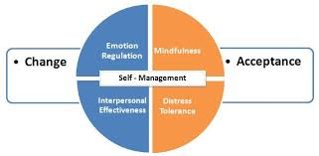
Dialectical Behavioral Therapy (DBT)
Developed for chronic suicidality and borderline personality disorder
Can be helpful for people having difficulty with emotion regulation/ “super-sensors” or are demonstrating self-destructive behaviors (e.g., non-suicidal self-injury, eating disorders, substance use disorders)
Notes:
3.Dialectical Behavior Therapy: A Brief Counseling Skill for Clinical Practice.
American Family Physician. 2025. Bylotas J, Cherubini MK, Dixon MA.New
Dialectic: change AND acceptance

Slide 15
DBT Skills Training
Mindfulness
  Being fully aware and present in the moment
Distress Tolerance
  Get through a bad situation without making it worse…survive painful emotions when now’s not the time to fix things
Emotion Regulation
  How to effectively experience and respond to emotions rather than emotions taking over
Interpersonal effectiveness
  How to ask for what you want and say no while maintaining self-respect and relationships with others
Emotion Mind
Wise Mind
Rational Mind
Notes:
self-soothing and tolerating ambivalence
Central dialectic is the balance between acceptance (mindfulness and distress tolerance)and change (interpersonal effectiveness, emotion regulation)
Core Mindfulness Skills:
“Learning to be in control of your own mind, instead of letting your mind to be in control of you.”
Reasonable Mind: approaching knowledge intellectually, thinking rationally and logically, attends to empirical facts, “cool” in approach to problems
Emotion Mind: thinking and behavior are controlled primarily by current emotional state, cognitions are “hot”, reasonable and logical thinking is difficult, facts are amplified or distorted to be congruent with the current emotional state
Exacerbated by illness; sleep deprivation and feeling tired; drugs and alcohol; hunger, overeating, and poor nutrition; environmental stress; environmental threats
Wise Mind: integration of “reasonable mind” and “emotion mind”, adds intuitive knowing to emotional experiencing and logical analysis.
What Skills: Observe, Describe (apply labels (just the facts) - learn not to take emotion and thoughts as literal reflections of environmental events), Participate without self-consciousness
How Skills: Taking a nonjudgmental stance (not labeling as good or bad, valuable or not, worthwhile or worthless), Focusing on one thing in the moment, and Being effective (do what works rather than what is “right” versus “wrong” or “fair” versus “unfair”)
“To a certain extent, being in control of one’s mind is actually learning to be in control of attention processes – that is, what one pays attention to and how long one pays attention to it.”
Emotion Regulation Skills:
Most borderline individuals ineffectively try to regulate emotions by instructing themselves not to feel whatever it is that they feel.
Requires application of mindfulness skills of nonjudgmental observation and description of one’s current emotional responses.
Note: The goal of this module is to learn to regulate emotions to decrease suffering, not to stop feeling. (Rather than allowing the emotions to control the individual, the individual learns to gain control over the emotions.)
The theoretical idea is that much of the borderline individual’s emotional distress is a result of secondary responses (e.g., intense shame, guilt, anxiety, or rage) to primary emotions.
Eight or so primary or basic emotions: anger, sorrow, joy, surprise, fear, disgust, guilt/shame, interest
Calls on psychoeducation re: emotions and validation of experience.
Emotions are particular types of patterned reactions to events. Emotions come and go.
Emotions are also self-perpetuating. Once an emotion starts, it keeps restarting itself. When an emotion seems to stay around, it is called a “mood.”
Identifying and Labeling Emotions
Recognizing, Describing, and naming emotions
There is some evidence that people who can give an emotion a name are better able to control the emotion.
The event prompting the emotion
Can be outside in the environment or can be inside the person (thoughts, behaviors, physical reactions)
One emotion can prompt another emotion
Some events can prompt an emotion automatically
The interpretations of the event that prompt the emotion
Emotion is usually prompted by a person’s interpretation of the event, or how the person appraises or thinks about the event.
Often people are responding to their own interpretations of an event, not to the event itself
The phenomenological experience, including the physical sensation, of the emotion
Emotions involve body changes, such as tensing or relaxing of muscles, changes in blood levels, fluctuations of heart rate, skin temperature, etc.
Facial muscles
Emotions involve brain changes
Emotions involve sensing
Difficult to stop feeling something – might be able to divert attention, but even this is not always easy
The behaviors expressing the emotion
Emotions involve action urges – an important function of emotion is to prompt behavior.
In the case of very complex emotions, interpretations, beliefs, and assumptions may be part of the emotions
Emotions communicate.
Types of expression:
Body language
Words
Actions
The aftereffects of the emotion on other types of functioning
Intense emotions have powerful aftereffects on memory, thoughts, and even the ability to think, physical function and behavior.
Identifying Obstacles to Changing Emotions
Generally, emotions function to communicate to others and to motivate one’s own behavior. Emotional behaviors influence and control other people’s behaviors and validate one’s own perceptions and interpretations of events.
Reducing Vulnerability to “Emotion Mind”
People are more prone to emotional reactivity when they are under physical or environmental stress
Increase Positive Emotional Events
In the short term, this involves increasing daily positive experiences. In the long term, it means making life changes so that pleasant events will occur more often.
Also work on being more mindful of pleasurable experiences when they occur, as well as unmindful of worries that the positive experience will end.
Increasing Mindfulness to Current Emotion
Experience emotions without judging them or trying to inhibit them, block them, or distract from them. The basic idea is that exposure to painful or distressing emotions, without association to negative consequences, will extinguish their ability to stimulate secondary negative emotions.
Taking Opposite Action
Act in a way that opposes or is inconsistent with the emotion.
Applying Distress Tolerance Techniques
Tolerate negative emotions without impulsive actions that make matters worse.
Let go of painful emotions by being mindful to them, instead of fighting them or walling them off
Understanding the nature of emotions
Some emotional experiences are primarily reactions to events in one’s environment (feeling happy that a loved one is coming to visit)
Other emotional experiences are primarily reactions to one’s own thoughts, actions, and feelings (guilty about getting angry, shame at not doing well on a task)
Emotions can be useful, neutral, or destructive
Learning how to identify and label emotions
Appraisals of emotions – what people say to themselves about emotions can influence our ease and comfort with them
Secondary emotional reactions can cover up or confuse primary emotional reactions.
Ambivalence about a situation/having more than one emotional reaction to the same event
Identifying the functions of emotions and their relationship to difficulties in changing emotions
Emotional behavior is probably necessary for survival
(Many emotional behaviors have been productive or helpful in the past, but at some point stop being productive or helpful)
Facial expressions are a hard-wired part of emotions
Verbal and nonverbal ways to communicate. When they do not match, people will usually trust the nonverbal cues
Some emotional expressions have an automatic effect on others
One person’s emotions can influence the emotions of the other person
Emotions prepare for and motivate behavior.
Emotions function to communicate to ourselves. That can be “self-validating.” It can be carried to an extreme, where emotions are treated as facts rather than communication.
Reducing vulnerability to negative emotions (emotion mind)
“ABC PLEASE”
Accumulate Positive Experiences
Build Mastery
Cope ahead for emotional situations
Treat Physical Illness
Balanced Eating
Avoid Mood-Altering Drugs
Balance Sleep
Get Exercise
How to increase positive emotional events
The assumption is that it is usually (but not always) the events in life that cause unhappiness, not faulty appraisals of events. Often cognitive distortions worsen the response. Focusing on cognitive distortions, however, invalidates the behavior, emotions, and thinking processes. So, goal is to validate the individual’s responses.
It is hard to be happy without a life worth living.
Attend to relationships
Avoid avoiding
Be mindful of positive experiences
Be unmindful or worries – “do not destroy positive experiences”
How to decrease emotional suffering
Be mindful of emotions – observe and describe them just as they are
Let them go rather that push them away. Fighting pain usually makes it worse.
There are valid reasons for negative emotions. The trick is to find a new way of relating to negative emotions so that they do not induce so much suffering. Do this through acceptance (which eliminated the suffering and leaves only the pain). Accepting them allows you to do something about the emotions.
Trying to build a wall to keep emotions out has the effect of keeping emotions in.
Distress Tolerance Skills
Get through a bad situation without making it worse…survive painful emotions when now’s not the time to fix things.
Use this skill set when there is no immediate solution, when the emotions are really intense and you could make the situation worse by acting on an impulsive, intense urge or if it is not an appropriate time to work on changing the source of pain or figuring out and changing the painful emotions. If a person cannot make a change for the better or cannot sort out feelings enough to change how (s)he feels, this person should use distress tolerance skills to survive in a terrible situation without resorting to behaviors that will make the situation worse. Basically, learn how to bear pain skillfully.
Pain and distress are part of life; they cannot be entirely avoided or removed.
Distress tolerance is the ability to perceive one’s environment without putting demands on it to be different, to experience your current emotional state without attempting to change it, and to observe your own thoughts and action patterns without attempting to stop or control them.
Skills for tolerating and surviving crises
Skills for accepting life as it is in the moment.
Acceptance of reality is not equivalent to approval of reality.
Avoidance can worsen the problem (ex PTSD is primarily a result of trying to avoid all contact with cues that cause discomfort). Trying to suppress emotional pain or avoid contact with pain-related cues leads to ruminating about the painful events. Experiencing, tolerating, and accepting emotional pain are the ways to reducing pain.
4 Sets of crisis survival strategies:
Distraction
Reduce contact with emotional stimuli
“Wise Mind ACCEPTS” – Activities (make a list while not in crisis), Contributing (refocus attention from self to what one can do for others), Comparisons (compare self/situation to something that is worse…generates sense of gratitude and relief), Emotions (generate opposite emotions, ex. play happy music if feeling sad), Pushing away (physically leave a situation or block it mentally…half smile, deep breathing), Thoughts (fill mind with other thoughts), Sensations
Self-soothing
Comforting, nurturing, and being gentle and kind to oneself
5 Senses: Vision, Hearing, Smell, Taste, Touch
Improving the moment
Replace immediate negative events with more positive ones
IMPROVE: Imagery, find or create Meaning (make lemonade out of lemons), Prayer, Relaxation (accepting with the body can help in accepting with the mind, be aware), One thing in the moment, mental Vacation, Encouragement (cheerleading oneself)
Thinking of pros and cons
Pros and cons of tolerating the distress and of not tolerating the distress (both short term and long term)…accepting reality and tolerating distress leads to better outcomes tan rejecting reality and refusing to tolerate distress
Acceptance Skills:
Radical Acceptance (complete acceptance from deep within)
Suffering comes when people cling to getting what they want, refusing to accept what they have
Turning the mind toward acceptance (choosing to accept reality as it is)
Willingness vs. willfulness (underlying attitude)
Willingness: allow the world to be what it is and agree to participate
Willfulness: impose one’s will on reality – try to fix everything or refuse to do what is needed
Interpersonal Effectiveness Skills
Include effective strategies for asking for what one needs, saying no, and coping with interpersonal conflict. Obtaining changes one wants, maintaining the relationship, and maintaining self-respect.
Attend to relationships
Balance priorities vs. demands in life and relationships
Demands can overwhelm if there is no balance
The level of demands that can be easily tolerated varies over time and from person to person, though some people overestimate what others can handle.
Balance the wants-to-shoulds ratio in life and relationships
A life dominated by wants often runs into trouble because responsibilities are not met and commitments are not kept
A life dominated by shoulds can lead to depression, frustration, and anger
Building mastery and self-respect
Do things that make you feel competent and effective
Get up after falling down
2 Interpersonal skills
Asking for things, making requests, initiating discussions
Saying no, resisting pressure, maintaining a position or point of view
3 Types of Effectiveness to consider in every conflict or interpersonal problem situation – which one to focus on depends on person’s priority:
Objectives effectiveness – obtaining your objectives or goals in a situation
Standing up for your rights in such a way that they are taken seriously
Requesting others to do something in such a way that they do it
Refusing unwanted or unreasonable requests and making the refusal stick
Resolving interpersonal conflict
Getting your opinion or point of view taken seriously
Use DEAR MAN
Describe the situation, Express feelings or opinions about the situation clearly, Assert wishes (don’t expect people to know what you want if you do not tell them), Reinforce (reward people who respond positively to you), stay Mindful, Appear confident, Negotiate and turn the table (ask the other person for alternative solutions)
*Although increased interpersonal skills should increase the probability of getting objectives met, they are not a guarantee.
Relationship effectiveness – maintaining or improving an interpersonal relationship while you get what you want (main goal of the interaction is to get the other person to approve of you more, stop criticizing or rejecting you, stay with you, or the like – want to choose a way of going about improving or keeping the relationship that does not at the same time damage the relationship over the long run).
Acting in a way that makes the other person actually want to give you what you are asking for or feel good about your saying no
Balancing immediate goals with good of the long-term relationship
Weighing short-term gains of getting what want without using interpersonal effectiveness vs risking long-term relationship – important to realize how blowing up or walking out of a relationship inadvertently jeopardizes the person’s own goals
Use DEAR MAN, GIVE
Be Gentle (no threats, no judging), act Interested, Validate, use an Easy manner
Self-respect effectiveness – maintaining or improving your good feelings about yourself, and respecting your own values and beliefs, while you try to attain your objectives
Acting in ways that fit your sense of morality
Acting in ways that make you feel competent
Use DEAR MAN, GIVE FAST
Be Fair to yourself and the other person, no over-Apologies, Stick to values, be Truthful
Factors that interfere with interpersonal effectiveness
Skills Deficits - People learn social behaviors by observing someone else do them first, practicing them, and refining them until they can be used to obtain good results. A person can have skills in one set of situations but not in another, or in one mood state but not in another, or in one frame of mind but not in another.
Worry thoughts – Worry about bad consequences, whether one deserves to get what one wants, and worrying about not being effective
Emotional reactions – A person gets angry, anxious, frustrated, guilty because of how he/she thinks about the situation or because he/she does not know what to do.
Emotional reactions can be automatic reactions to situations, based on previous conditioning, or they can be a result of believing myths (handout 4*):
Need to try to argue against the myths logically (cognitive modification)
Wise mind challenge – emotionally and rationally test the myth
Indecision – ambivalence about priorities or inability to decide how to balance asking with not asking
Environment – At times even the most skilled individuals cannot be effective at getting what they want, keeping others liking them, or behaving in ways that they respect. People often do not get what they want or need
Interplay of factors
Being interpersonally effective requires thinking through whether it is appropriate to ask for something or to say no to a request. Determine intensity of asking and saying no
Priority: Objective vs. Relationship vs. self-respect
Capability
Timelessness: good time to ask?
Homework: if one knows all the facts necessary to support a request, and both the goal and the request are clear, intensity of asking should be higher
Authority
Rights
Relationship
Reciprocity
Long vs. short term: if being submissive will result in peace now but create problems in the long run, the intensity of asking should be higher
Respect

Slide 16
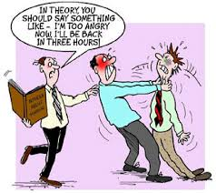
Distress Tolerance
Crisis Survival
  Distraction (Wise Mind ACCEPTS)
  Self-soothing, 5 senses
  IMPROVE the moment
  Pros/Cons
Acceptance
  Radical Acceptance
  Turning the mind
  Willingness vs. willfulness
Notes:
Distress Tolerance:
Get through a bad situation without making it worse…survive painful emotions when now’s not the time to fix things.
Use this skill set when there is no immediate solution, when the emotions are really intense and you could make the situation worse by acting on an impulsive, intense urge or if it is not an appropriate time to work on changing the source of pain or figuring out and changing the painful emotions. If a person cannot make a change for the better or cannot sort out feelings enough to change how (s)he feels, this person should use distress tolerance skills to survive in a terrible situation without resorting to behaviors that will make the situation worse. Basically, learn how to bear pain skillfully.
Pain and distress are part of life; they cannot be entirely avoided or removed.
Distress tolerance is the ability to perceive one’s environment without putting demands on it to be different, to experience your current emotional state without attempting to change it, and to observe your own thoughts and action patterns without attempting to stop or control them.
Skills for tolerating and surviving crises
Skills for accepting life as it is in the moment.
Acceptance of reality is not equivalent to approval of reality.
Avoidance can worsen the problem (ex PTSD is primarily a result of trying to avoid all contact with cues that cause discomfort). Trying to suppress emotional pain or avoid contact with pain-related cues leads to ruminating about the painful events. Experiencing, tolerating, and accepting emotional pain are the ways to reducing pain.
4 Sets of crisis survival strategies:
Distraction
Reduce contact with emotional stimuli
“Wise Mind ACCEPTS” – Activities (make a list while not in crisis), Contributing (refocus attention from self to what one can do for others), Comparisons (compare self/situation to something that is worse…generates sense of gratitude and relief), Emotions (generate opposite emotions, ex. play happy music if feeling sad), Pushing away (physically leave a situation or block it mentally…half smile, deep breathing), Thoughts (fill mind with other thoughts), Sensations
Self-soothing
Comforting, nurturing, and being gentle and kind to oneself
5 Senses: Vision, Hearing, Smell, Taste, Touch
Improving the moment
Replace immediate negative events with more positive ones
IMPROVE: Imagery, find or create Meaning (make lemonade our of lemons), Prayer, Relaxation (accepting with the body can help in accepting with the mind, be aware), One thing in the moment, mental Vacation, Encouragement (cheerleading oneself)
Thinking of pros and cons
Pros and cons of tolerating the distress and of not tolerating the distress (both short term and long term)…accepting reality and tolerating distress leads to better outcomes tan rejecting reality and refusing to tolerate distress
Acceptance Skills:
Radical Acceptance (complete acceptance from deep within)
Suffering comes when people cling to getting what they want, refusing to accept what they have
Turning the mind toward acceptance (choosing to accept reality as it is)
Willingness vs. willfulness (underlying attitude)
Willingness: allow the world to be what it is and agree to participate
Willfulness: impose one’s will on reality – try to fix everything or refuse to do what is needed

Slide 17
DBT Distress Tolerance: TIPP Skills for Acute Crisis
Temperature
Ice diving (dive reflex)
Ice pack on cheeks or neck
Intense exercise
brief bursts of physical activity
Paced breathing
boxed breathing
Progressive Muscle Relaxation
Tense and release muscle groups
Notes:
TIPP Skills - For immediate physiological calming: [3][7]
T - Temperature
Cold water on face, ice pack on neck
Activates the dive reflex, slowing heart rate
"Hold ice cubes in your hands" or "splash cold water on your face"
I - Intense Exercise
Brief burst of physical activity
Burns off adrenaline, releases endorphins
"Let's take a quick walk" or "shake out your arms and legs"
P - Paced Breathing
Slow, deep breaths (4 counts in, 4 counts hold, 4 counts out)
Activates parasympathetic nervous system
Box breathing: Inhale 4 sec → Hold 4 sec → Exhale 4 sec → Hold 4 sec
P - Paired Muscle Relaxation
Tense and release muscle groups
Progressive muscle relaxation
Evidence: Patients report DTS provides immediate reduction of tension and helps them feel stable, safe, and self-confident.

Slide 18
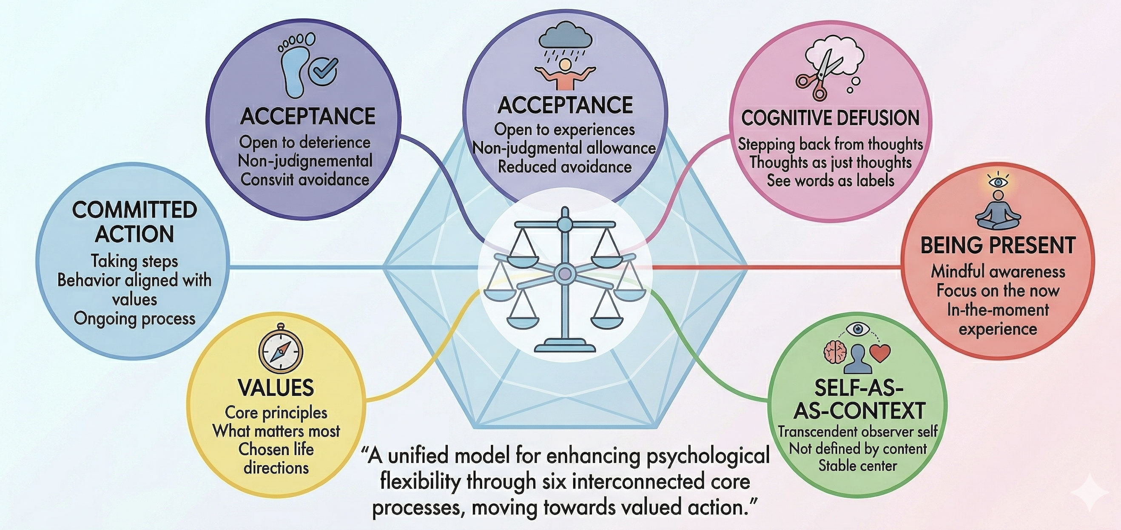
Acceptance and Commitment Therapy (ACT)
Notes:
Particularly helpful with OCD, perfectionism, amotivated kids (no values)
Acceptance and Commitment Therapy (ACT) - The 6 Core Processes
ACT aims to increase "psychological flexibility" - the ability to be present, open, and do what matters. [13-15]
The 6 Core Processes (Hexaflex):
Present Moment Awareness: Being here now, not lost in past/future
Acceptance: Allowing difficult feelings without fighting them
Cognitive Defusion: Seeing thoughts as just thoughts, not facts
Self-as-Context: The observing self that is separate from thoughts/feelings
Values: Clarifying what truly matters to you
Committed Action: Taking steps aligned with your values
Evidence: ACT produces medium-to-large effect sizes for anxiety (g = 0.52) and depression (g = 0.47-0.69). [16-18]
The solution you use to avoid unpleasant thoughts and feelings becomes the problem (e.g., leaving class to go to nurse when feeling anxious)
DBT is great for managing emotions that are so strong that it is hard to even imagine the thoughts associate with the emotions.
CBT is great for being able to pay attention to the irrational and unhelpful thoughts and change direction of behavior to a more productive place.
But some people are tied very strongly to their anxious thoughts – this comes out in a couple of ways. 1) they find their anxious thoughts protective so they do not want to get rid of them, 2) when they do an assessment of evidence for/against they always seem to find evidence for that is too compelling to let go, 3) the just feel it’s right, so even if they have tons of evidence against, it just doesn’t matter. For these kids, we take a different approach. Rather than trying to change their thoughts, we encourage them to accept it. The accept that it is a thought, and nothing else.
Acceptance
Noticing thoughts and feelings when they show up
Making room for thoughts and feelings
Not trying to get rid of, reduce, or eliminate unpleasant thoughts and feelings
[Opposite of avoidance]
The solution you use to avoid unpleasant thoughts and feelings becomes the problem (e.g., leaving class to go to nurse when feeling anxious)
1st ACT book in 1999
Over 100 clinical trials
Primarily targeting psychological inflexibility – trying to promote psychological flexibility – an openness, adjustment, ability response more openly to stimuli
Can target inflexibility with six processes (hexaflex): Acceptance, Defusion, Contact with present moment, Self as context, Values, Acceptance:
Acceptance: meant to target experiential avoidance
Acknowledgement and openness to private events (thoughts, physical sensations, etc.)
Not an agreement with, submission to, giving up
Experience with openness, curiosity, willingness, provides opportunity for another response
Not about getting rid of the thoughts, more about how you act on them
Defusion: targets cognitive fusion
Step back as an observer to view those private events and to notice that they sometimes pretend to be something that they are not.
Thoughts that seem to be literal truth about how the world works – instead, see them as thoughts and feelings, not something that had to guide how we live our life
“I’m having this thought that...but let’s see” – maybe I have some flexibility in how I respond to this, which will allow a different behavior.
Personal experience of process of interacting with private events – does not have to be so literal
Self as context – targets conceptualized self
Contact with present moment – targets past/future preoccupations
Values clarification – targets disconnections from values
You decide how your respond to life vs. living according to how you think or feel
We do not have to respond to all private contact
Committed action – targets impulsivity and avoidance
Acceptance: differentiate private (internal experiences) vs. public (observable behaviors) events
Set up idea of control as part of the problem – let go a bit – willingness, acknowledgment
“If I give you a$100,000 to make it a week without hand washing, would you do it?
“I’ll give you $100,0000...but I’ll make it $200,000 if you do it without any anxiety” – how strong is their control agenda – how strongly are they trying to control, suppress private events?
Put work on the behavior rather than the feelings/thoughts
How do you respond when it’s raining outside? What does your body do? Tense, tight, trying not to get wet, but getting just as wet if relax and open up...notice the impulsive tight, controlling impulse to stimuli and internal content – they way we respond, we get wet no matter what, maybe we can make a choice after we notice how we respond immediately.
Buy 1000 piece puzzle – “I don’t care how it goes, but you can only do 1 piece a day.” Do the exercise, notice what internal content arises, and use it as a chance to practice more open, willing approach.
Once upon a time, a very long time ago there were two caveman named Ugg and Jugg.
Ugg Jugg
Ugg and Jugg looked very much the same except for one big difference that was invisible. Ugg had a danger center in his brain but Jugg did not have a danger center in his brain.
The danger center would go off like an alarm whenever there was danger and make them feel scared.
One day Ugg and Jugg, carrying big sticks, went hunting for food. After a while they turned around a big rock and standing there in front of them was a huge dinosaur with very sharp teeth.
When Ugg saw the dinosaur his danger center sounded a silent alarm. Ugg’s heart started to beat faster, his muscles got tense, his breathing got quicker and he ran away as fast as he could.
Unfortunately, for Jugg, who did not have a danger center in his brain, no silent alarm went off. His heart did not beat faster, his muscles did not get tense and his breathing did not get quicker and he did not run away as fast as he could.
Poor Jugg just did not have what he needed to survive – a danger center in his brain.
Everyone today has the good fortune to have a danger center in the brain just like Ugg. Moms, dads, teachers and even doctors have a danger center in their brains. All kids have danger centers in their brains too, just like Ugg.
These danger centers let us know when there is a real danger so we can get away from the real danger. Even though there are no dinosaurs around today, there are busy streets with a lot of cars and edges of cliffs of which we all need to be careful.
But there is a dark side to the danger center in our brain. Sometimes we get a false alarm where the danger center goes off when there really is no actual danger. If we avoid or run away when our brain tells us “DANGER” when it is really a false alarm then we may not be able to do all the things in life that are important to us like learning something new or doing something different for the first time.
It is always important to listen to your mind to avoid doing things that are really dangerous (like a song said …don’t tug on Superman’s cape…don’t spit into the wind…don’t pull the mask off an “ole Lone Ranger…”).
It is also important to not listen to your mind when it tells you to avoid things that are really not dangerous.

Slide 19
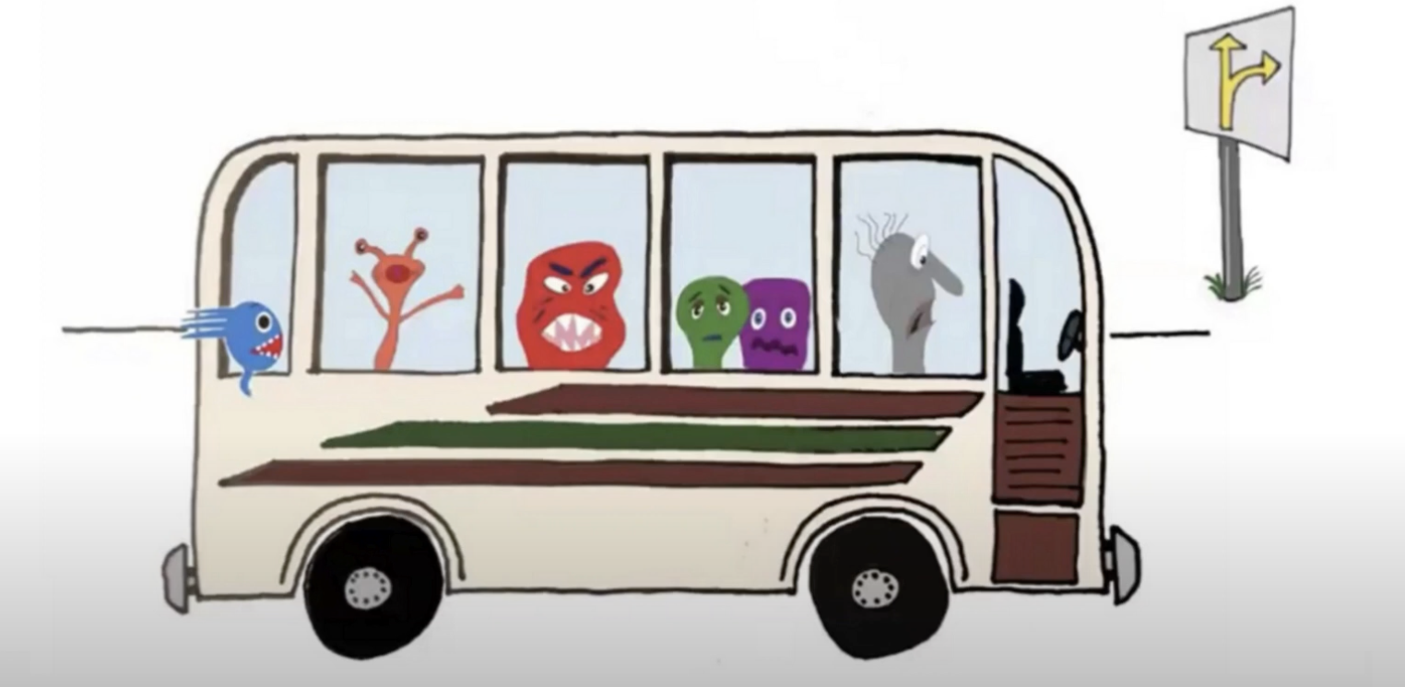
Passengers on the bus
Accepting emotions for what they are and choosing behaviors that are values driven
https://www.youtube.com/watch?v=EVsZfqylkOQ
Notes:
e.g. perfectionism, OCD
https://www.youtube.com/watch?v=EVsZfqylkOQ
Tried to be this is right/wrong – didn’t work
Tried to say I understand why you’re feeling this way – didn’t work
Ok, you feel terrible – what do you value in life – can you serve that?
unhook, towards moves
Aims to change how a person relates and responds to thoughts/feelings in order to more fully engage in values-based behaviors
Incorporates acceptance-based cognitive techniques (e.g., mindfulness and cognitive defusion) with the goal of changing one’s relationship with their thoughts
Uses acceptance and mindfulness strategies, together with commitment and behavior change strategies, to increase psychological flexibility
Encourages pursuit of actions that contribute to a life with meaning, purpose and vitality, while accepting associated painful internal experiences

Slide 20
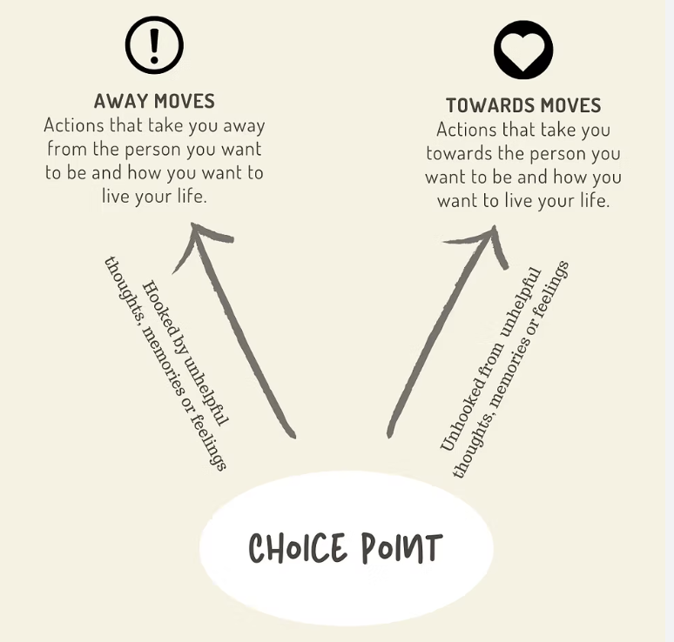
Choice Point
Notes:
SLIDE 13: ACT Techniques for the Field
Cognitive Defusion - "Unhooking" from Thoughts: [13][19]
Instead of: "I'm worthless"
Try: "I'm having the thought that I'm worthless"
Field Application:
"Notice that thought. Now try saying 'I'm having the thought that...' before it. Does that change how it feels?"
Acceptance - Making Room for Difficult Feelings:
"What if, instead of fighting this feeling, you just let it be there? Not liking it, but not struggling with it either. Like a wave that will eventually pass."
Values Clarification:
"If you weren't feeling this way, what would you want your life to be about? What matters most to you?"
Committed Action:
"What's one small step you could take today that moves you toward what matters to you?"
Key Insight: ACT is transdiagnostic—it works across depression, anxiety, chronic pain, and substance use

Slide 21
Psychotherapies for Depression:
Future Directions
Transdiagnostic Approaches
  Reduced focus on disorders
  Target constructs central to development and maintenance of psychopathology (e.g., emotion regulation, repetitive negative thinking)
  Example: Unified Protocol for Emotional Disorders (Barlow et al., 2018)
Digital Health
  Self-guided, internet delivered (evidence for CBT)
  Telehealth, telephone-delivered
  Smart-phone applications (https://mindapps.org/)
Notes:
There is not one true answer in therapy
Therapy – tools – they don’t try to explain (unlike religion)
axe and saw
Future Directions
Digital Delivery: Internet CBT, smartphone apps
Transdiagnostic Protocols: Focus on core emotional processes (e.g., Unified Protocol)
Personalized Care: Tailored to genetics, symptoms, patient values

Slide 22
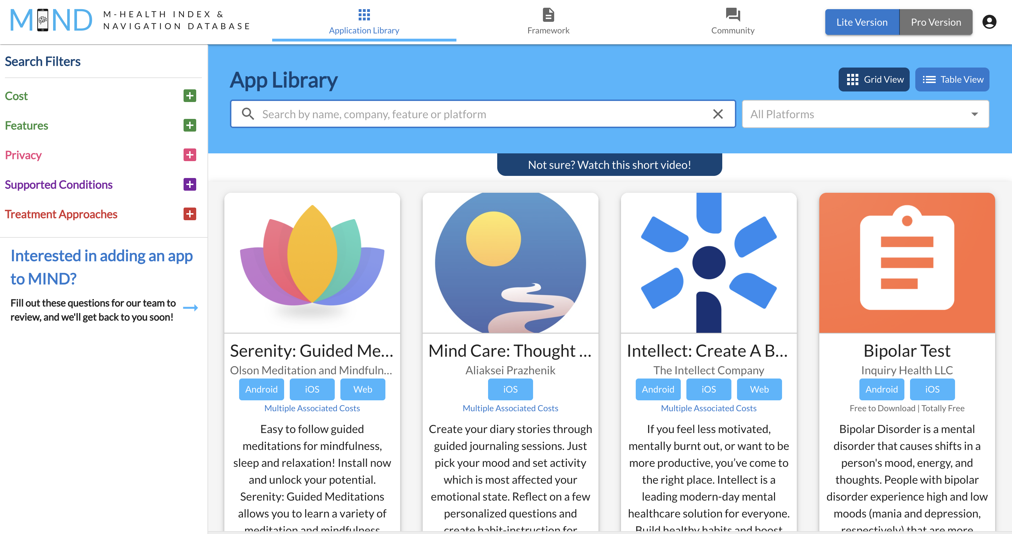

Slide 23
Treatment Selection
Psychotherapy | Individual characteristics/challenges that may be a good fit
Cognitive Behavior Therapy | appreciate structure, find “class-like” settings appealing, open to “homework,” willing to be actively engaged in treatment
Interpersonal Psychotherapy | challenging relationship patterns, grief, life/role transitions
Psychodynamic Psychotherapy | complicated and unresolved early life experiences, ambivalence, challenging relationship patterns or complex psychological issues
Mindfulness-Based Cognitive Therapy | interested in meditation, pattern of symptom fluctuation or relapse, rumination, self-criticism
Acceptance and Commitment Therapy | rigid thinking patterns, thoughts/feelings dominate actions, avoidance, perfectionism, chronic pain
Dialectical Behavior Therapy | emotion dysregulation, destructive behaviors/disorders, benefit from validation and structure
Supportive Therapy | need emotional support for acute life stressor or life transitions
Notes:
Treatment Selection Tips
Match to patient strengths, symptoms, preferences
Consider access (telehealth, guided self-help, insurance)
Early alliance predicts better outcomes
Use symptom tracking tools to measure progress
Case Vignette (Interactive)
28-year-old with low motivation, isolation, job dissatisfaction
No prior therapy, prefers skills over “talking about childhood”
Which therapy fits best? (Prompt discussion: CBT vs IPT vs ACT)

Slide 24
Thank you!

