Slide 1
LUNCH: BACK AT 1:20

Slide 2
Clinical Pearls of Anxiety Disorders

Slide 3
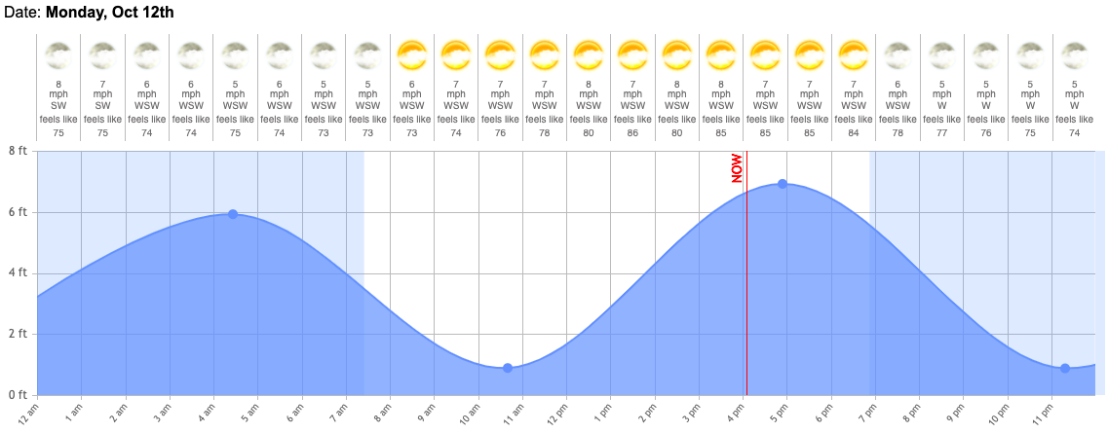
Diurnal variation, reprise

Slide 4
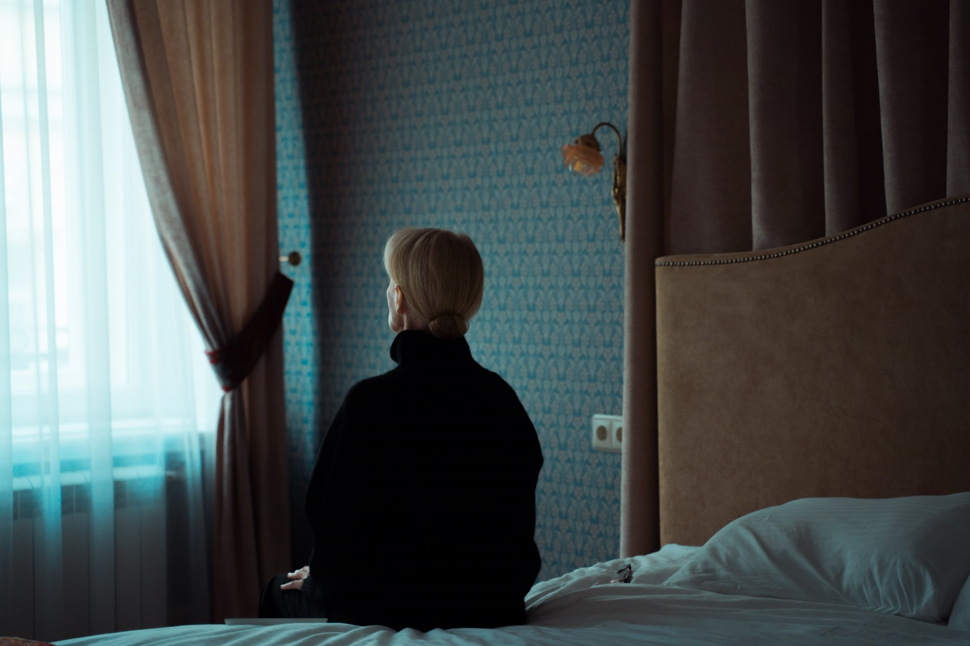
Behavioral consequence of depression and anxiety are the same

Slide 5
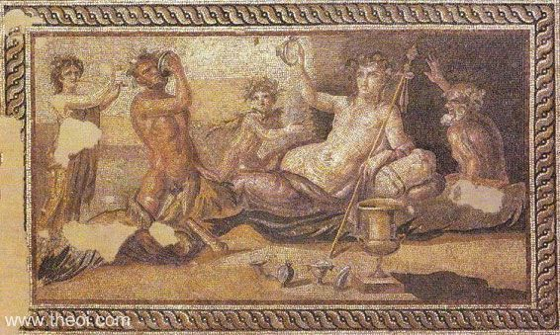
Self-medication quickly becomes mythology

Slide 6

There are anxious tyrants

Slide 7

Parental fears are powerful

Slide 8
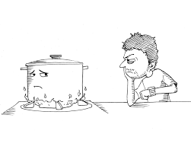
A watched pot never boils

Slide 9

GAD is a second job

Slide 10

Your healthy body is uncomfortable

Slide 11
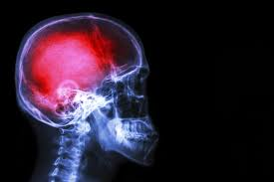
Psychosomatic symptoms are real

Slide 12

OCD: from syntonic to dystonic

Slide 13

Compulsions can be subcontracted

Slide 14
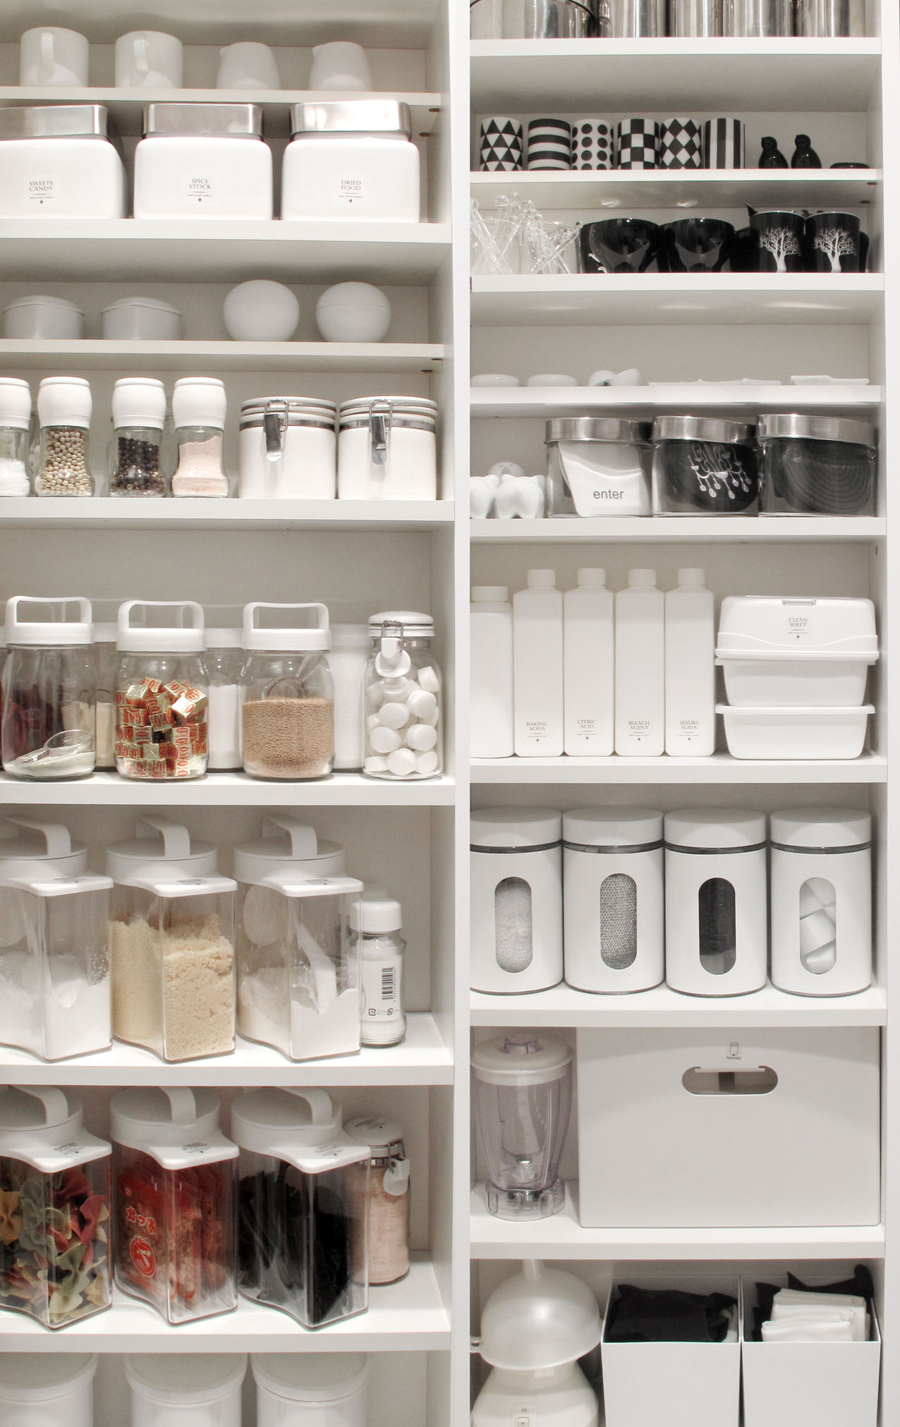
Internally positive reinforcing behaviors the hardest to extinguish

Slide 15

Trauma is ubiquitous, PTSD is rare

Slide 16

Better to be organized than accurate in trauma narratives

Slide 17

Depression and addiction are the most common post-traumatic diagnoses

Slide 18

Memories are state dependent

