Slide 1
Psychopharmacology: Just the Hits

Slide 2

The most common psychiatric medications, their side effects, and how they act
Nearly all figures and text from Stahl’s Essential Pharmacology, 4th Edition

Slide 3
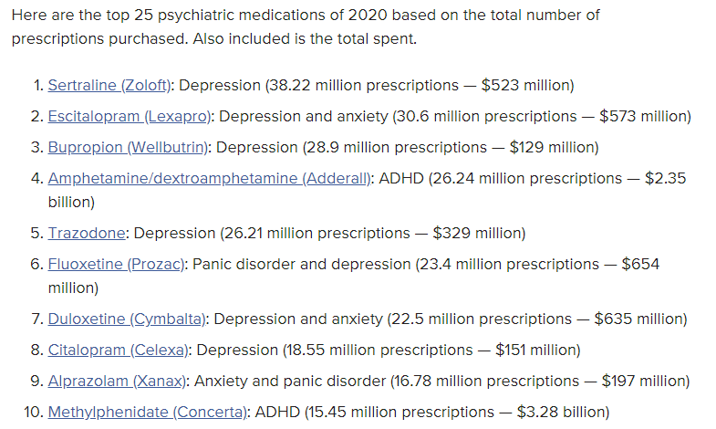
The Top 10
What Are the Top Psych Meds Prescribed? I Psych Central

Slide 4
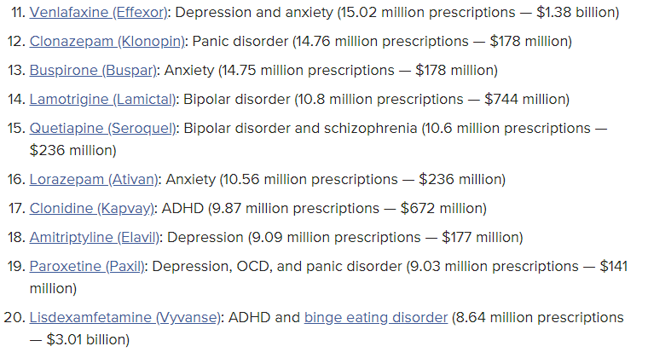
The Top 10
What Are the Top Psych Meds Prescribed? I Psych Central

Slide 5
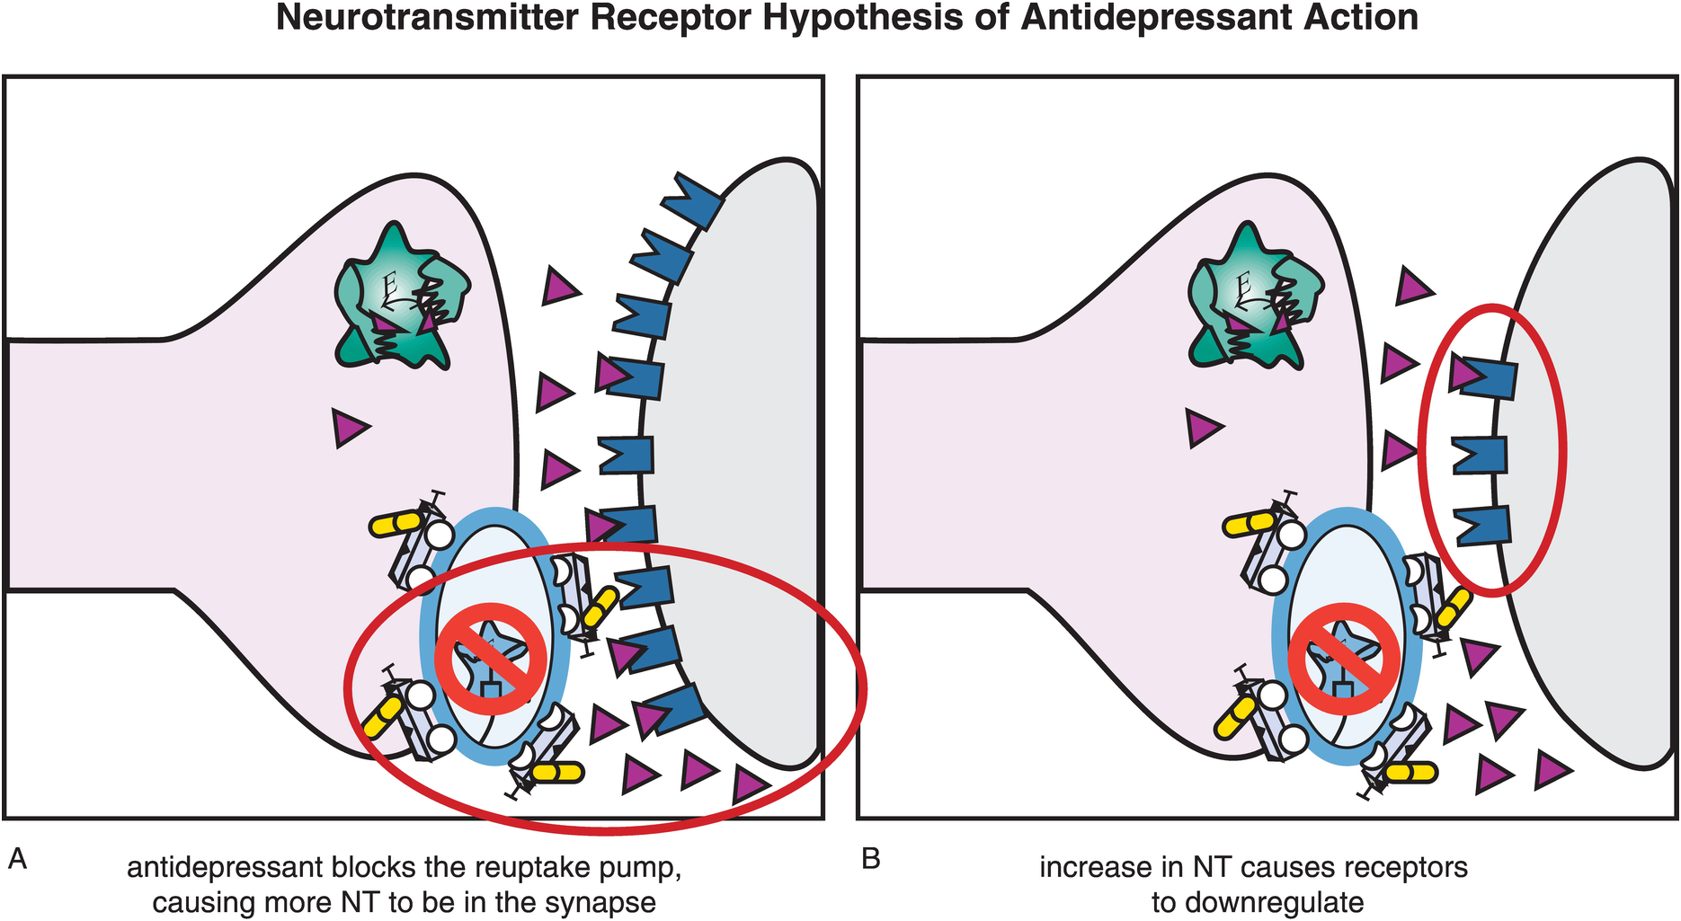
SSRIs
Zoloft (sertraline), Celexa (citalopram), Prozac (fluoxetine), Lexapro (escitalopram), Paxil (paroxetine)

Slide 6
Zoloft (sertraline)
Commonly Prescribed for
Major depressive disorder
Premenstrual dysphoric disorder (PMDD)
Panic disorder
Posttraumatic stress disorder (PTSD)
Social anxiety disorder (social phobia)
Obsessive-compulsive disorder (OCD)
Generalized anxiety disorder (GAD)
Notable Side Effects
Sexual dysfunction
Gastrointestinal (decreased appetite, nausea, diarrhea, constipation, dry mouth)
Mostly central nervous system (insomnia but also sedation, agitation, tremors, headache, dizziness)
Autonomic (sweating)
Bruising and rare bleeding
Rare hyponatremia
Rare hypotension
Potential Advantages
Patients with atypical depression
Patients with fatigue and low energy
Patients who wish to avoid hyperprolactinemia
Potential Disadvantages
Initiating treatment in anxious patients with some insomnia
Patients with comorbid irritable bowel syndrome
Can require dosage titration

Slide 7
Celexa (citalopram)
Commonly Prescribed for
Depression
Premenstrual dysphoric disorder (PMDD)
Obsessive-compulsive disorder (OCD)
Panic disorder
Generalized anxiety disorder
Posttraumatic stress disorder (PTSD)
Social anxiety disorder (social phobia)
Notable Side Effects
Sexual dysfunction
Gastrointestinal
Mostly central nervous system (insomnia but also sedation, agitation, tremors, headache, dizziness)
Autonomic (sweating)
Bruising and rare bleeding
Rare hyponatremia
SIADH (syndrome of inappropriate antidiuretic hormone secretion)
Cardiac at high doses
Potential Advantages
Elderly patients/medically sick patients
Patients excessively activated or sedated by other SSRIs
Potential Disadvantages
May require dosage titration to attain optimal efficacy
Can be sedating in some patients

Slide 8
Prozac (fluoxetine)
Commonly Prescribed for
Major depressive disorder (ages 8 and older)
Obsessive-compulsive disorder (OCD) (ages 7 and older)
Premenstrual dysphoric disorder (PMDD)
Bulimia nervosa
Panic disorder
Bipolar depression [in combination with olanzapine (Symbyax)]
Treatment-resistant depression [in combination with olanzapine (Symbyax)]
Social anxiety disorder (social phobia)
Posttraumatic stress disorder (PTSD)
Notable Side Effects
Sexual dysfunction
Gastrointestinal (decreased appetite, nausea, diarrhea, constipation, dry mouth)
Mostly central nervous system (insomnia but also sedation, agitation, tremors, headache, dizziness)
Autonomic (sweating)
Bruising and rare bleeding
Potential Advantages
Patients with atypical depression
Patients with fatigue and low energy
Patients with comorbid eating disorders
Generic is less expensive
Weekly administration
Children with OCD or depression
Potential Disadvantages
Patients with anorexia
Initiating treatment in anxious, agitated patients
Initiating treatment in severe insomnia

Slide 9
Paxil (paroxetine)
Commonly Prescribed for
Major depressive disorder (paroxetine and paroxetine CR)
Obsessive-compulsive disorder (OCD)
Panic disorder (paroxetine and paroxetine CR)
Social anxiety disorder (social phobia) (paroxetine and paroxetine CR)
Posttraumatic stress disorder (PTSD)
Generalized anxiety disorder (GAD)
Premenstrual dysphoric disorder (PMDD) (paroxetine CR)
Notable Side Effects
Sexual dysfunction
Gastrointestinal
Mostly central nervous system (insomnia but also sedation, agitation, tremors, headache, dizziness)
Autonomic (sweating)
Bruising and rare bleeding
Rare hyponatremia
Withdrawal
Potential Advantages
Patients with anxiety disorders and insomnia
Patients with mixed anxiety/depression
Potential Disadvantages
Patients with hypersomnia
Alzheimer/cognitive disorders
Patients with psychomotor retardation, fatigue, and low energy

Slide 10
SNRIs
Cymbalta (duloxetine), Effexor XR (venlafaxine HCL ER)

Slide 11
Effexor (venlafaxine)
Commonly Prescribed for
Depression
Generalized anxiety disorder (GAD)
Social anxiety disorder (social phobia)
Panic disorder
Posttraumatic stress disorder (PTSD)
Premenstrual dysphoric disorder (PMDD)
Notable Side Effects
Most side effects increase with higher doses, at least transiently
Headache, nervousness, insomnia, sedation
Nausea, diarrhea, decreased appetite
Sexual dysfunction
Asthenia, sweating
SIADH (syndrome of inappropriate antidiuretic hormone secretion)
Hyponatremia
Dose-dependent increase in blood pressure
Potential Advantages
Patients with depression that includes motor slowing
Patients with atypical depression
Patients with comorbid anxiety
Depressed patients with somatic symptoms, fatigue, and pain
Patients who do not respond to SSRIs
Potential Disadvantages
Patients sensitive to nausea
Patients with borderline or uncontrolled hypertension
Patients with cardiac disease

Slide 12
Cymbalta (duloxetine)
Commonly Prescribed for
Major depressive disorder
Diabetic peripheral neuropathic pain (DPNP)
Fibromyalgia
Generalized anxiety disorder, acute and maintenance
Chronic musculoskeletal pain
Stress urinary incontinence
Neuropathic pain/chronic pain
Other anxiety disorders
Notable Side Effects
Nausea, diarrhea, decreased appetite, dry mouth, constipation
Insomnia, sedation, dizziness
Sexual dysfunction
Sweating
Increase in blood pressure (up to 2 mm Hg)
Urinary retention
Potential Advantages
Patients with physical symptoms of depression
Patients with depression with motor slowing
Patients with atypical depression
Patients with comorbid anxiety
Depressed patients with somatic symptoms, fatigue, and pain
Patients who do not respond to SSRIs
Potential Disadvantages
Patients with urologic disorders, prostate disorders (e.g., older men)
Patients sensitive to nausea

Slide 13
Wellbutrin (bupropion)
Commonly Prescribed for
Major depressive disorder (bupropion, bupropion SR, and bupropion XL)
Seasonal affective disorder (bupropion XL)
Nicotine addiction (bupropion SR)
Bipolar depression
Attention deficit /hyperactivity disorder (ADHD)
Sexual dysfunction
Notable Side Effects
Dry mouth, constipation, nausea, weight loss, anorexia, myalgia
Insomnia, dizziness, headache, agitation, anxiety, tremor, abdominal pain, tinnitus
Sweating, rash
Hypertension
Rare seizure (more with immediate release)
Potential Advantages
Depression with motor slowing
Atypical depression
Bipolar depression
Patients concerned about sexual dysfunction
Patients concerned about weight gain
Potential Disadvantages
Patients experiencing weight loss associated with their depression
Patients who are excessively activated

Slide 14
Dopamine
Reuptake Pump
Dopamine
Dopamine Receptor

Slide 15
Dopamine
Reuptake Pump
AMP
Dopamine
AMP, MPH
Dopamine Receptor

Slide 16
Adderall (mixed amphetamine salts)
Commonly Prescribed for
Attention deficit hyperactivity disorder (ADHD) in children ages 3–12 (Adderall)
Attention deficit hyperactivity disorder (ADHD) in children ages 6–17 and in adults (Adderall XR)
Narcolepsy (Adderall)
Treatment-resistant depression
Notable Side Effects
Insomnia, headache, exacerbation of tics, nervousness, irritability, overstimulation, tremor, dizziness
Anorexia, nausea, dry mouth, constipation, diarrhea, weight loss
Slowing of normal growth in children (controversial)
Palpitations, tachycardia, hypertension
Cardiovascular adverse effects
Potential Advantages
May work in ADHD patients unresponsive to other stimulants, including pure d-amphetamine sulfate
Sustained-release option
Potential Disadvantages
Patients with current or past substance abuse
Patients with current or past bipolar disorder or psychosis

Slide 17
Concerta (methylphenidate)
Commonly Prescribed for
Attention deficit hyperactivity disorder (ADHD) in children and adults (approved ages vary based on formulation)
Narcolepsy (Metadate ER, Methylin ER, Ritalin, Ritalin SR)
Treatment-resistant depression
Notable Side Effects
Insomnia, headache, exacerbation of tics, nervousness, irritability, overstimulation, tremor, dizziness
Anorexia, nausea, dry mouth, constipation, diarrhea, weight loss
Slowing of normal growth in children (controversial)
Palpitations, tachycardia, hypertension
Cardiovascular adverse effects
Potential Advantages
Established long-term efficacy as a first-line treatment for ADHD
Multiple options for drug delivery, peak actions, and duration of action
Potential Disadvantages
Patients with current or past substance abuse
Patients with current or past bipolar disorder or psychosis

Slide 18
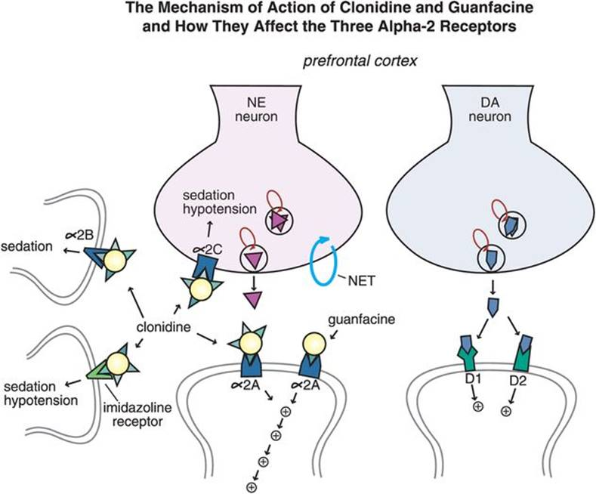
Alpha-agonists

Slide 19
Kapvay/Catapres (clonidine)
Commonly Prescribed for
Attention deficit hyperactivity disorder (ADHD) in children and adults
hypertension
Notable Side Effects
Constipation
Pruritus of skin
Drowsy
Dizziness
Fatigue
General weakness
Orthostatic hypotension
Potential Advantages
Nonstimulant. Little abuse potential
Comes in long acting form
Sedation can be useful in insomnia
Potential Disadvantages
Sedation and hypotension
Less effective than stimulants

Slide 20
Intuniv/Tenex (guanfacine)
Commonly Prescribed for
Attention deficit hyperactivity disorder (ADHD) in children and adults
hypertension
Notable Side Effects
Drowsy, Dizziness, Sedation, Lethargy, Fatigue
Insomnia
Nausea
Hypotension
Weight gain
Headache disorder
Irritability
Potential Advantages
Nonstimulant. Little abuse potential
Comes in long acting form
Potential Disadvantages
Sedation and hypotension (less than clonidine)
Less effective than stimulants

Slide 21
Strattera (atomoxetine)
Commonly Prescribed for
Attention deficit hyperactivity disorder (ADHD) in children and adults
Notable Side Effects
Nausea, Vomiting, Abdominal pain
Drowsy, fatigue, sedation
Headache disorder
Sedation
Mood changes
Depression
Potential Advantages
Nonstimulant. Little abuse potential
May be useful with co-occurring anxiety
Potential Disadvantages
Sedation or insomnia (less than clonidine)
Less effective than stimulants

Slide 22
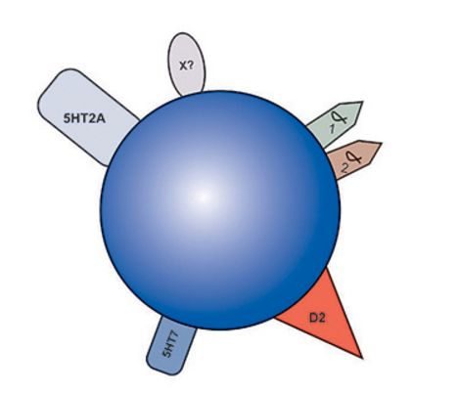
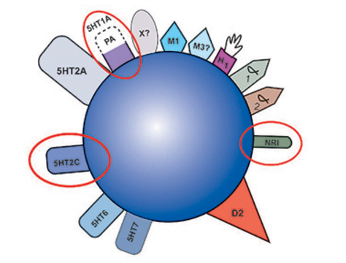
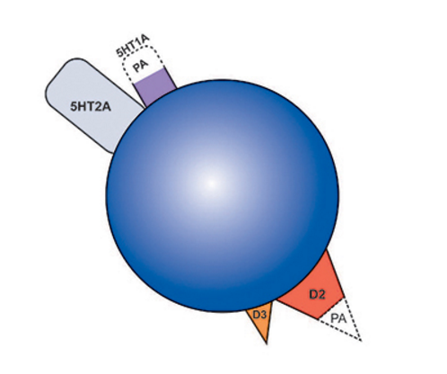
Antipsychotics
Quetiapine
Risperidone
Others:
Geodon (ziprasidone)
Zyprexa (olanzapine)
Latuda (lorasidone)
Invega (paliperidone)
Aripiprazole

Slide 23
Benzodiazepines
Anxiolytics
Xanax (alprazolam)
Ativan (lorazepam)
Valium (diazepam)
Others: Klonopin (clonazepam), Librium (chlordiazepoxide)

Slide 24
Others?
Place them in the Q&A and I’ll try to address

Slide 25


